Slide 1
Current Topics in Memory
Brian M. Siefke, Ph.D.

Slide 2
Some topics of interest
Relationship between working memory and long term memory
Relationship of memory to attention
Is working memory nature or nurture?
Optimizing studying via episodic/working memory
Sleep and memory
Effects of stress, alcohol, marijuana

Slide 3
Relationship between WM and LTM

Slide 4
Relationship between WM and LTM
Episodic Memory = Stored information about events in one’s life, including information about when they happened and what happened.
Working Memory = The active and conscious maintenance and manipulation of different types of information.

Slide 5
A Working Memory Model

Slide 6
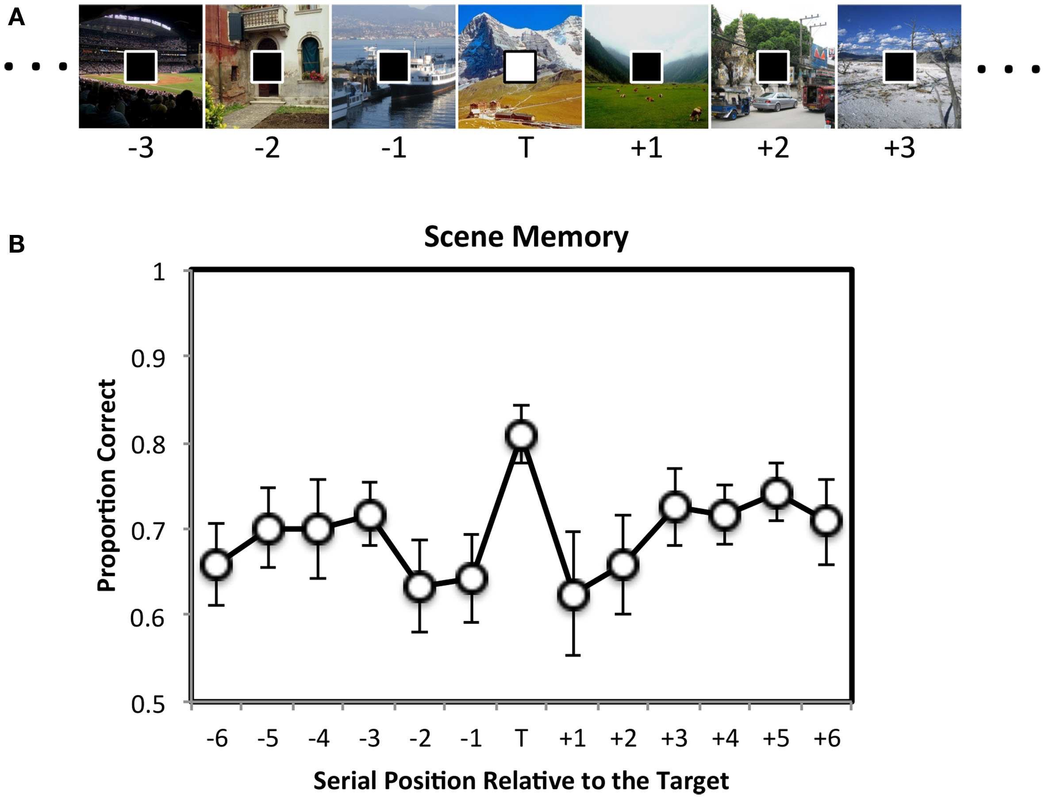
Relationship of memory to attention
Swallow & Jiang, 2010

Slide 7
Is working memory nature or nurture?
WM is largely affected by environmental factors.
However, Blokland et al., (2011) investigated individual variation in task-related fMRI brain activation across the brain in a large sample of 75 MZ, 66 DZ, and 37 unpaired twins.

Slide 8
Is working memory nature or nurture?
Blokland, et al. found a significant and substantial genetic influence on WM task-related activation across the brain, with genes accounting for up to 65% of the variance, averaging ~33%. Heritable areas include the dorsolateral prefrontal cortex

Slide 9
Can cognitive training improve episodic memory?
First Challenge:
Many effective mnemonic strategies are designed to work within a specific domain and do not always generalize to new situations.
Second Challenge:
Spontaneous initiation does not occur even when people know appropriate strategies, it seems to depend on cognitive control.

Slide 10
Can cognitive training improve episodic memory?
Traditional WM tasks:
Subvocal rehearsal
Chunking
Metacognitive Strategies:
  Reflective problem-solving skills
  Puzzles
  Mazes
  Word-search problems
  Picture sequencing
  Dot-to-dot & error checking activities
  20 questions, etc.
NOT an effective educational intervention for children with hyperactivity!
(Abikoff & Gittleman, 1985)

Slide 11
Can cognitive training improve episodic memory?
BUT motor and perceptual training can lead to plasticity in the primate brain:
Motor areas (Nudo, et al., 1996)
Somato-sensory (Recancone, et al., 1992)
Visual learning in frontal areas (Rainer & Miller, 2000)

Slide 12
Nudo, R.J., et al. (1996) Use-dependent alterations of movement representations in primary motor cortex of adult squirrel monkeys. Journal of Neuroscience. 16, 785–807

Slide 13
Can cognitive training improve episodic memory?
USE IMPLICIT MEMORY TRAINING!
Torkel Klingberg’s work on Children with ADHD:
*REPEATED PERFORMANCE* 30-40 min per day, 5 days a week for 5 weeks (totaling approx. 15 h)
Visuo-spatial WM task (Circles)
Sequence Blocks
Stroop Task
Raven’s Progressive Matrices
Backwards digit span
Letter span
Go-No-Go
N-back

Slide 14
Human Brain areas impacted by implicit wm tasks
Increases in frontal and parietal activity after training of WM
(Olesen, et al., 2004)

Slide 15
Human Brain areas impacted by implicit wm tasks
Increased activity in the caudate nucleus after training of WM tasks requiring updating
(Dahlin, et al., 2008)

Slide 16
Human Brain areas impacted by implicit wm tasks
Changes in cortical dopamine D1 receptor binding associated with cognitive training
(McNab, et al., 2009)

Slide 17
Can cognitive training improve episodic memory?
1) Stick to hardcopy & use a pen/pencil, if possible (interact physically!)
2) Study in silence (or ONLY with light instrumental music, NO LYRICS)
3) Exercise first (massive correlation between brain health & physical health)
4) Take breaks to RELAX (spaced-apart learning is better than massed learning!!)
5) DO NOT CRAM (spaced-apart learning is better than massed learning!!)
6) Study in multiple locations / contexts.
7) Interact with your material in multiple ways (flashcards, transcribing, discussion, reading, etc.)
8) Review each reading or lecture within 24 hours.
9) DO NOT MULTITASK– focus on one topic / goal / body of material at a time
10) Teach your material to someone else.

Slide 18
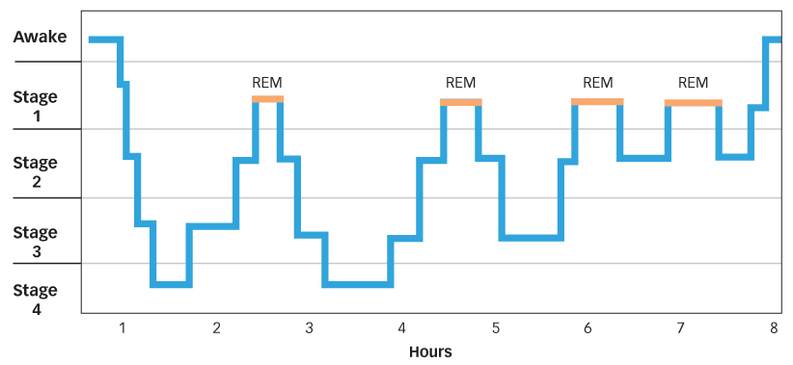
Sleep and memory

Slide 19
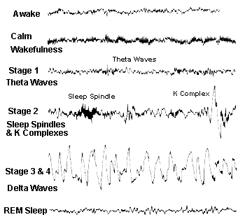
Sleep and memory
Stage 1 Sleep
Brain activity slows by 50%
  Theta Waves = 4-7 cycles/s
Stage 2 Sleep
Brain waves slow down even more
Sleep Spindles = sudden intense bursts of brain waves.
K-Complexes = sudden sharply rising and falling waves
Heart rate slows
Body temperature decreases
Muscles relax
Eye movement stops

Slide 20
Sleep and memory
Stage 3 & 4 Sleep
Brain waves slow even more
Delta Waves appear (20-50% of waves)
Extremely deep sleep
Need these stages of sleep to feel fully rested.
Alcohol suppresses these stages of sleep.
REM Sleep : “Stage 5,” when vivid dreaming most often occurs
Brain is as active as when awake.
Heart rate & blood pressure increase
Breathing rapid & irregular

Slide 21
Sleep and memory
How much do we all need?
  Average for adults: 7 – 10 hours
  Newborns: 16 hours
  College students: 9 hours
    (Typically get only 6)
  Elderly 7-10 hours

Slide 22
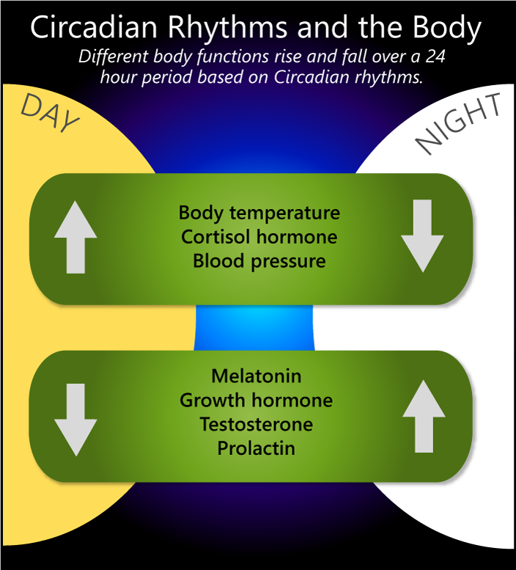
Circadian Rhythm
Daily biological rhythms
Physical, mental and behavioral changes:
  Hormones
  Brain waves
  Body temp
  Drowsiness
Found in most living things, including animals, plants and many tiny microbes
Notes:
MAY SKIP
Lose one night’s sleep= feel edgy, irritable, and unable to concentrate well the next day
Lose several night’s sleep= really out of it, depression, difficulty learning new information, difficulties paying attention, slow reaction time
More than 4 days of sleep deprivation- hallucinations
Sleep deprivation is associated with a lot of negative health outcomes including weight gain (because we burn a lot of calories while we’re sleeping); increased risk of diabetes, high blood pressure, heart problems, worse immune response (more likely to get sick). It CAN kill you.
Take home == Deprivation can wipe out learning; sleep following learning appears to be essential for consolidating memories.
A recent issue of the journal SLEEP had two prominent researchers square off on their opinions of the present research into Sleep Debt - that is, the need to catch up on missing sleep over a period of several days.
The leading ANTI researcher say that the debt is a myth and that the amount that we sleep is largely determined by context. He concedes that many people may feel that they benefit from a “power nap” at certain times of the day, and that the benefit of this exercise might actually be greater than picking up an hour or two at night. If you’re only off your regular sleep schedule by an hour or so, it’s unlikely that you’ll need to pick that hour back up, he argues.
The PRO sleep debt researcher: Still, there’s clear evidence that when we are DEPRIVED of sleep we do require some kind of recuperation period, and that in fact, people who don’t get enough REM sleep (which we’ll talk about in a bit) actually appear to get more REM when they are allowed to sleep without interruption.

Slide 23
Violating Circadian Rhythms
Shift Maladaptation Syndrome
  Health, mood, personality, and social problems
  Higher accident rates
  Higher error rates

Slide 24
Sleep and memory
Stage-specific enhancement theory:
Deficits in declarative memories form before or after REM sleep deprivation
Deficits in non-declarative memory occur before or after NREM sleep deprivation.

Slide 25
Sleep and memory
Dual-step memory hypothesis:
Memory improvement is greater with either SWS (stages 3 & 4) or REM sleep compared to sleep deprivation, but memory is even more accurate when the sleep period contains both

Slide 26
The Benefits of Sleep
Production of neurons!
More robust immune system
Deprivation of REM leads to death in rats!
Without sleep, RT is worse than drunk!
Without sleep, joint pain in older adults
Need REM sleep to consolidate learning & memory!
Notes:
REM sleep is VERY important. Biologically important: the idea that REM is bio important is suggested by Depriving rats of REM sleep leads to their deaths within a few weeks although rats die even sooner from total sleep deprivation.
Dreams: during REM sleep, our supercharged brains are creating dreams, but our bodies are relaxed and paralyzed. For this reason, scientists sometimes call REM sleep paradoxical sleep because the brain is active at the same time that the body is inactive. If REM didn’t paralyze us, we’d act out our dreams, something that people with strange and very rare condition recalled REM behavior disorder (RBD) do on occasion.
Hence, “paradoxical sleep”

Slide 27
Sleep and memory
Three phases of memory consolidation and all are thought to be facilitated by sleep or not sleep:
Stabilization is the encoding of a memory which takes only 6 milliseconds.
Enhancement is the continual process of consolidation which can occur over minutes, hours, or days. Post-sleep behavioral activities can be seen to show significant improvements in the absence of practice.
Integration can also take hours or years and is the process of connecting recently encoded memories into existing memory networks.

Slide 28
Sleep and memory
Neural correlates of motor sequence memory consolidation during NREM sleep.
Vahdat, Fogel, Benali, & Doyon, (2017).

Slide 29
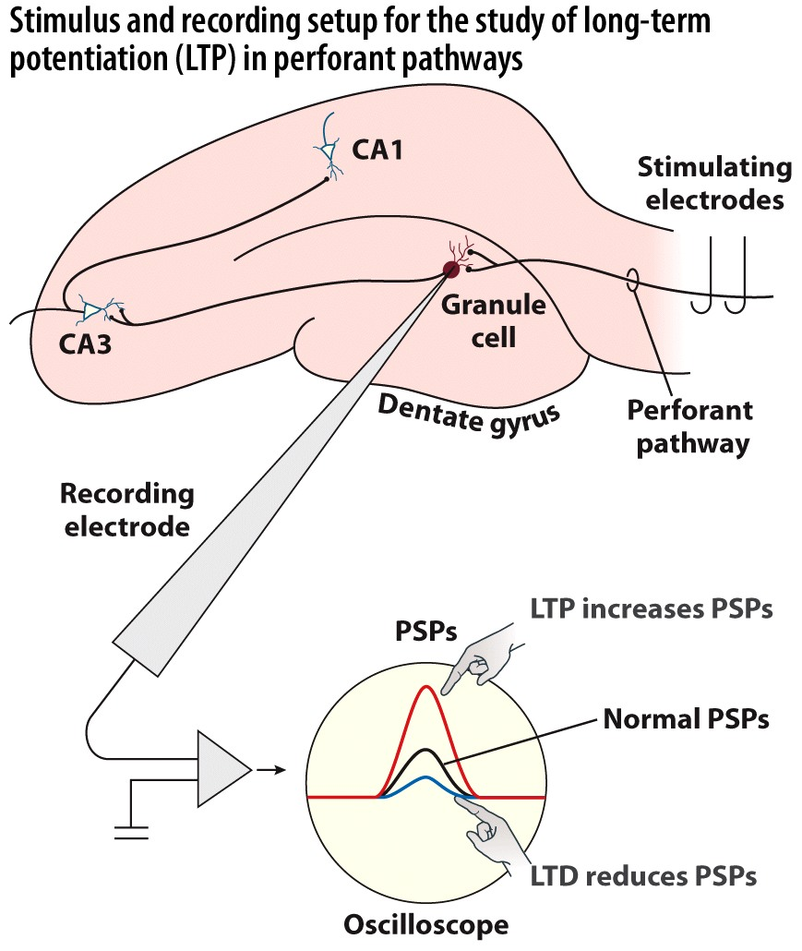
Long-Term Potentiation
Stimulation of perforant pathway resulted in a long-term increase in magnitude of EPSPs in granule cells of dentate gyrus.
These changes can last for hours in isolated tissue slices in a dish; days or weeks in living animals.
Low-frequency pulses create long-term depression (LTD)

Slide 30
Associative LTP
If a neuron is simultaneously activated by a pathway with weak input and another pathway with strong input, both pathways show LTP and the weak synapse becomes stronger
Three rules for associative LTP
  Cooperativity. More than one input must be active at the same time
  Associativity. Weak inputs are potentiated when co-occurring with stronger inputs
  Specificity. Only the stimulated synapse shows potentiation

Slide 31
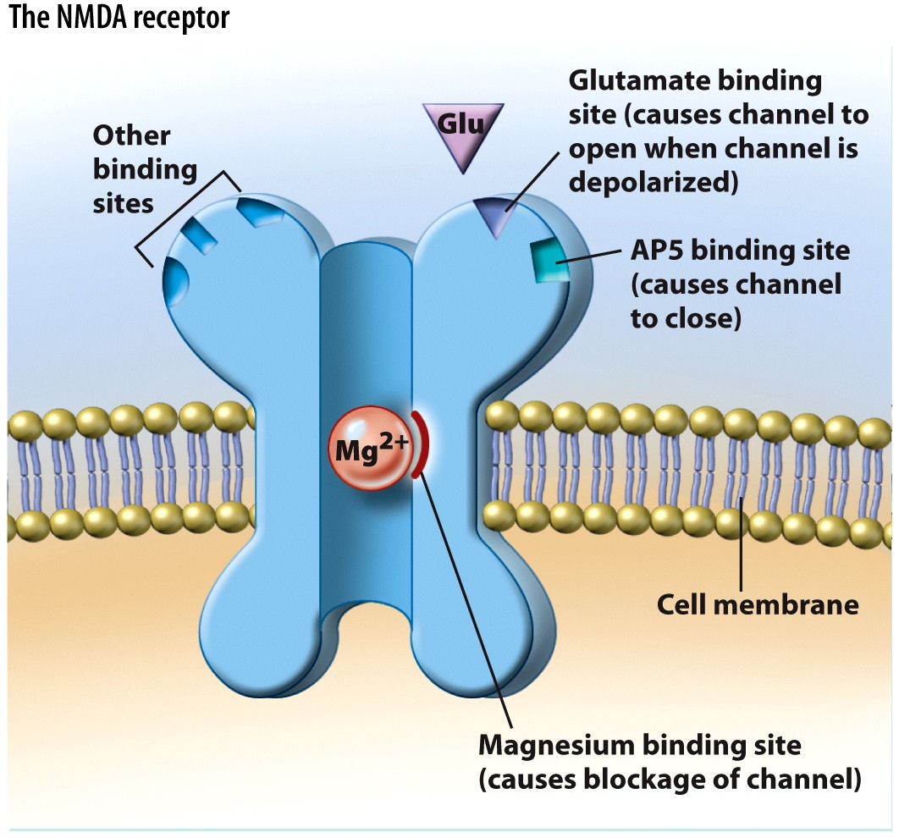
NMDA receptors
N-methyl-D-aspartate
  When blocked with AP5 (chemical), LTP is prevented; but AFTER LTP, AP5 has no effect!
NMDAs are central to producing LTP, but not maintaining it.
Mg blocks; ejected only when cell depolarizes

Slide 32
NMDA receptors
Blocking LTP prevents spatial memory in mice
Once learning has occurred, new memories can be formed without activation of NMDA receptors.
  mice pre-trained in one maze could learn a second.

Slide 33
Effects of stress on Memory
The major effect of stress on LTM is that it improves consolidation of memory, while it impairs the retrieval.
(You can remember information about a stressful situation after the fact, but while experiencing stress, it is hard to recall specific information.) → de Quervain et al. (2000)

Slide 34
Effects of alcohol on Memory
Memory impairment caused by alcohol has been linked to the disruption of hippocampal function — particularly affecting gamma-Aminobutyric acid (GABA) and NMDA neurotransmission which negatively impacts LTP.
Daisruption to hippocampal CA1 cells adversely affects memory formation. This disruption has been linked to dose-dependent levels of alcohol consumption.
At higher doses, alcohol significantly inhibits neuronal activity in both the CA1 and CA3 pyramidal cell layers of the hippocampus. This impairs memory encoding, since the hippocampus plays an important role in the formations of new memories.

Slide 35
Effects of alcohol on Memory
Alcohol suppresses hippocampal pyramidal cell activity in an awake, freely behaving rat
White (2003).
Notes:
Alcohol suppresses hippocampal pyramidal cell activity in an awake, freely behaving rat. Pyramidal cells often fire when the animal is in discrete regions of its environment, earning them the title “place-cells.” The specific areas of the environment where these cells fire are referred to as place-fields. The figure shows the activity of an individual pyramidal cell before alcohol administration (baseline), 45 to 60 minutes after alcohol administration, and 7 hours after alcohol administration (1.5 g/kg). Each frame in the figure shows the firing rate and firing location of the cell across a 15-minute block of time during which the rat was foraging for food on a symmetric, Y-shaped maze. White pixels are pixels in which the cell fired at very low rates, and darker colors represent higher firing rates (see key to the right of figure). As is clear from a comparison of activity during baseline and 45 to 60 minutes after alcohol administration, the activity of the cell was essentially shut off by alcohol.

Slide 36
Effects of marijuana on Memory
Associations between cannabis use and cognitive functioning in cross-sectional studies of young people are small and may be of questionable clinical importance for most individuals.
Abstinence of longer than 72 hours diminishes cognitive deficits associated with cannabis use.
Previous studies of cannabis in youth may have overstated the magnitude and persistence of cognitive deficits associated with use. Reported deficits may reflect residual effects from acute use or withdrawal.
Statistically significant but small negative effect sizes in cognitive functioning associated with cannabis.
Little evidence for more severe effects with cannabis use at earlier ages or specifically in adolescence.
Associations between length of abstinence and restored cognitive functioning.
Large-scale longitudinal studies are needed to examine the effects of sustained, heavy cannabis use and identify genetic factors, individual differences, and cannabis use parameters that may affect risk for brain-behavior dysfunction in individuals who use cannabis.
Notes:
Alcohol suppresses hippocampal pyramidal cell activity in an awake, freely behaving rat. Pyramidal cells often fire when the animal is in discrete regions of its environment, earning them the title “place-cells.” The specific areas of the environment where these cells fire are referred to as place-fields. The figure shows the activity of an individual pyramidal cell before alcohol administration (baseline), 45 to 60 minutes after alcohol administration, and 7 hours after alcohol administration (1.5 g/kg). Each frame in the figure shows the firing rate and firing location of the cell across a 15-minute block of time during which the rat was foraging for food on a symmetric, Y-shaped maze. White pixels are pixels in which the cell fired at very low rates, and darker colors represent higher firing rates (see key to the right of figure). As is clear from a comparison of activity during baseline and 45 to 60 minutes after alcohol administration, the activity of the cell was essentially shut off by alcohol.

Slide 37
Effects of marijuana on Memory
Statistically significant but small negative effect sizes in cognitive functioning associated with cannabis.
Scott, et al. (2018). Association of cannabis with cognitive functioning in adolescents and young adults, a systematic review and meta-analysis. JAMA Psychiatry. 75(6)

Slide 38
References
Abikoff, H. and Gittelman, R. (1985) Hyperactive children treated with stimulants. Is cognitive training a useful adjunct?Arch. Gen. Psychiatry 42, 953–961.
Blokland, G.A.M., et al. (2011). Heritability of working memory brain adaptation. Journal of Neuroscience. 31(30)10882-10890
Butterfield, E.C. et al. (1973) On the theory and practice of improving short-term memory. Am. J. Ment. Defic.77, 654–669
Dahlin, E.et al. (2008) Transfer of learning after updating training mediated by the striatum. Science 320, 1510-1512
de Quervain et al. (2000). Acute cortisone administration impairs retrieval of long-term declarative memory in humans. Nature Neuroscience, 3, 313-314
Klingberg T, Training and plasticity of working memory. Trends Cogn Sci. 2010 Jul; 14(7):317-24.
Nudo, R.J.et al. (1996) Use-dependent alterations of movement representations in primary motor cortex of adult squirrel monkeys. J. Neurosci. 16, 785–807
Olesen, P.et al.(2004) Increased prefrontal and parietal brain activityafter training of working memory. Nat. Neurosci.7, 75-79
Rainer, G. and Miller, E.K. (2000) Effects of visual experience on therepresentation of objects in the prefrontal cortex. Neuron 27, 179-189
Recanzone, G.H., et al. (1992) Topographic reorganization of the hand representation in cortical area 3b of owl monkeys trained in a frequency-discrimination task. J. Neurophysiol.67, 1031–1056
Swallow, K. M., and Jiang, Y. V. (2010). The attentional boost effect: transient increases in attention to one task enhance performance in a second task. Cognition 115, 118–132.
Vahdat, S., Fogel, S., Benali, H., & Doyon, J. (2017). Network-wide reorganization of procedural memory during NREM sleep revealed by fMRI. eLife, 6
White A (2003). What Happened? Alcohol, Memory Blackouts and the Brain. Alcohol Research & Health, 27(2),186-196

