Slide 1
Op-Amp Oscillator

Slide 2
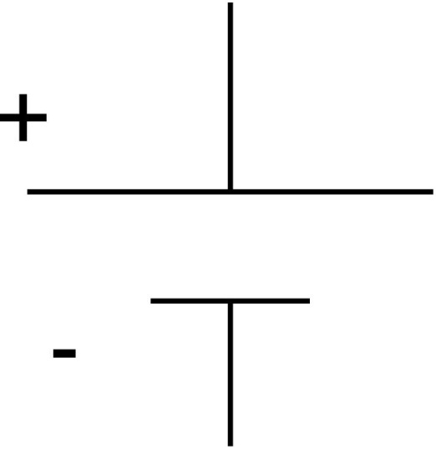

Reading Schematics:
What’s this?
Battery

Slide 3
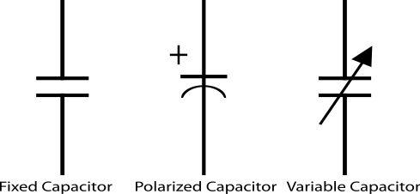
Reading schematics
Store electrical energy in an electric field (static electricity).
Uses include:
  Timing circuits
  Coupling circuits
  Energy storage
  Bypass circuits
  Filter circuits
Eric Schrader
CC BY-SA 2.0

Slide 4
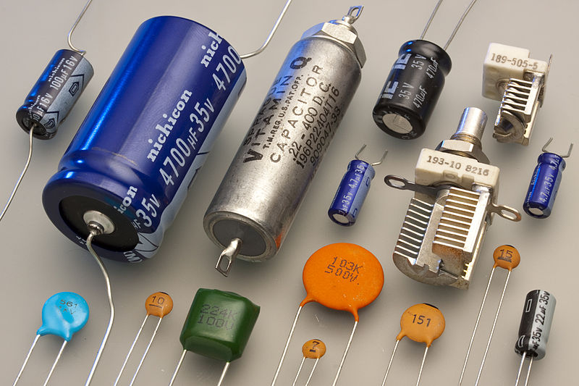
Capacitors
Eric Schrader
CC BY-SA 2.0

Slide 5

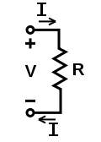

How about this?
Resistor

Slide 6
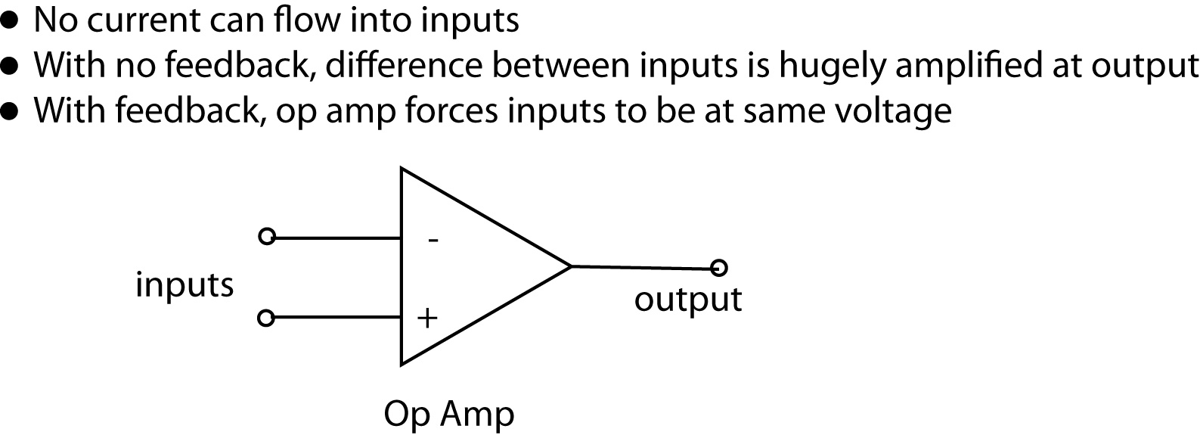
Operational Amplifier
Very popular integrated circuit

Slide 7
What’s it for?
Just about everything!
Depends on how you hook it up
  Convert current to voltage
  Convert voltage to current
  Amplify voltage
  Amplify current
  Compare voltages

Slide 8
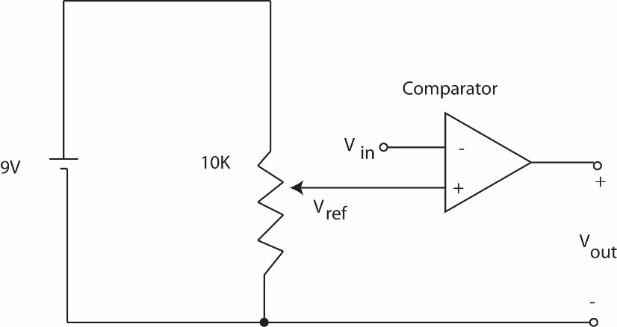
This one does NOT have feedback
No connection from output back to input
This will amplify any difference in voltage between the inputs

Slide 9
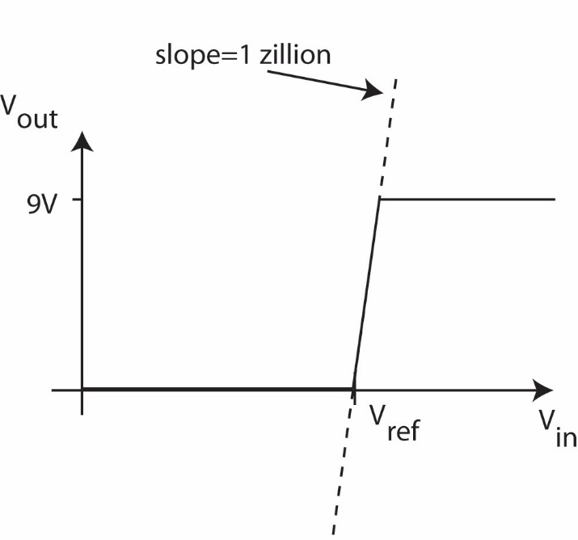
Gain is about a zillion
Suppose V_{in} is greater than V_{ref} (this would be when the room is dark)
Comparator multiplies difference by a zillion, wants to go to a zillion volts
But, battery is only 9 V, so that’s as high as it can go
Similarly, can’t go lower than 0V

Slide 10
Operation:
If input higher than ref, output goes to 9V
If input lower than ref, output goes to 0 V
Nothing in between

Slide 11
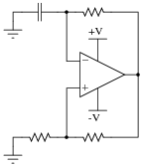
Comparator

Slide 12
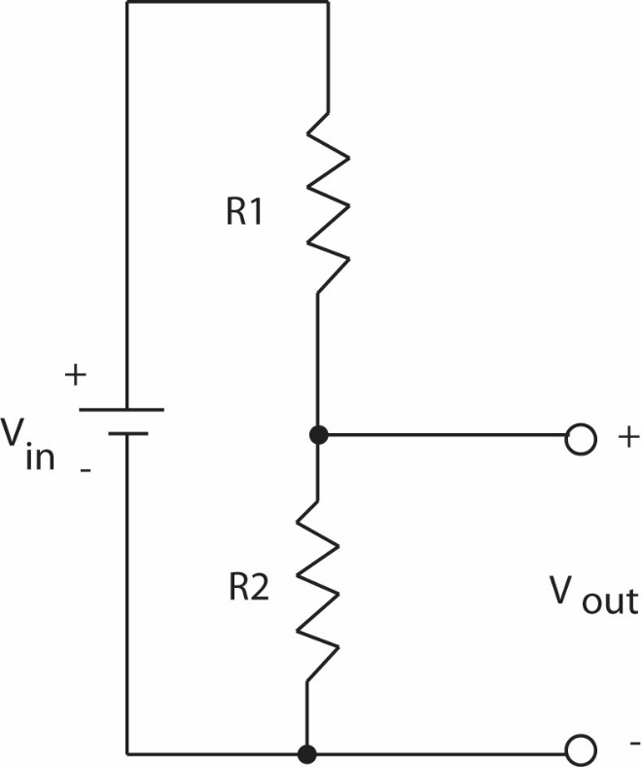
Positive Feedback

Slide 13
Voltage Divider
Also called voltage divider
Ohm’s Law: V=IR
Same current flows through both resistors

Slide 14
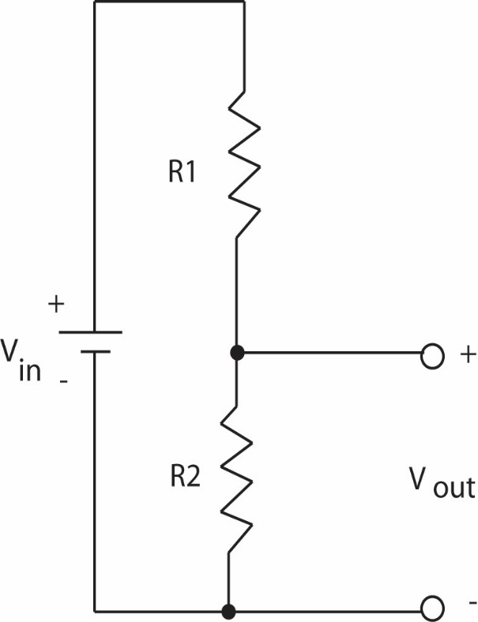
Voltage Divider
If R₁=R₂, then V_{out} will be half of V_{in}.

Slide 15
Voltage Divider
If R₁=R₂, then V_{out} will be half of V_{in}.

Slide 16
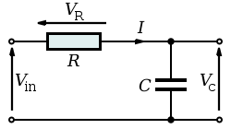
Timing Circuit

Slide 17
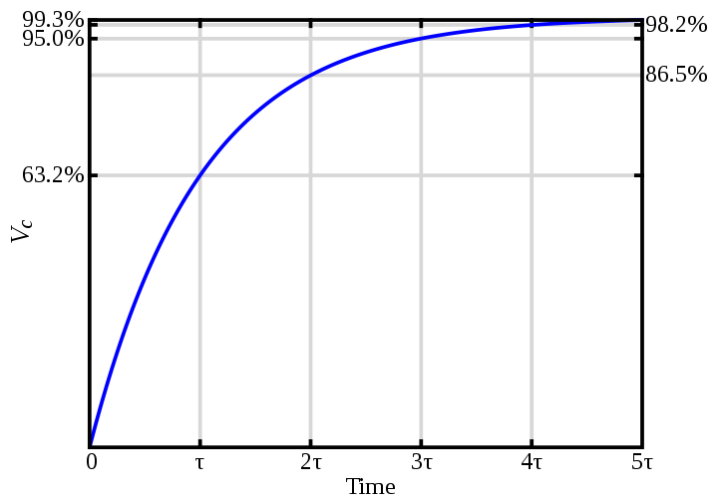
RC Circuit

Slide 18
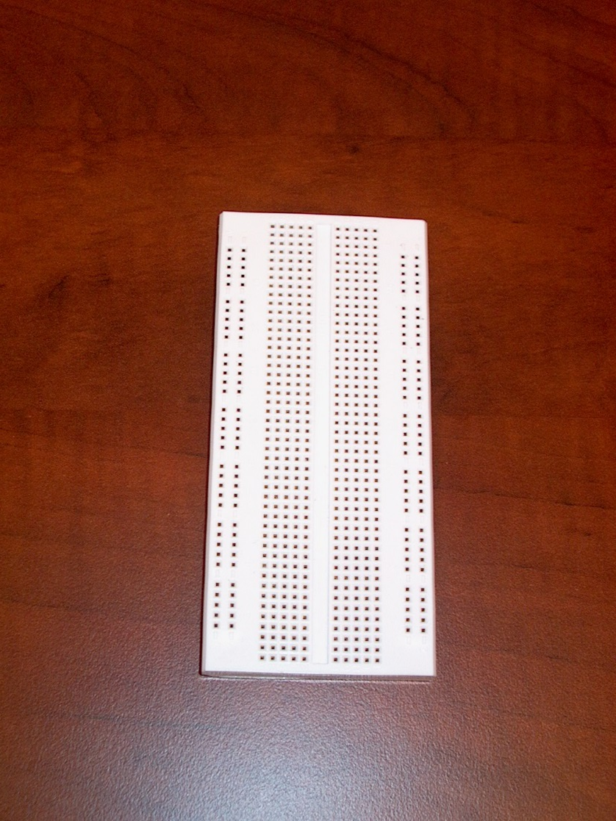
The breadboard

Slide 19
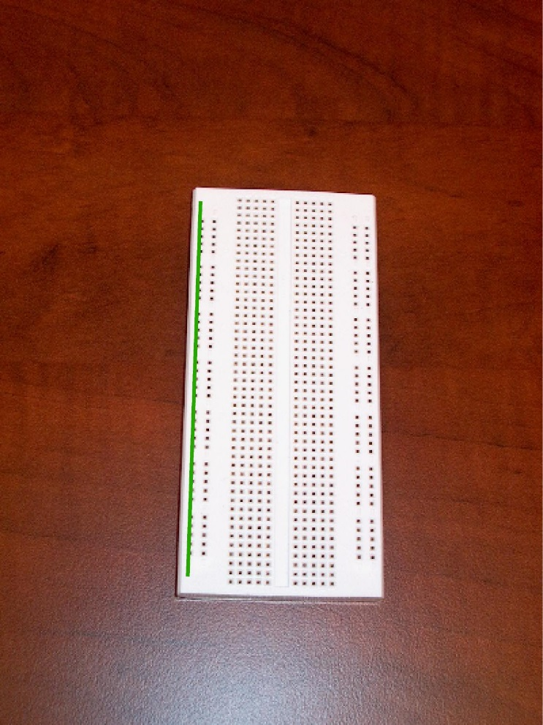
The buses
Every hole along this green line is electrically connected

Slide 20
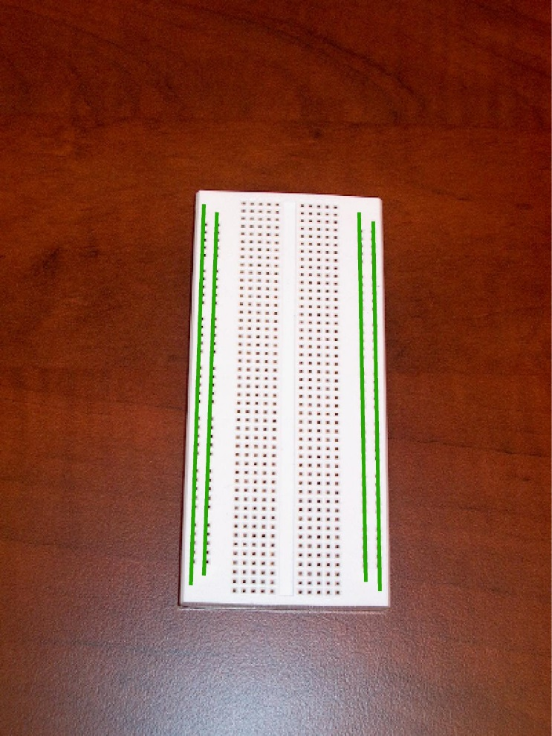
There are four buses you can use

Slide 21
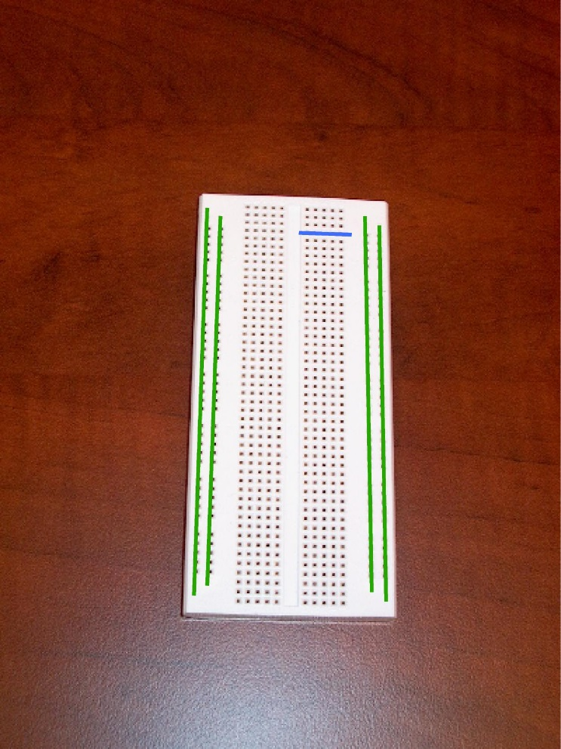
All rows connected too

Slide 22
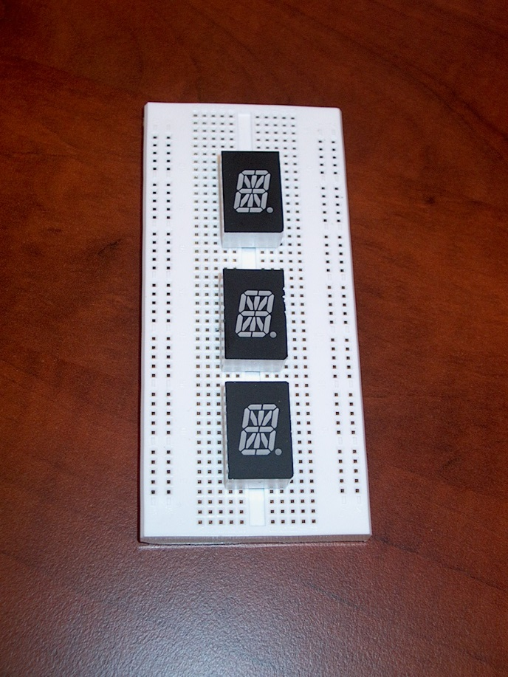
To connect to your devices
Recommend putting displays across center channel

Slide 23
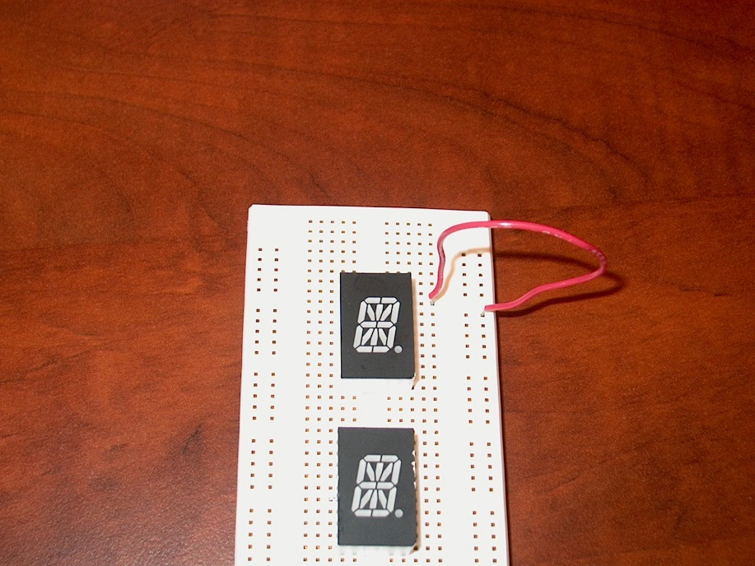
To make connections
One end of wire is connected to the bus
  And anything else connected there
Other end is connected to one pin

Slide 24
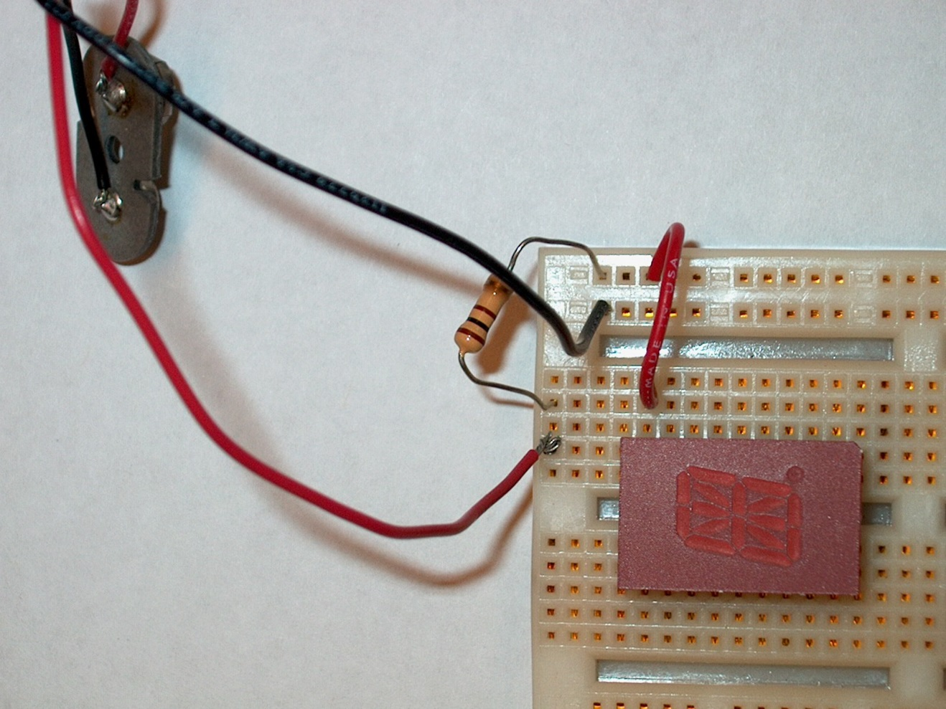
Connect common anode to positive bus

Slide 25
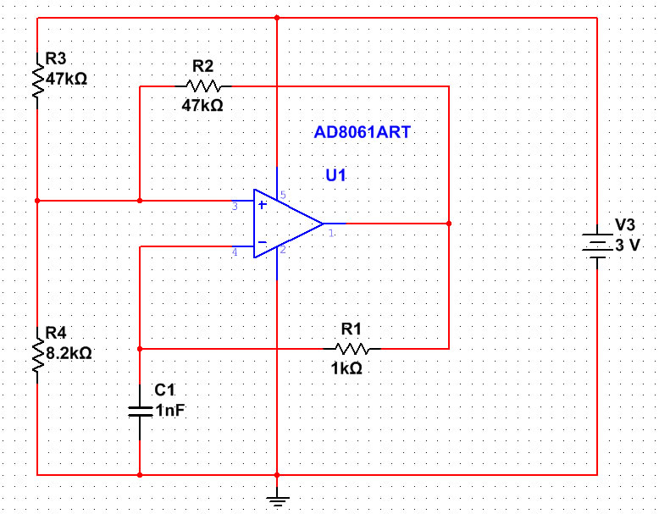

Slide 26
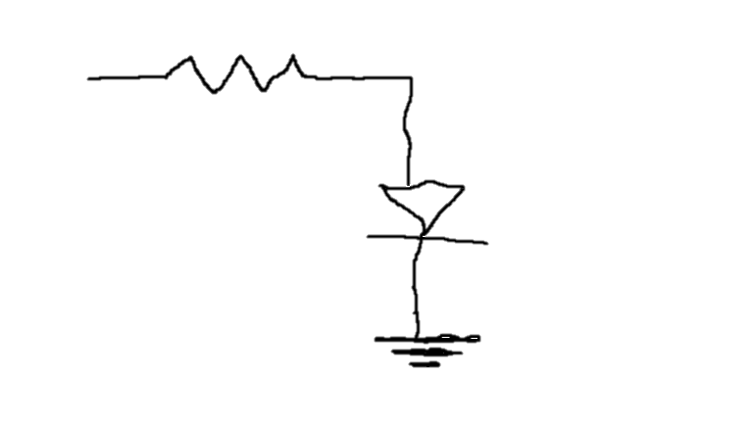
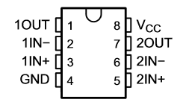
R2 = R3 = R4
Time: R1, C1
8
5
7
6
4

