Slide 1
Wireless Energy Transfer

Slide 2
http://miovision.com/blog/the-internet-of-things-and-transportation/

Slide 3
Melvin Kranzberg
Technology is neither good nor bad; nor is it neutral.

Slide 4
Edward R. Murrow
On television: this instrument can teach, it can illuminate; yes, and it can even inspire. But it can do so only to the extent that humans are determined to use it to those ends. Otherwise it is merely wires and lights in a box.

Slide 5
Wireless Energy Transfer
Electromagnetism Electromagnetic Induction
Chetvorno
CC0

Slide 6
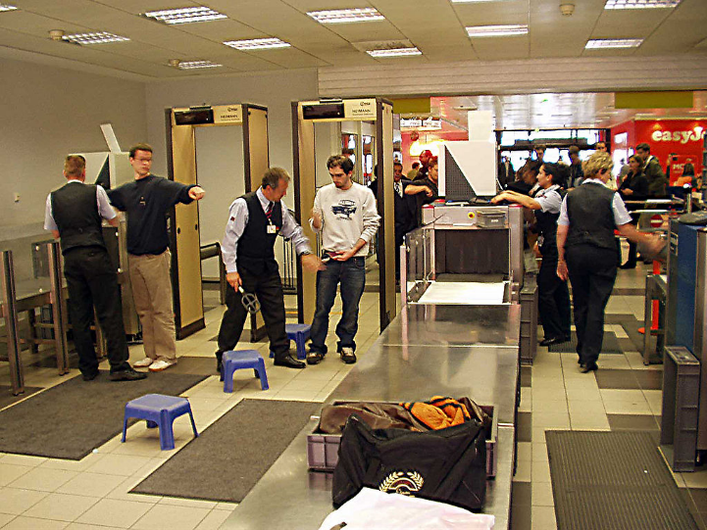
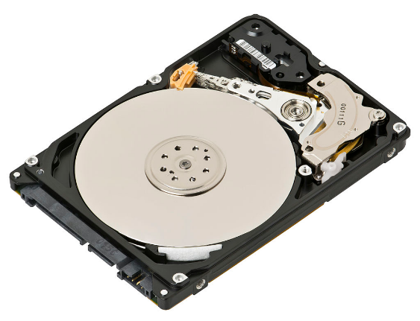
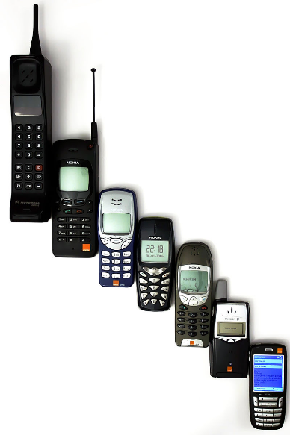
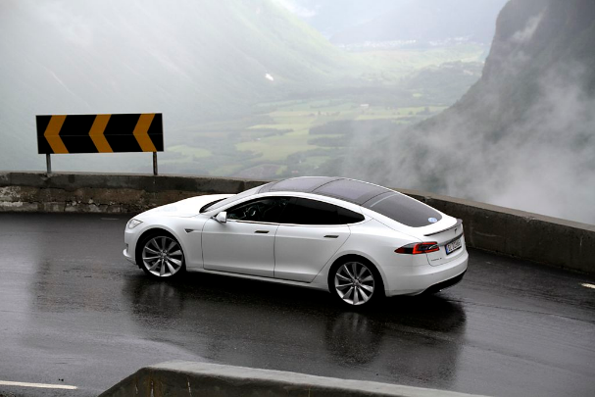
Evan-Amos
CC BY-SA 3.0
Ralf Roletschek, GFDL
© Hans Hillewaert
CC BY-SA 4.0
Anders
Public Domain
Norsk Elbilforening
CC BY 2.0

Slide 7
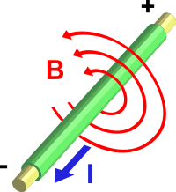
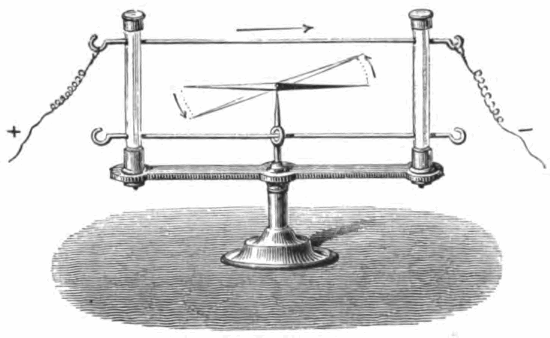
Hans Christian Ørsted, ca. 1820
Electromagnetism
http://en.wikipedia.org/wiki/Electromagnet

Slide 8
Right-hand Rule
N
S

Slide 9
Wow! Can a magnet make electricity?
https://phet.colorado.edu/

Slide 10
Faraday’s Experiments
Eviatar Bach
CC0

Slide 11
Faraday’s Experiments
Physics for Scientists and Engineers: A Strategic Approach with Modern Physics (2nd Edition), Randy Knight

Slide 12
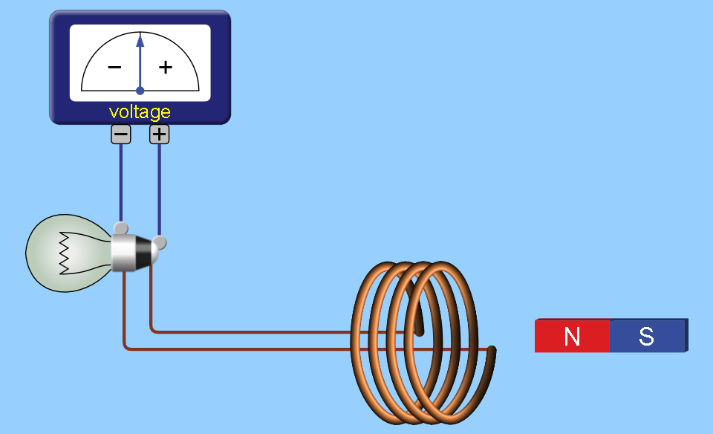
Lenz’s Law
If an induced current flows, its direction is always such that it will oppose the change which produced it.
S N
N S

Slide 13
Faraday’s Law
The induced electromotive force in any closed circuit is equal to the negative of the time rate of change of the magnetic flux enclosed by the circuit.
Single loop of wire
N loops of wire
https://en.wikipedia.org/wiki/Faraday%27s_law_of_induction

Slide 14
Wireless Energy Transfer
Electromagnetism Electromagnetic Induction
Chetvorno
CC0

Slide 15
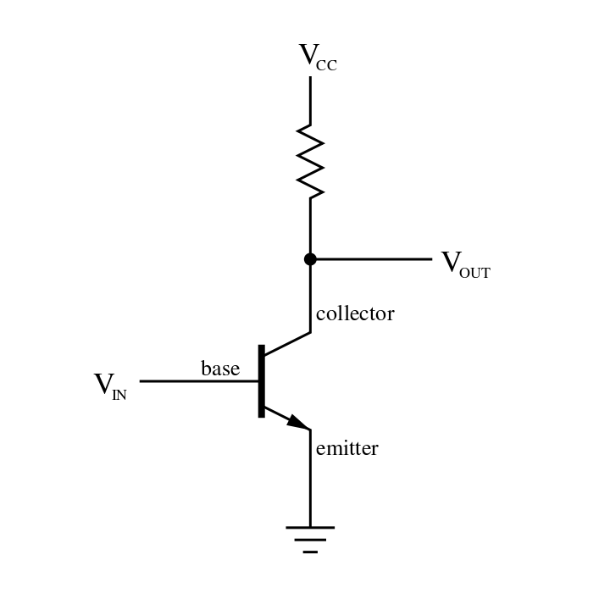
Transistor

Slide 16
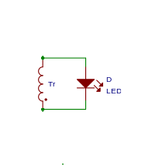
Oscillator Circuit
Rowland
CC BY-SA 3.0

Slide 17
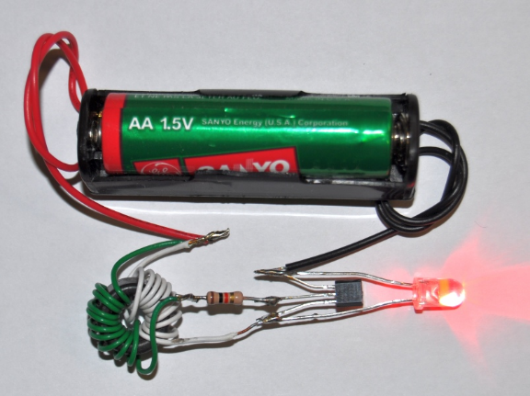
More information
Joule Thief
Steal every last joule of energy from a dead battery.
Blocking Oscillator
Acmefixer
CC BY-SA 3.0

Slide 18
Receiver Materials
30 AWG Magnet wire (15 ft.)
LED
Transmitter Materials
Transistor (2N3904)
Resistor (270 Ohm)
3 Long screws
Piece of cardboard
3 Short screws
3 Washers
AA Battery
3 Wing nuts
30 AWG Magnet wire (15 ft.)

Slide 19
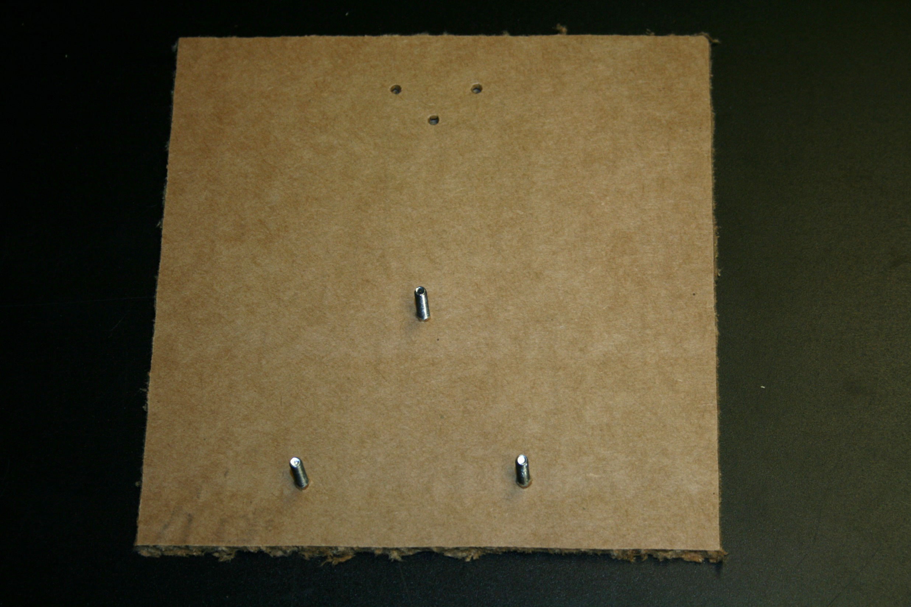
Push the three long screws through the cardboard

Slide 20
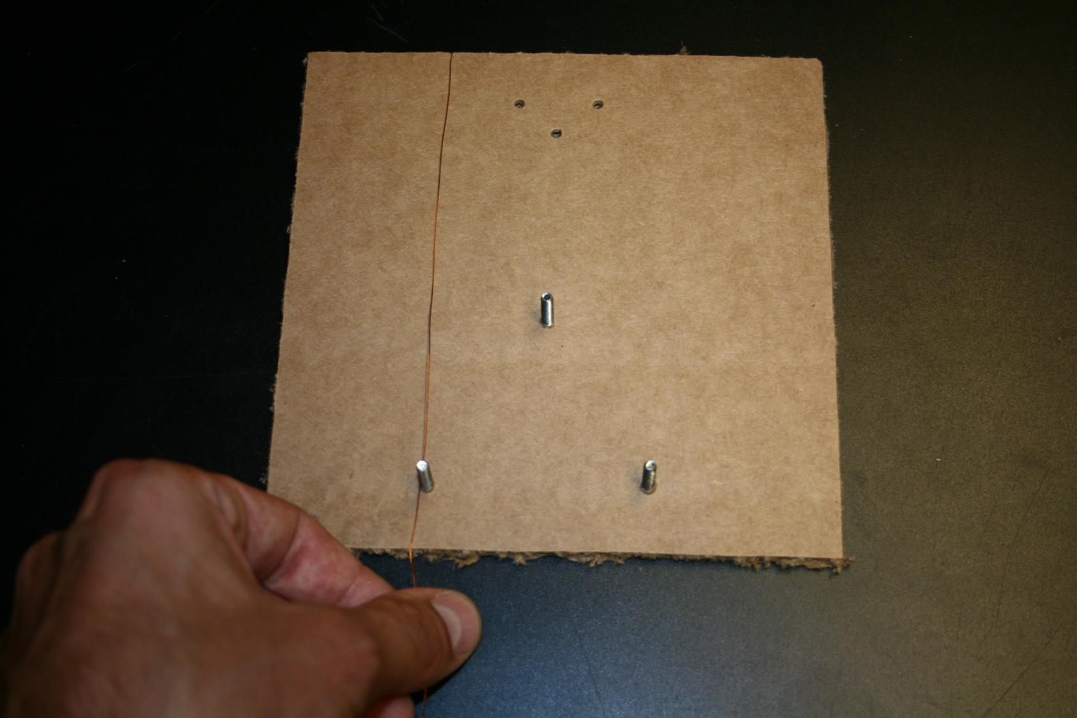
1. Start the wire at the top of the cardboard
2. Wrap the wire around the triangle 10 times!

Slide 21
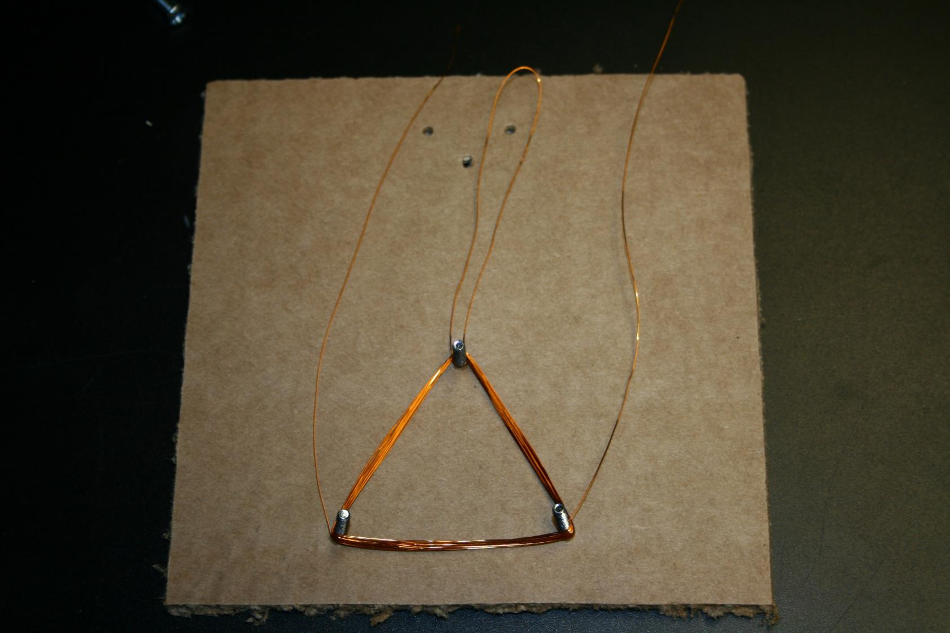
1. Make a loop of wire at the top of the triangle.
The loop should reach the top of the cardboard.
2. Wrap the remaining wire around the triangle in the same direction as before.
At the end, leave enough wire to reach the top of the board.

Slide 22
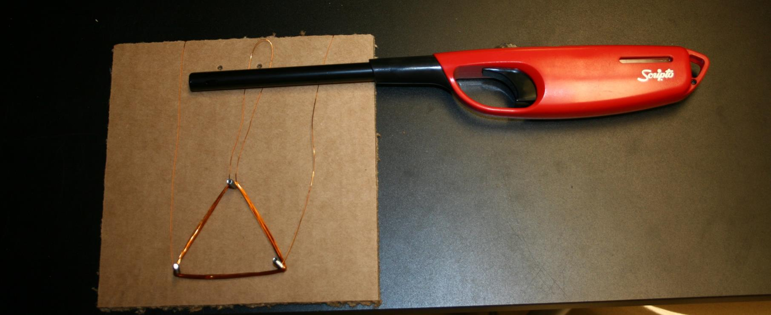
Burn the top 2 inches of each wire and the loop

Slide 23
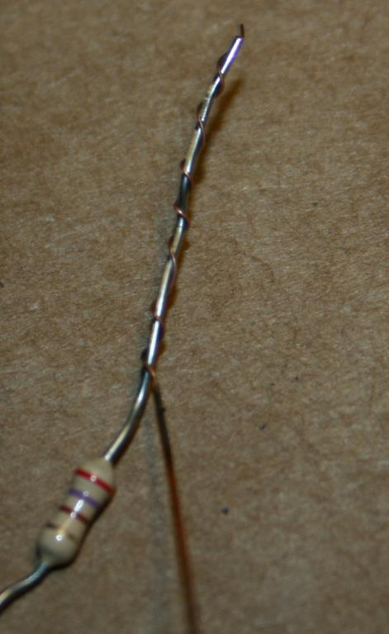
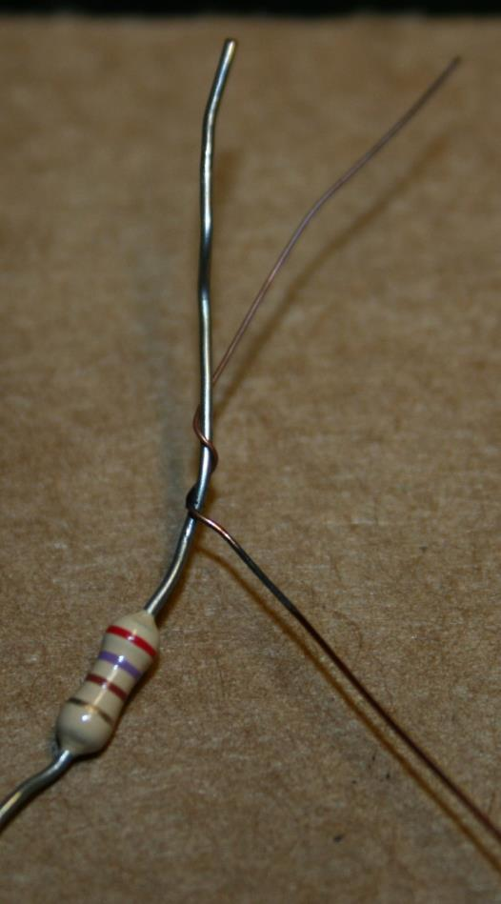
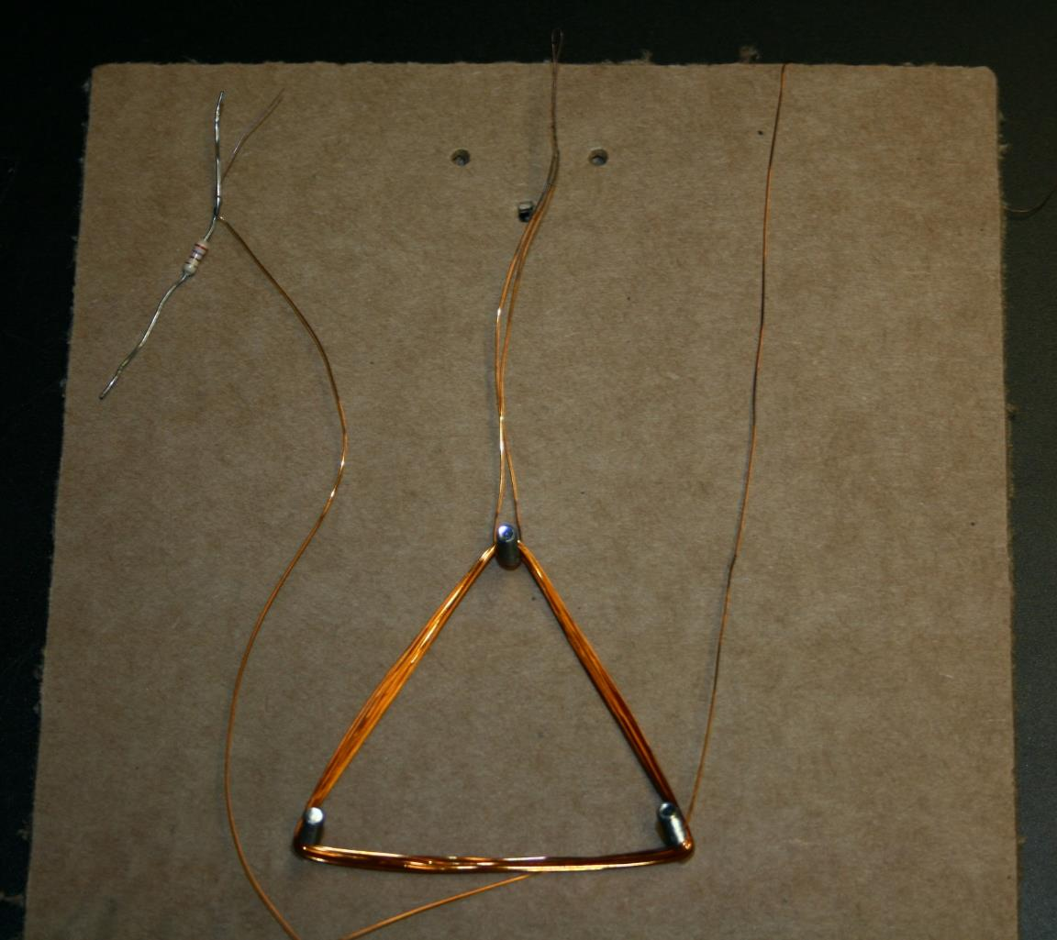
Twist the burnt part of the left wire with either end of the resistor

Slide 24
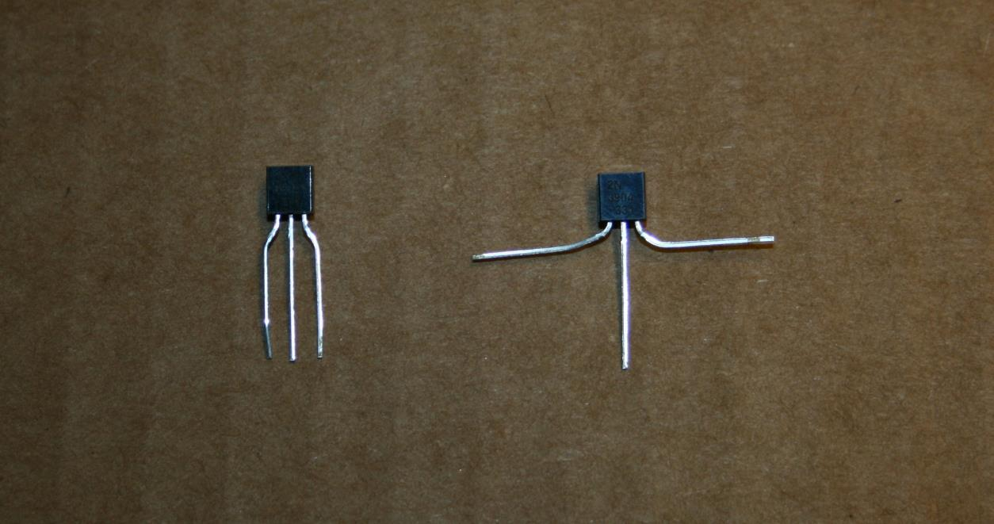
Spread the leads of the transistor

Slide 25
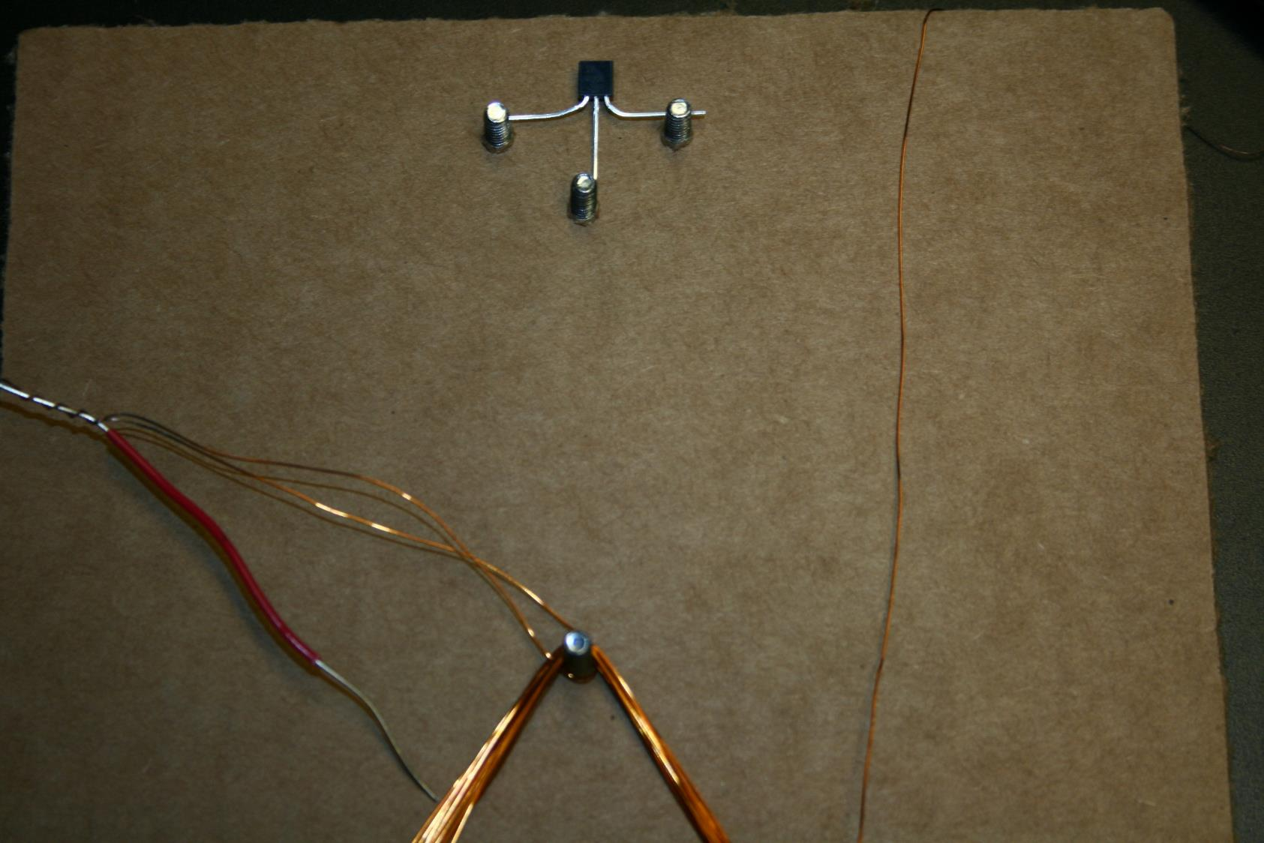
Be sure the ROUND SIDE
of the TRANSISTOR
is AGAINST THE CARDBOARD
Push the short screws through the cardboard and place the transistor as shown.

Slide 26
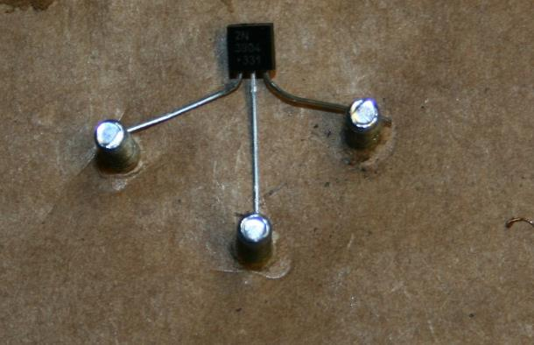
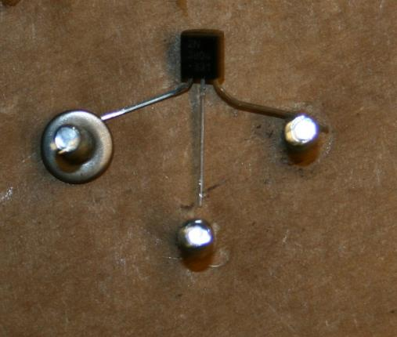
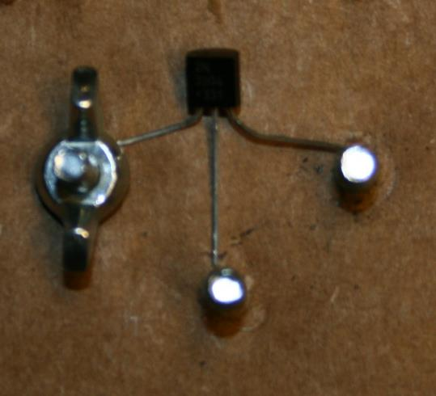
Smash the left lead of the transistor against the cardboard

Slide 27
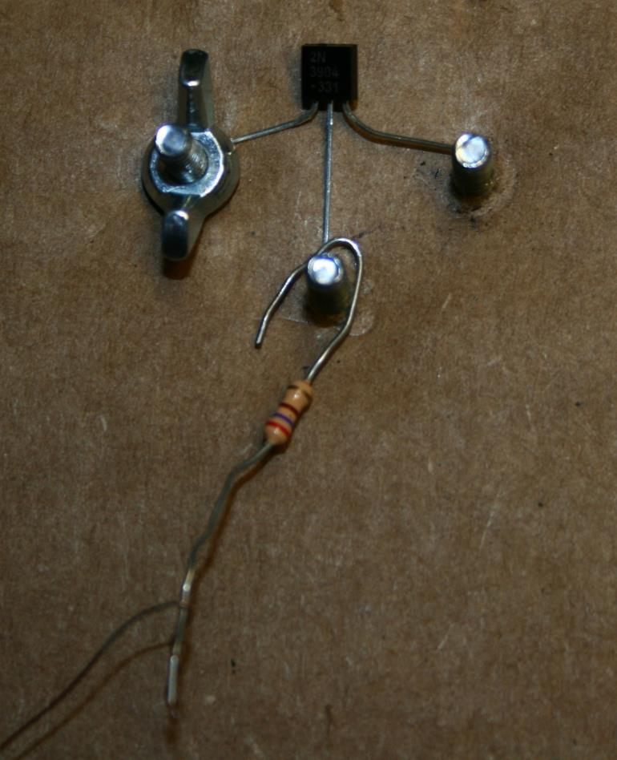
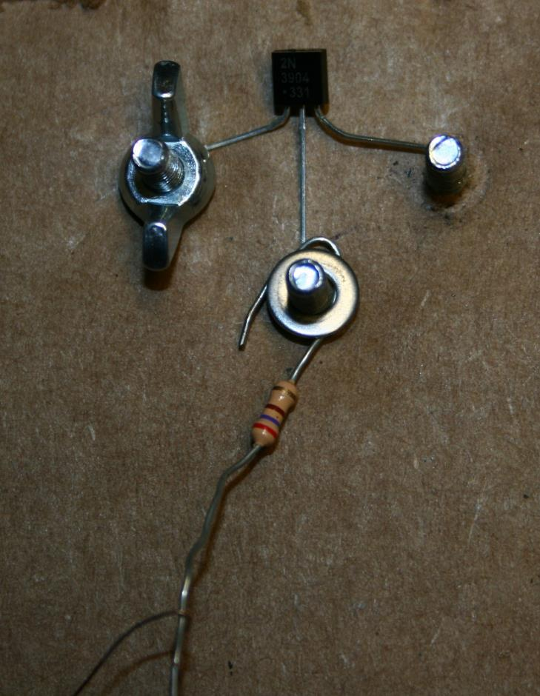
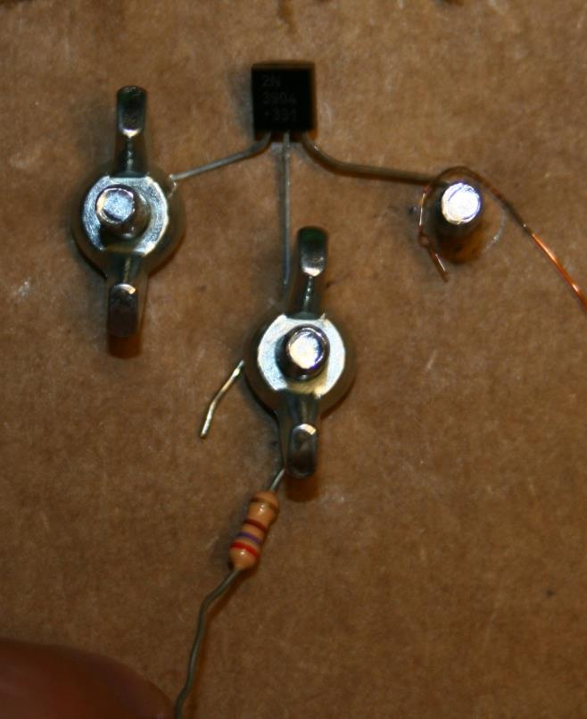
Smash the unused end of the resistor and the middle lead of the transistor against the cardboard

Slide 28
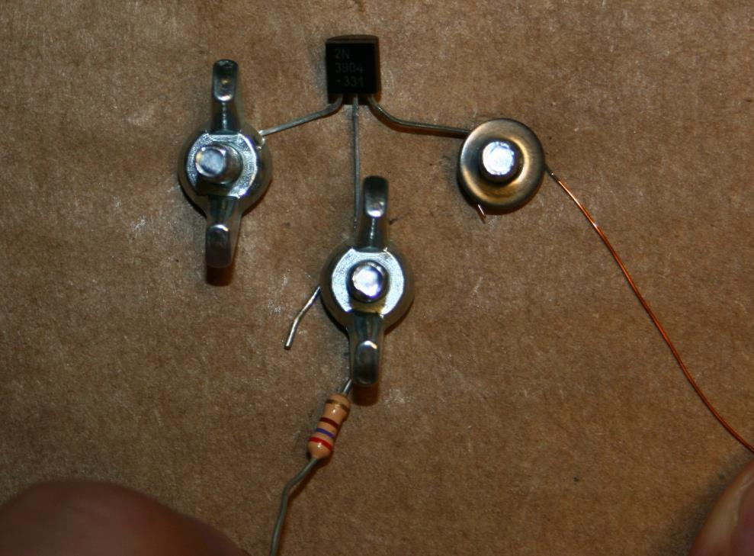
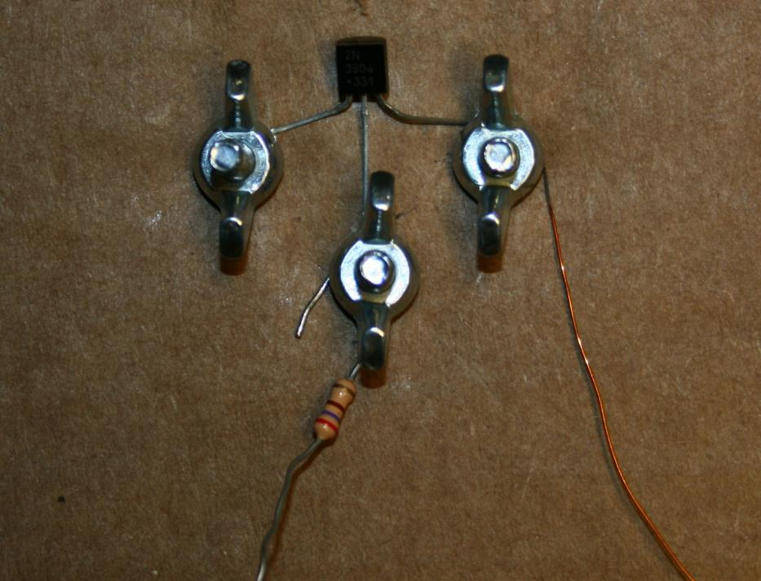
Smash the unused wire and the right lead of the transistor against the cardboard

Slide 29
Receiver
Start with a cylindrical form, like a D battery

Slide 30
Receiver
Wrap the receiver wire around the form.
Eventually you need to take this wire off the form so DON’T WRAP IT TOO TIGHTLY!

Slide 31
Receiver
Carefully slide the coil off the form.
The coil will attempt to SELF-DESTRUCT!
Use tape or wrap the wire ends through the coil to hold it together
BURN THE WIRES BEFORE twisting them with the LED leads.

Slide 32
Put it all together!
Touch the flat end of the battery to the left wing nut.
Touch the burnt part of the loop to the ‘+’ side of the battery.
Put the receiver near the transmitter.
If everything is working, the LED should light up!

