Slide 1
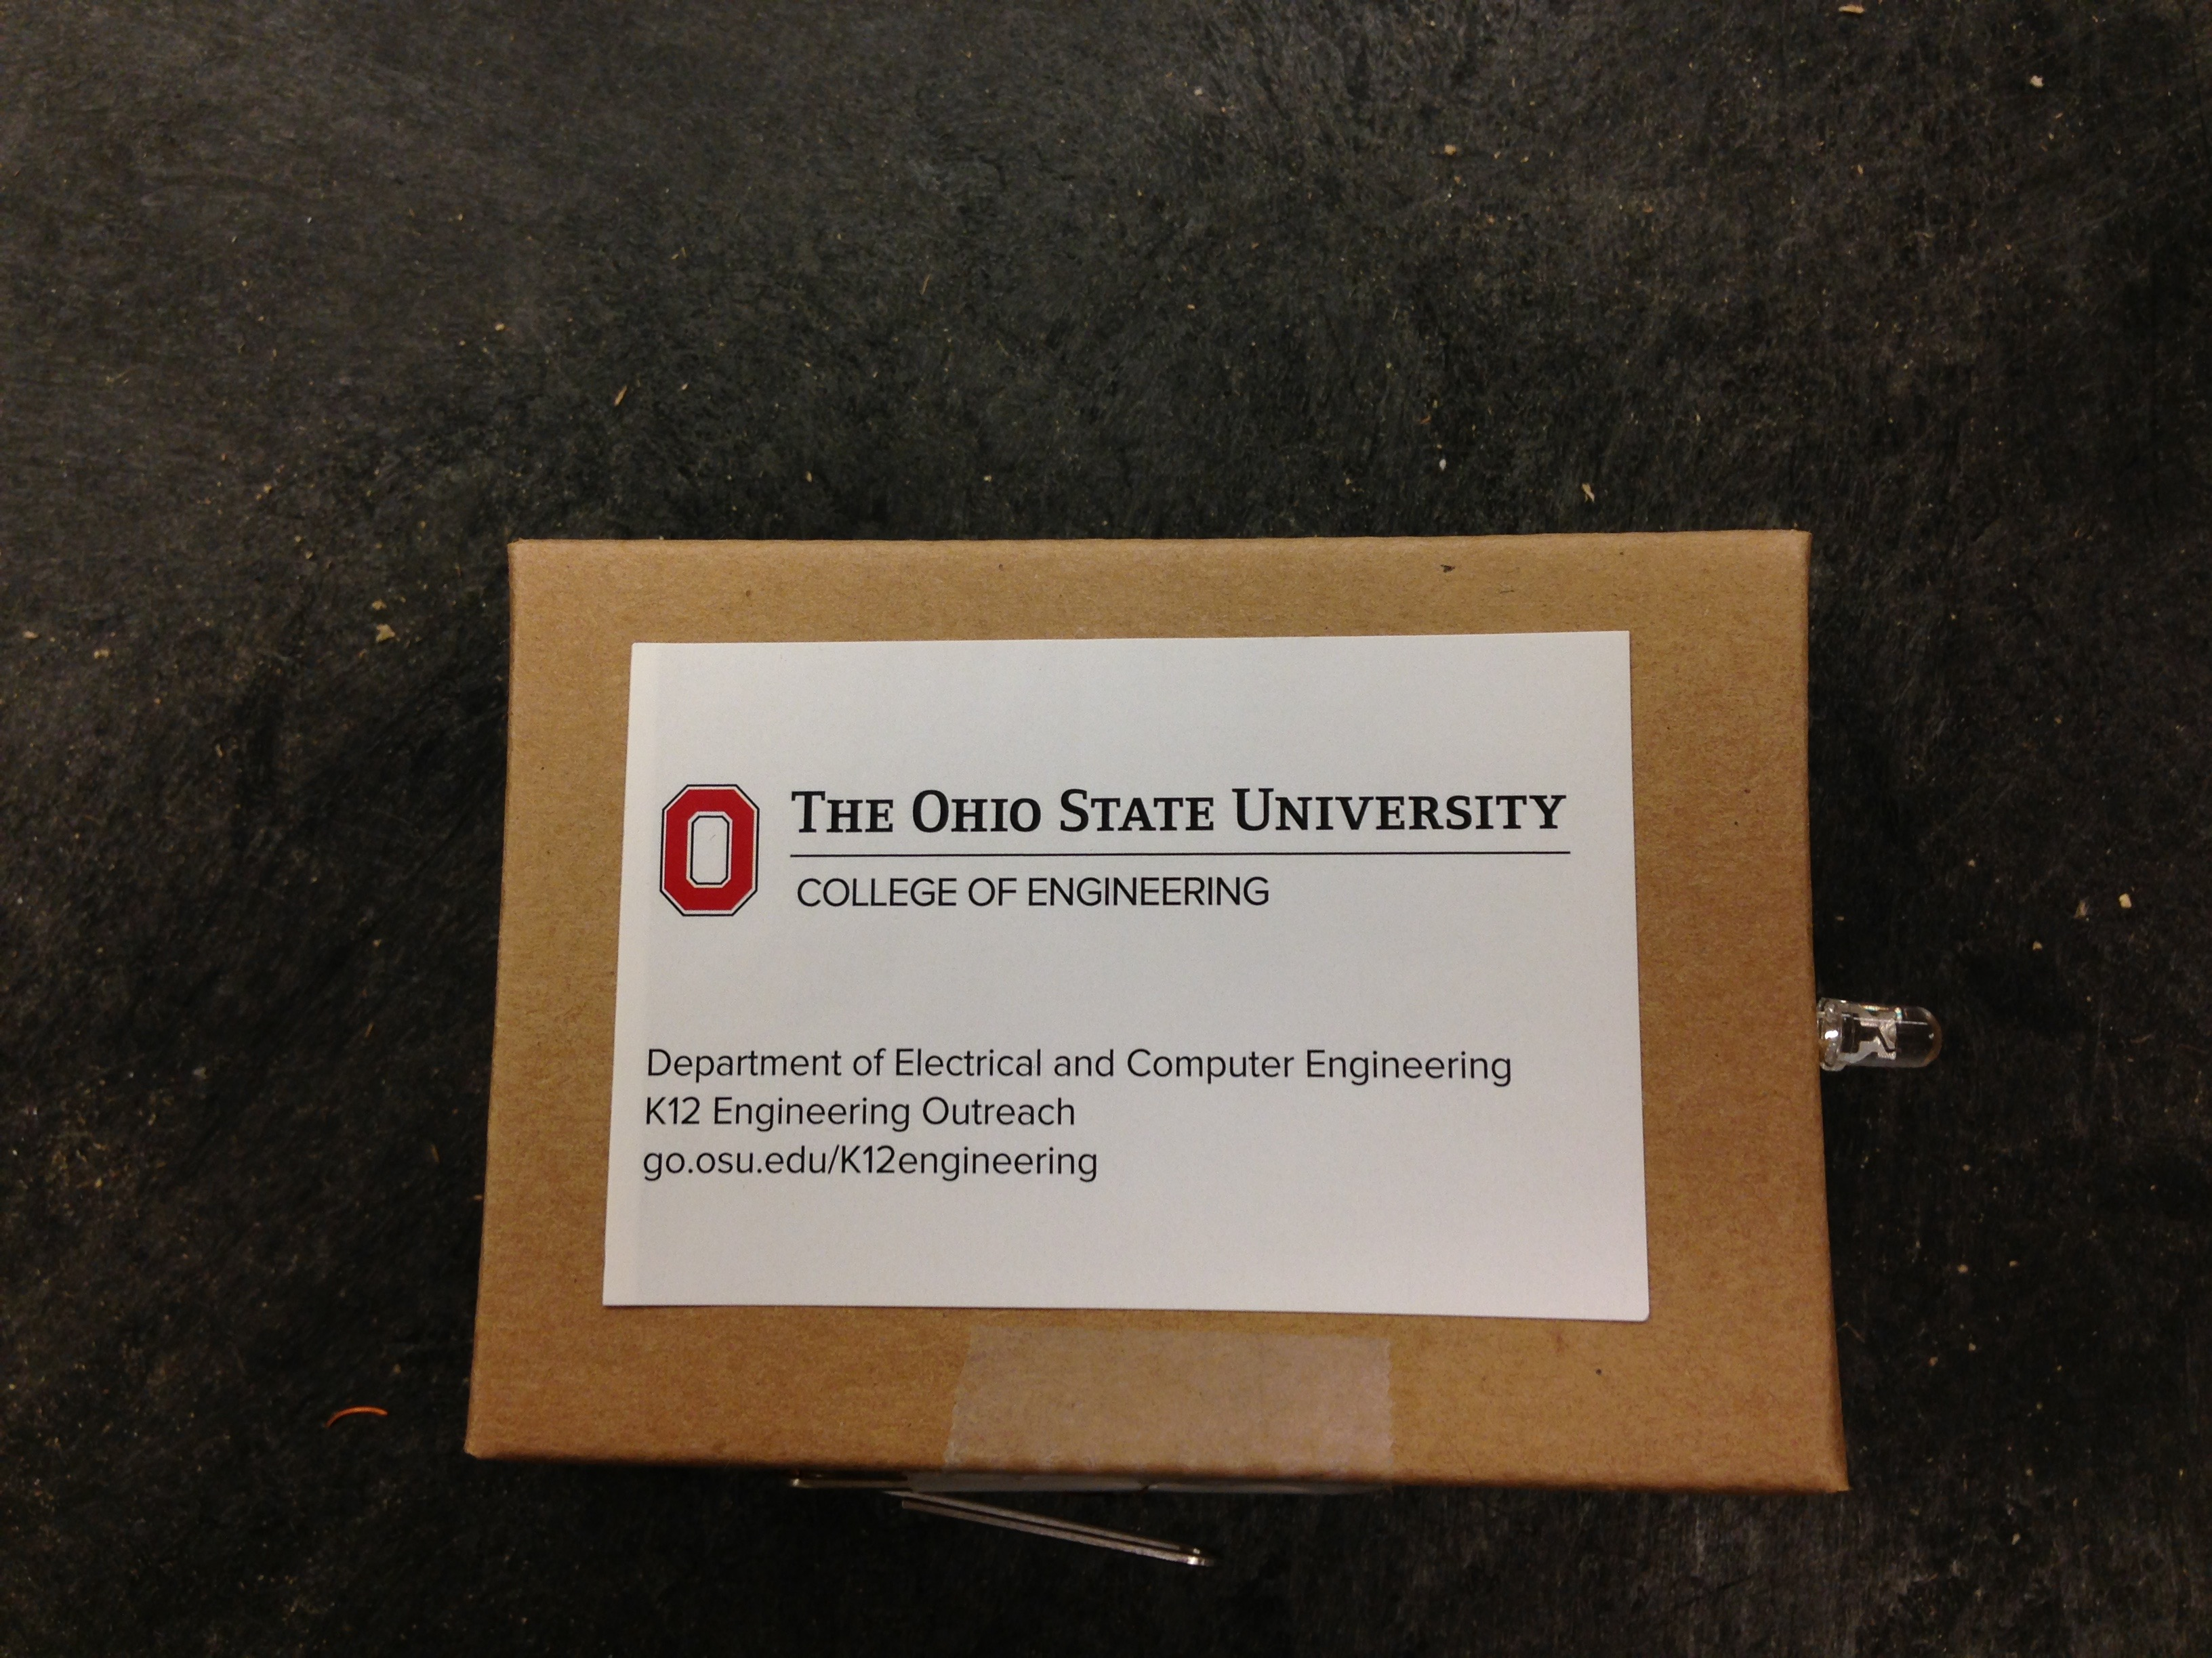
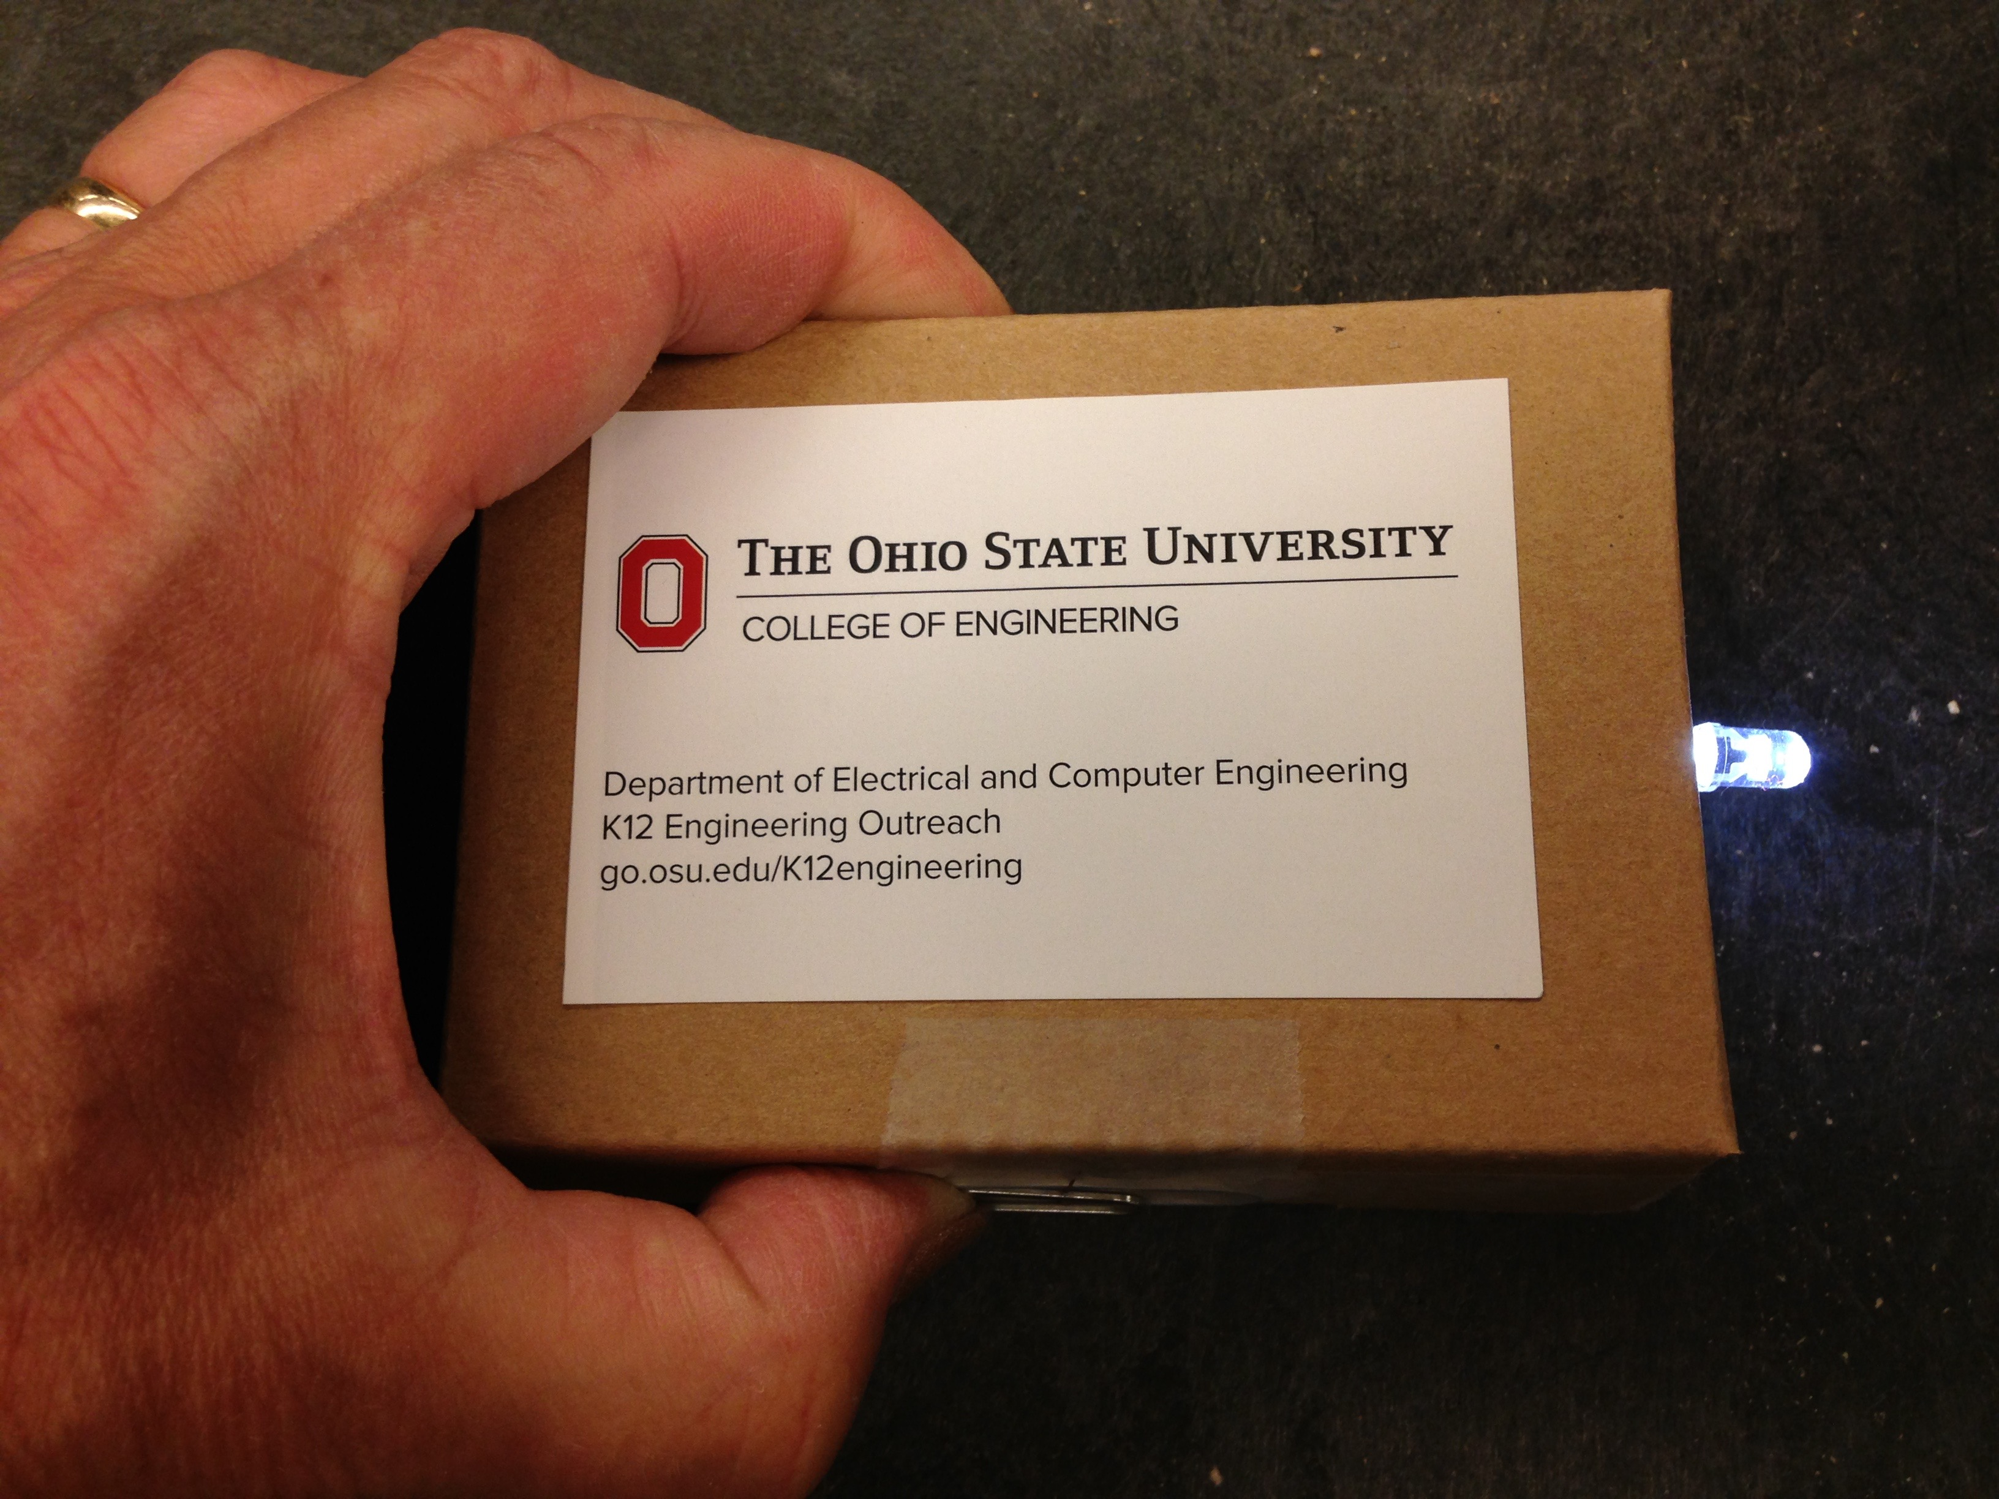
LED Flashlight

Slide 2
How does it work?
When electricity flows through an LED (light-emitting diode), the LED lights up
We need a battery, two LEDs, some wire, a switch and some know-how!

Slide 3
Need to learn some things
How to read an electrical schematic
What parts we’re using
How to build the flashlight

Slide 4
Reading Schematics:
What’s this?
Battery

Slide 5
What’s this?
Diode
Lets current flow one direction but not the other
YES
X
NO

Slide 6
Electrical circuit
Must have a closed path all the way from one terminal of the battery to the other

Slide 7
Will current flow?

Slide 8
How about here?

Slide 9
And here?

Slide 10
Will current flow?

Slide 11
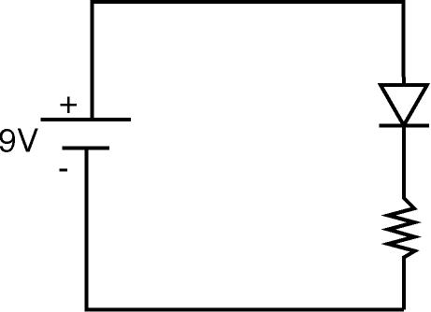
How about now?

Slide 12
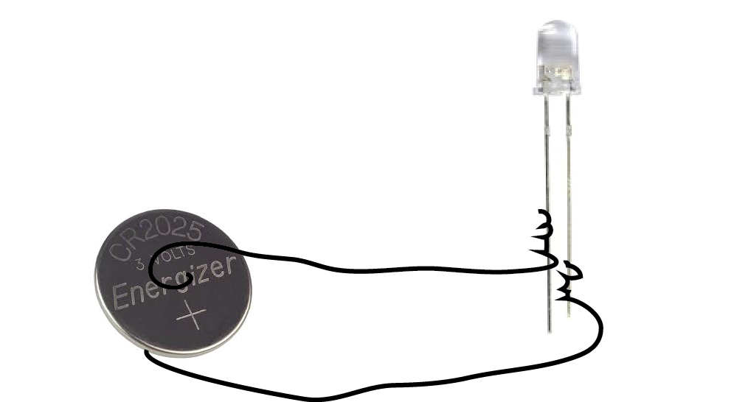
Schematic versus real life
anode
cathode
long lead is anode

Slide 13
Here’s our battery
Called a coin or button battery
This one is only 3 V
Hey, we don’t need a resistor then!
Notice the top is positive- that should connect to the anode (long lead)

Slide 14
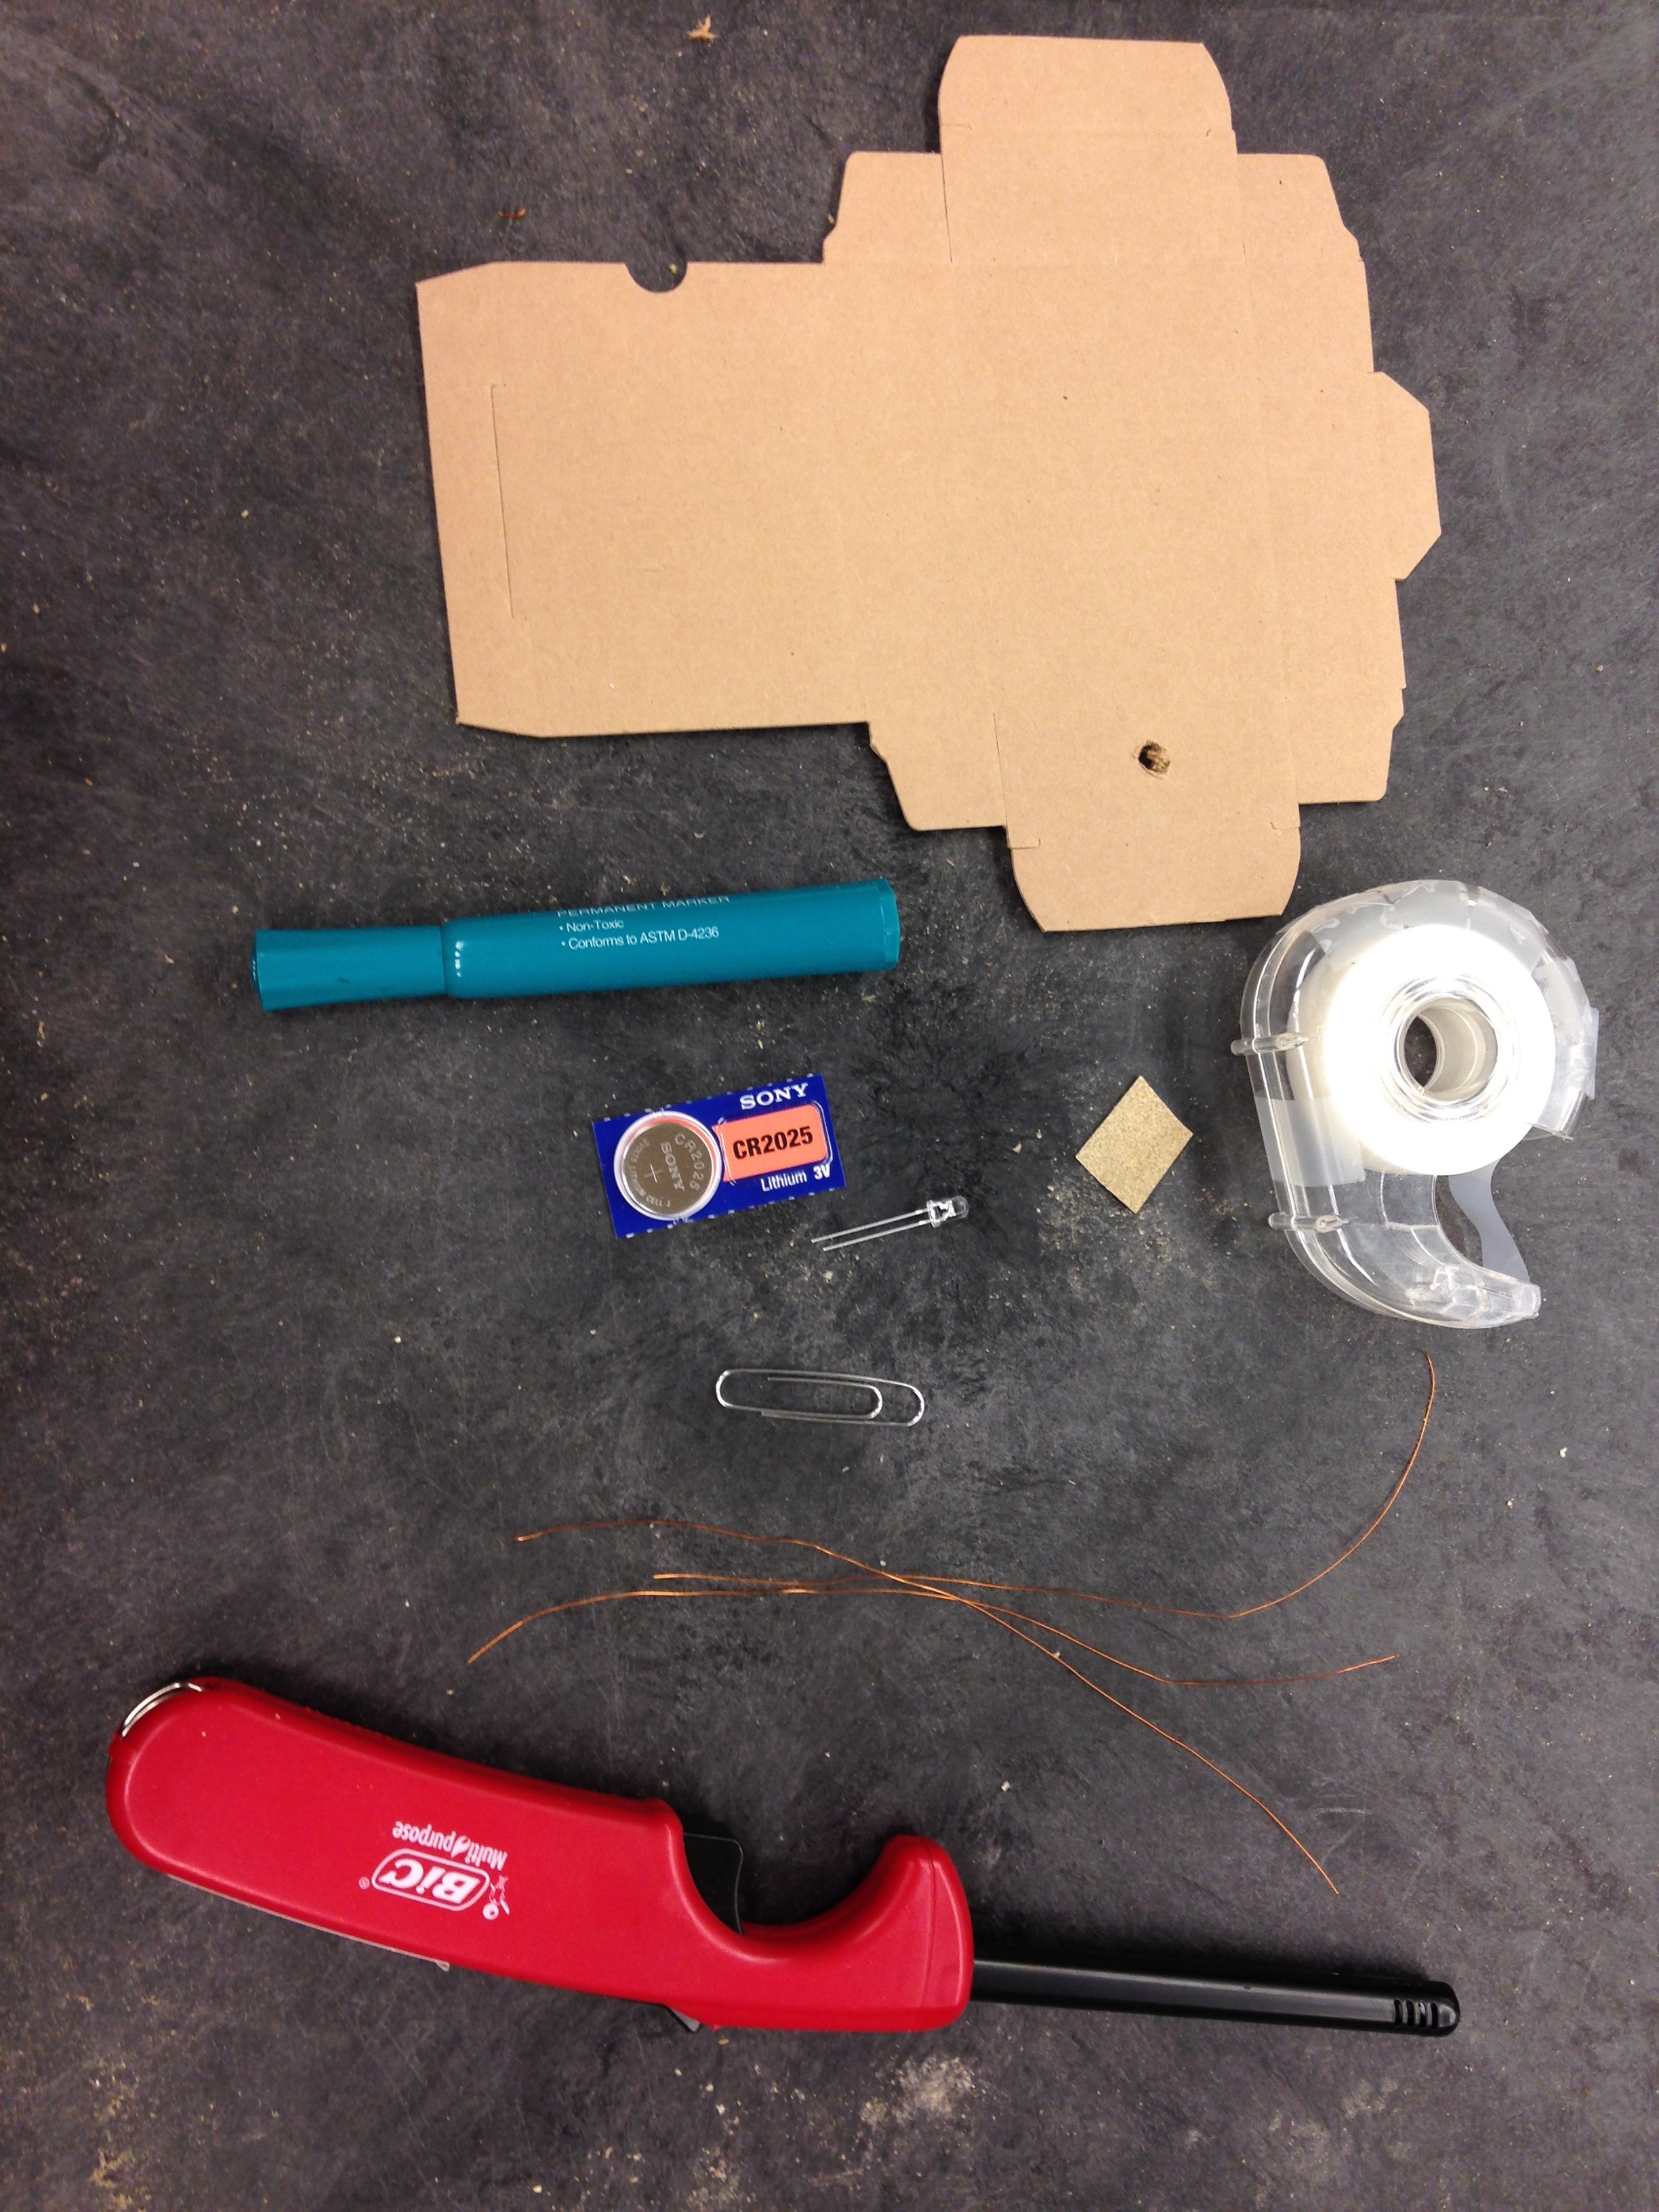
Are you ready to build?
Box
Coin battery
LED
3 pieces wire
Paper clip
Scissors, tape
Sandpaper
Lighter
Sticker
Marker

Slide 15
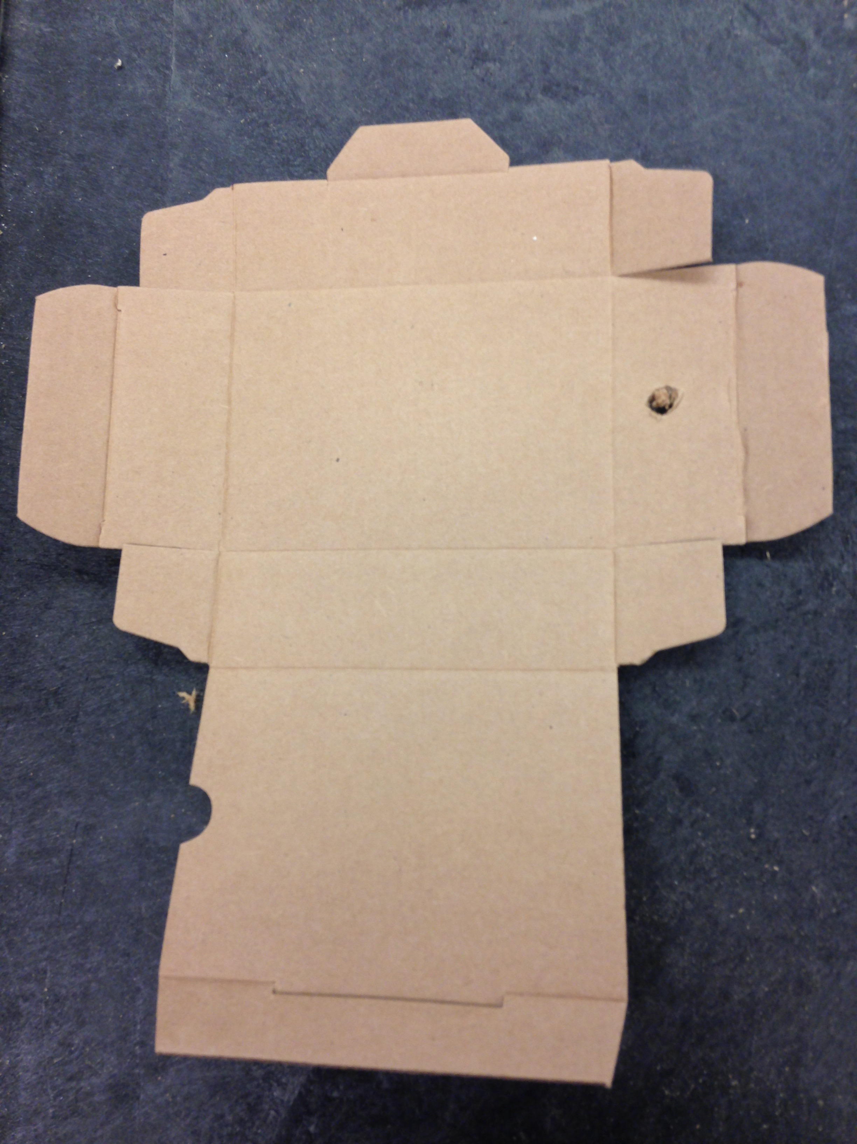
Fold this flap and punch a hole through both layers

Slide 16
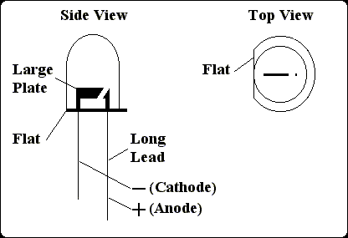
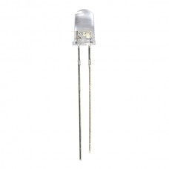
LEDs: one lead is shorter!
If you forget which is shorter, look for the flat

Slide 17
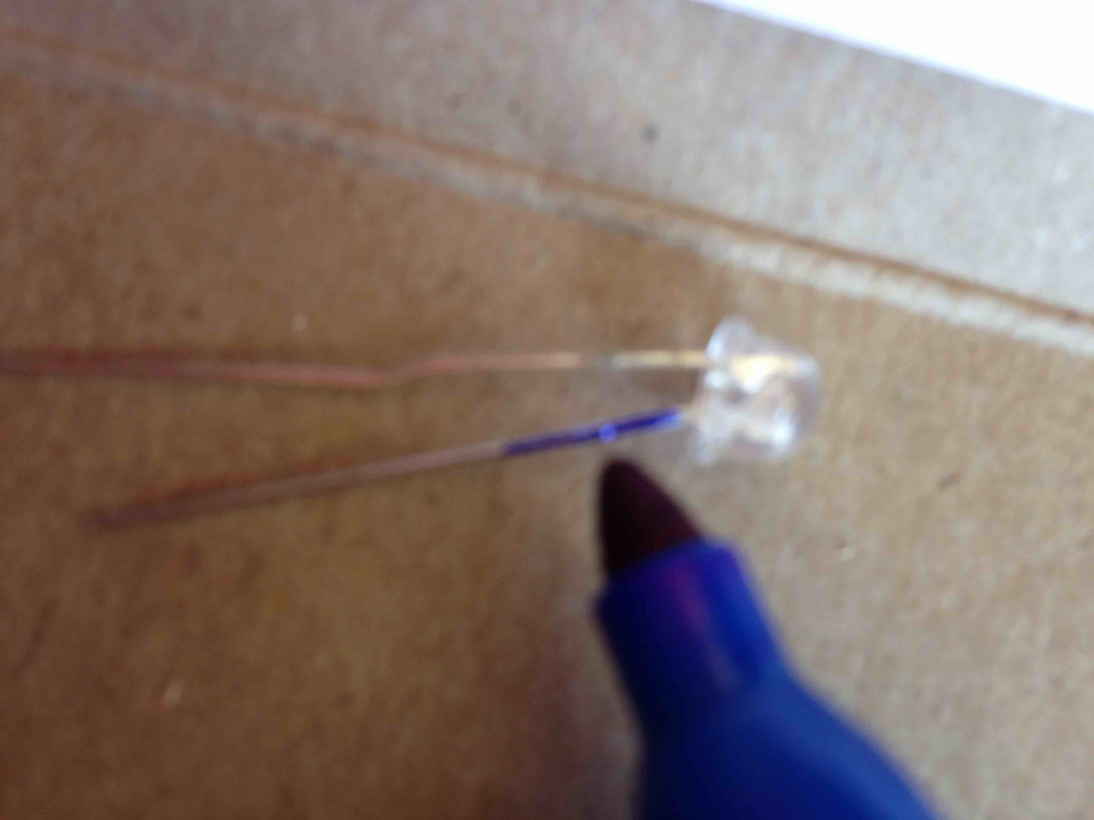
Color the top of the short lead

Slide 18
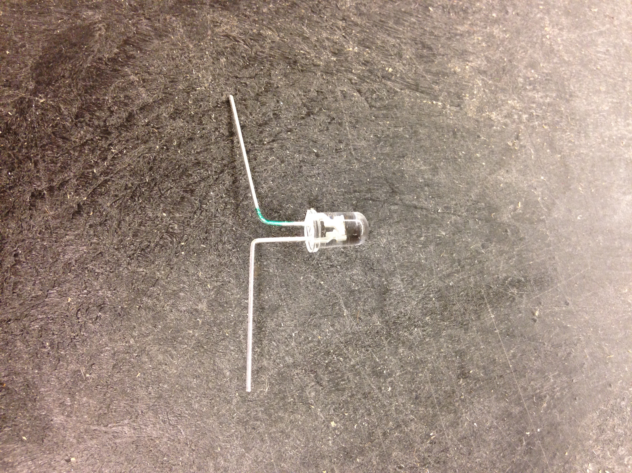
Bend legs at the knees
Short!

Slide 19
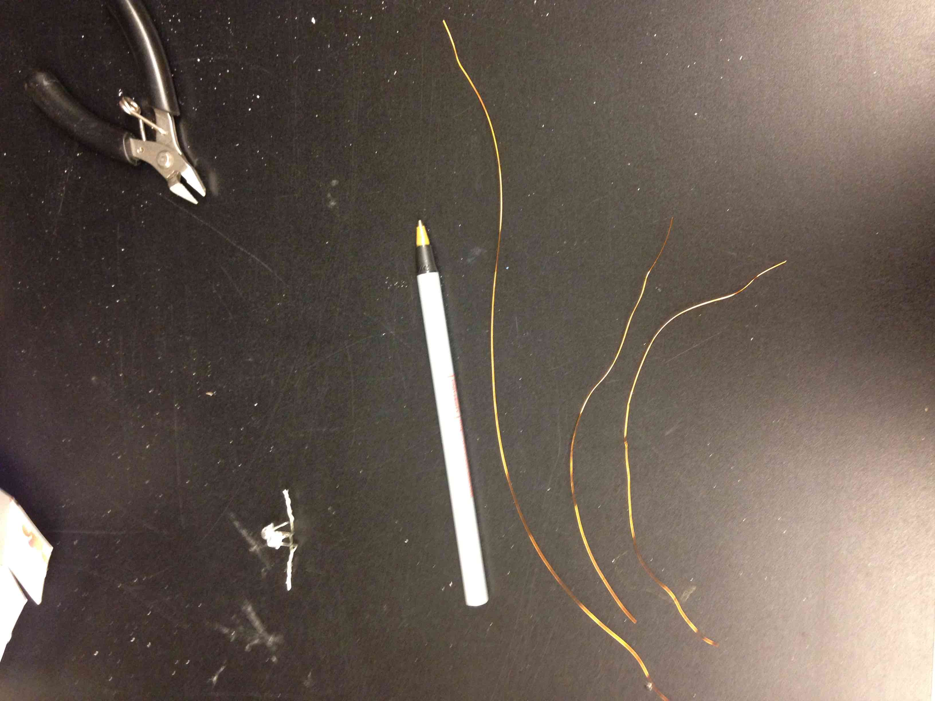
Got three pieces of magnet wire?

Slide 20
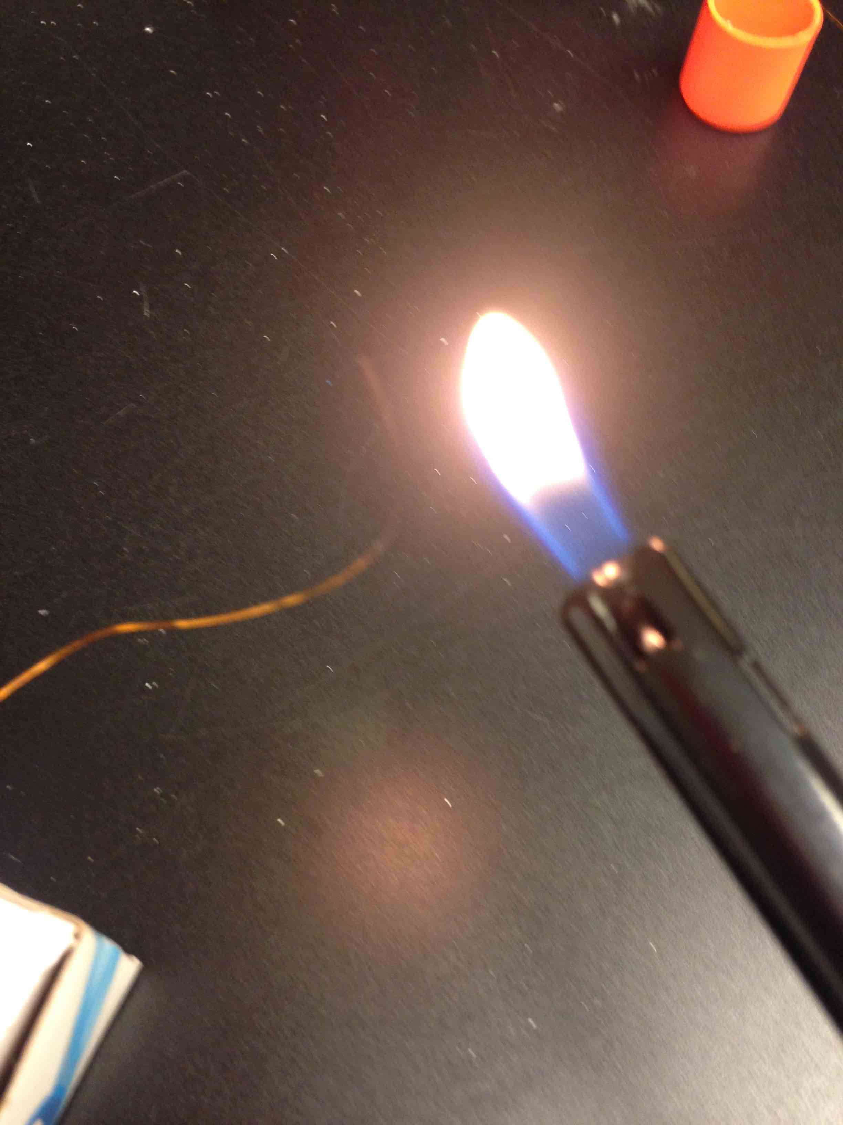
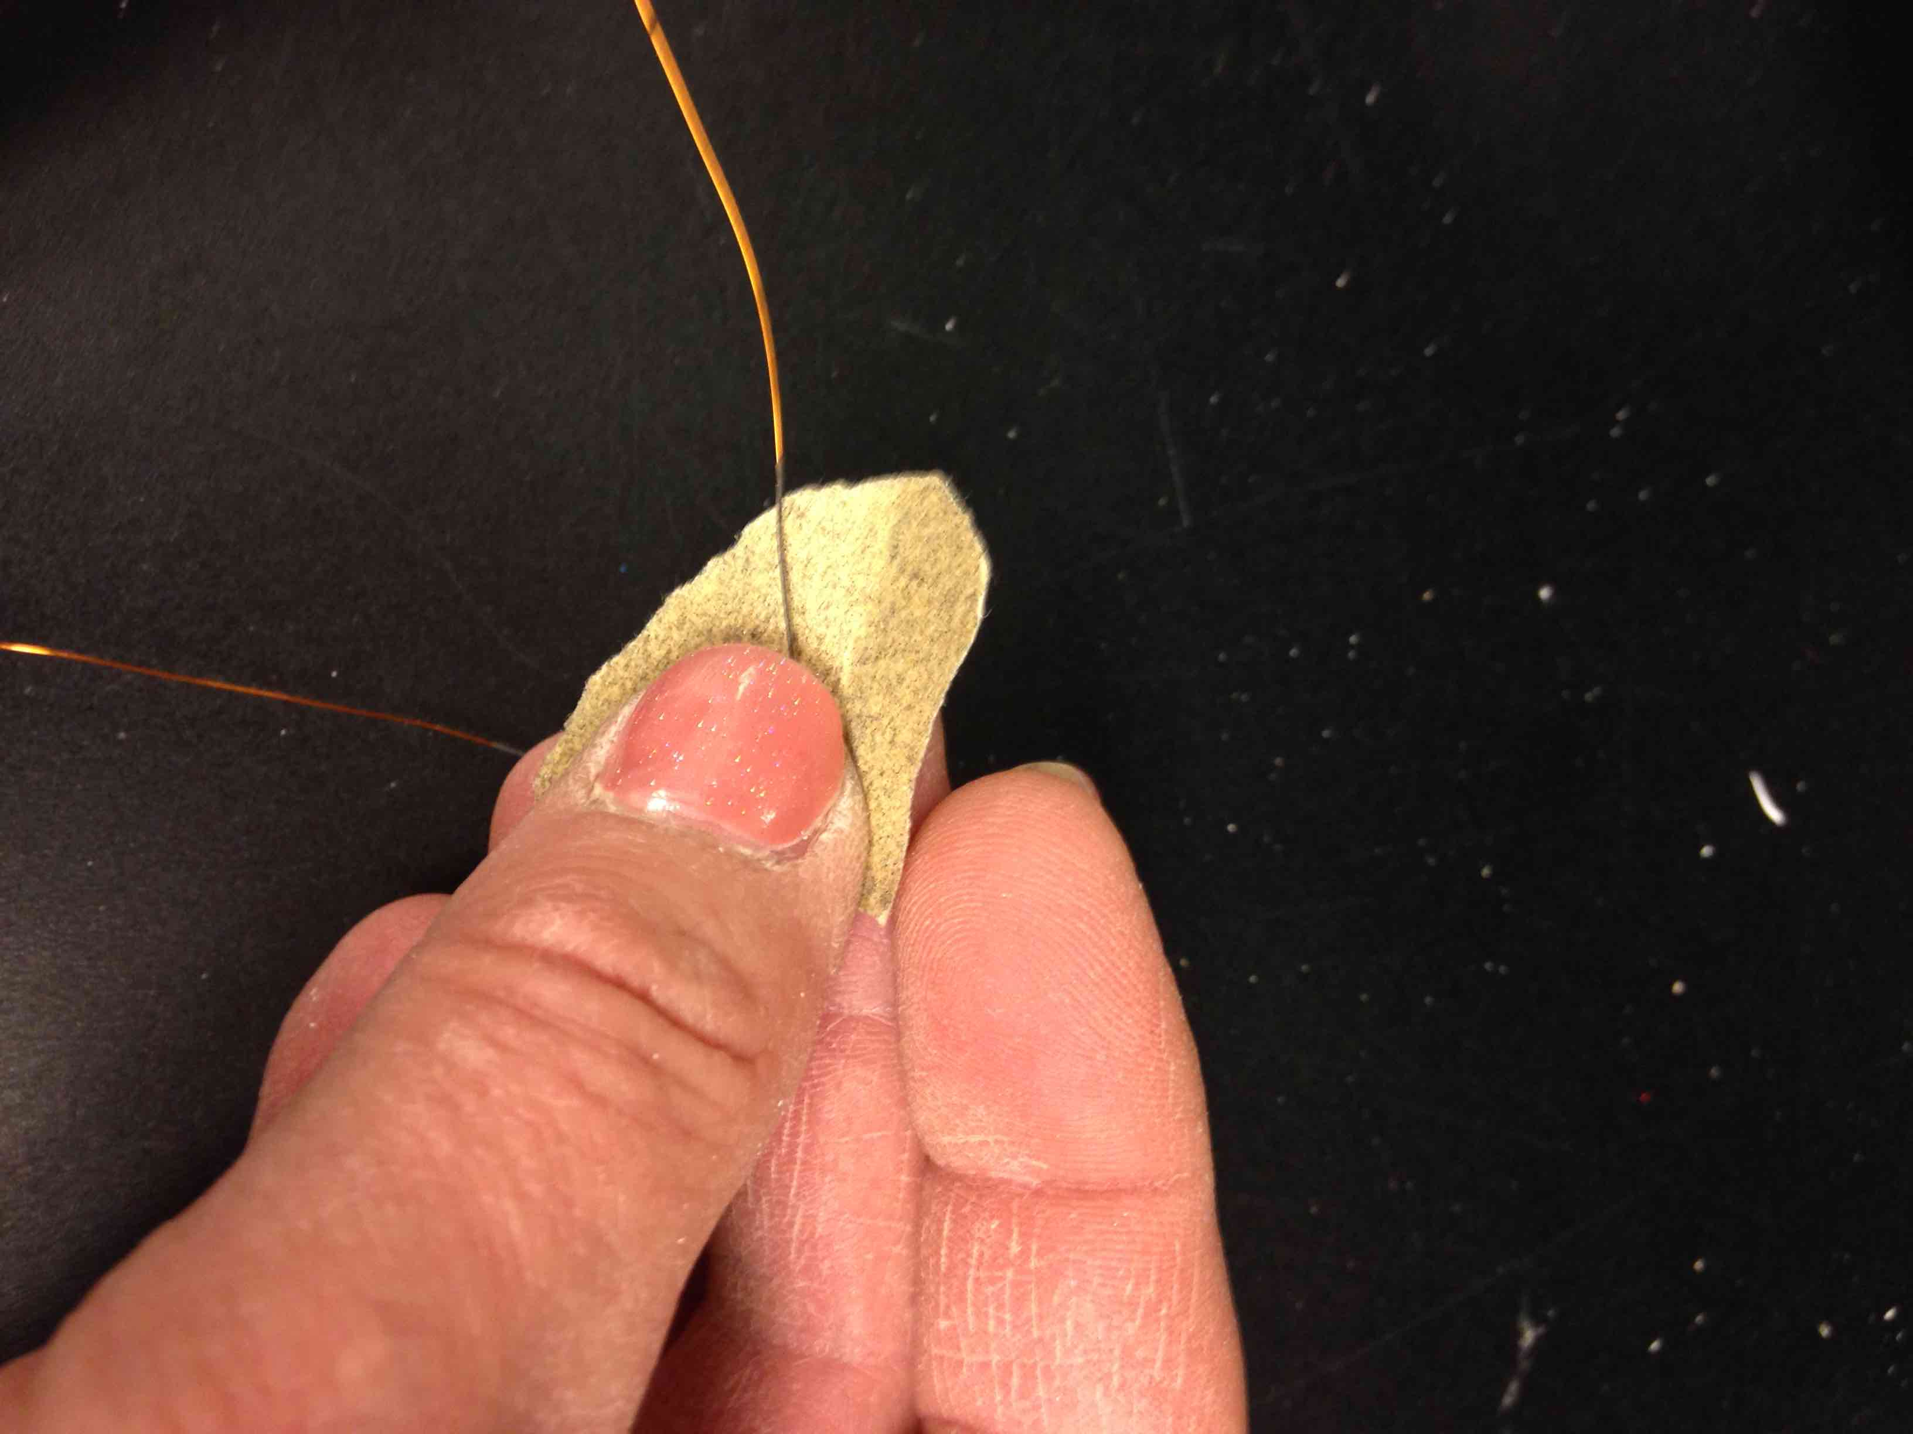
Burn insulation off the ends
Then sand off the black stuff

Slide 21
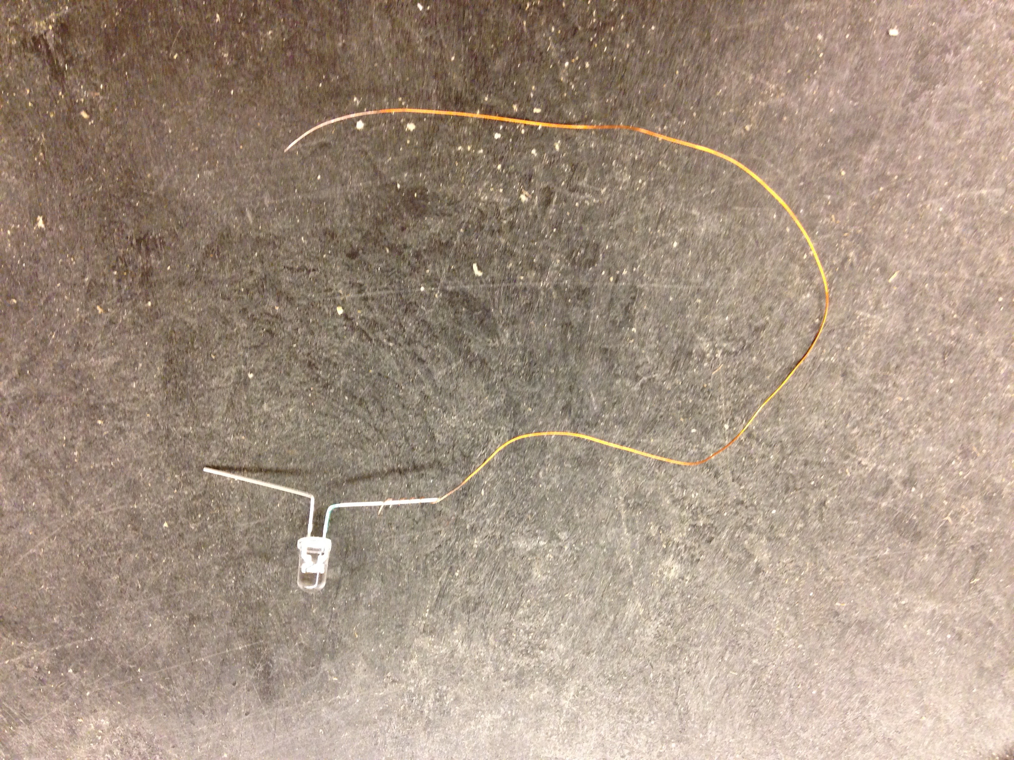
Twist one around the SHORT lead

Slide 22
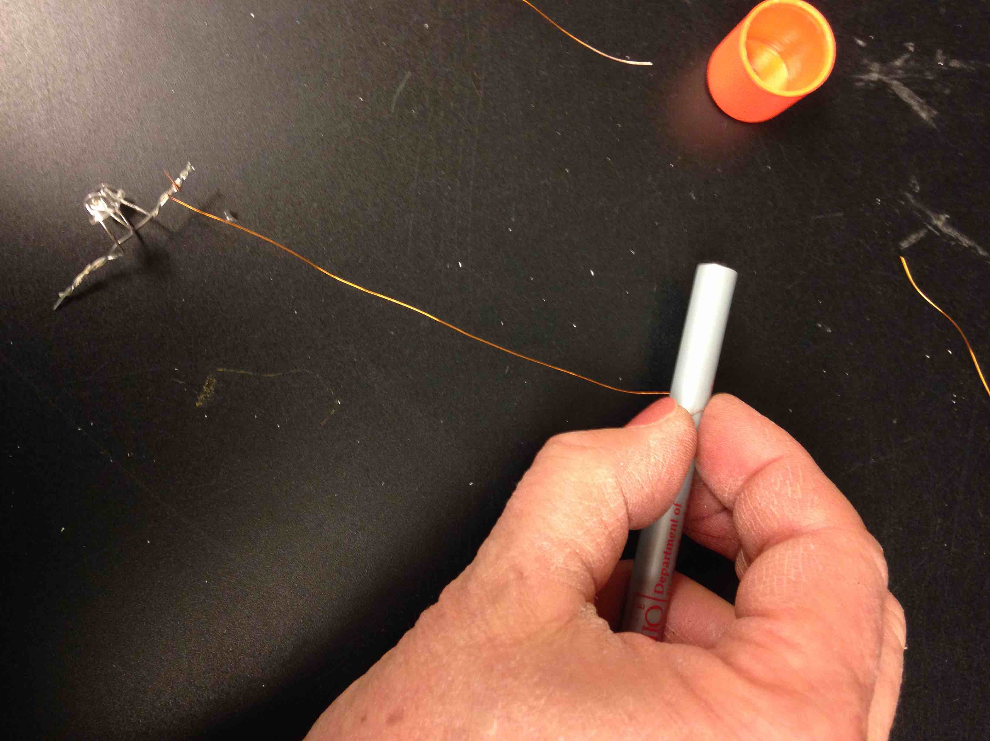
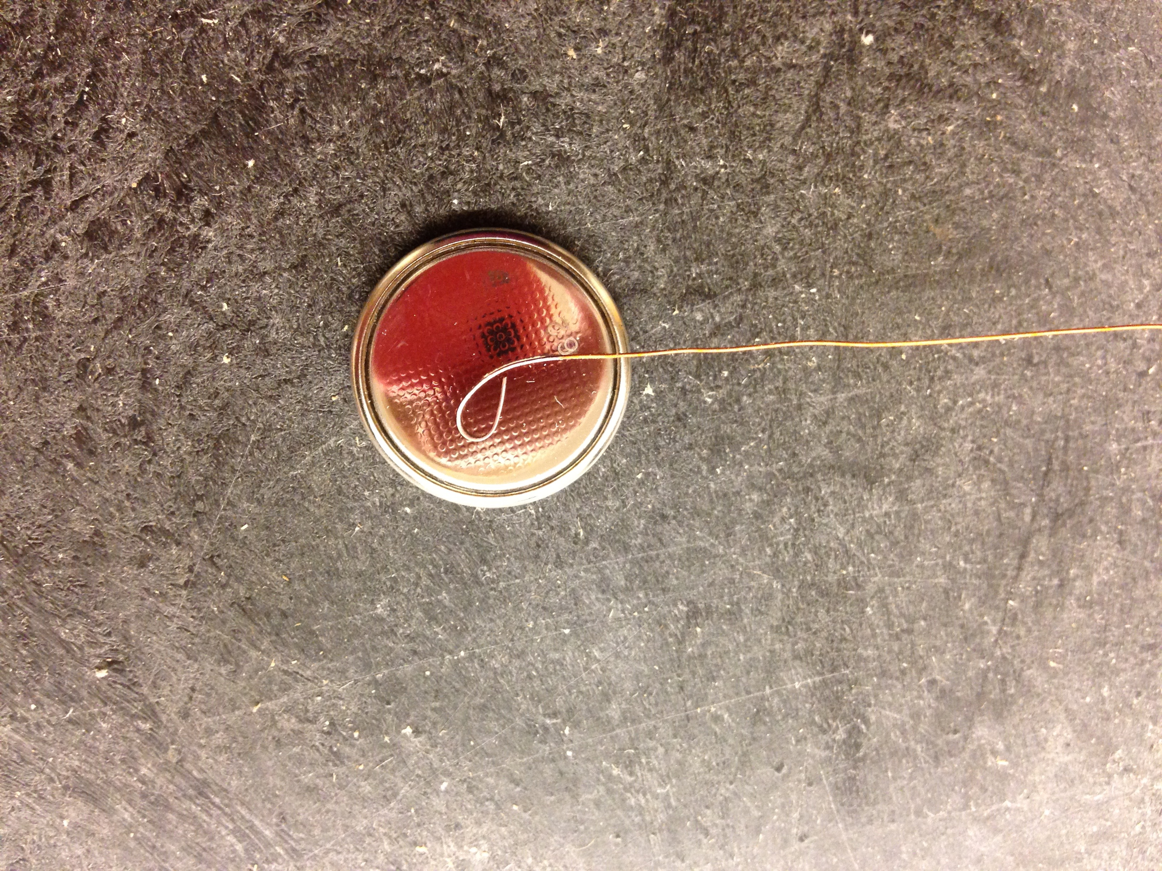
Use a pen or pencil to make a small loop in the other end

Slide 23
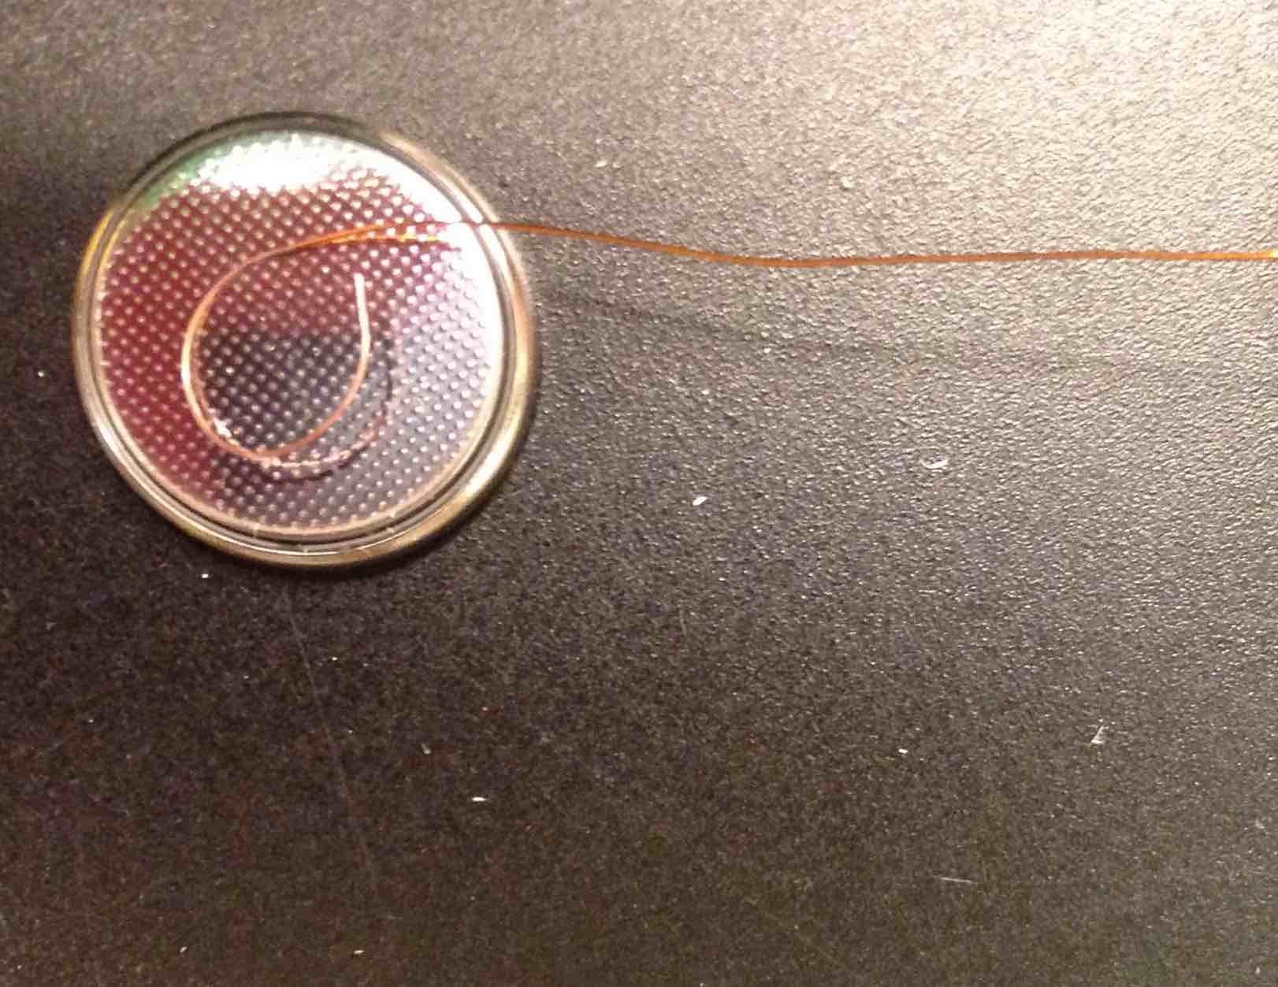
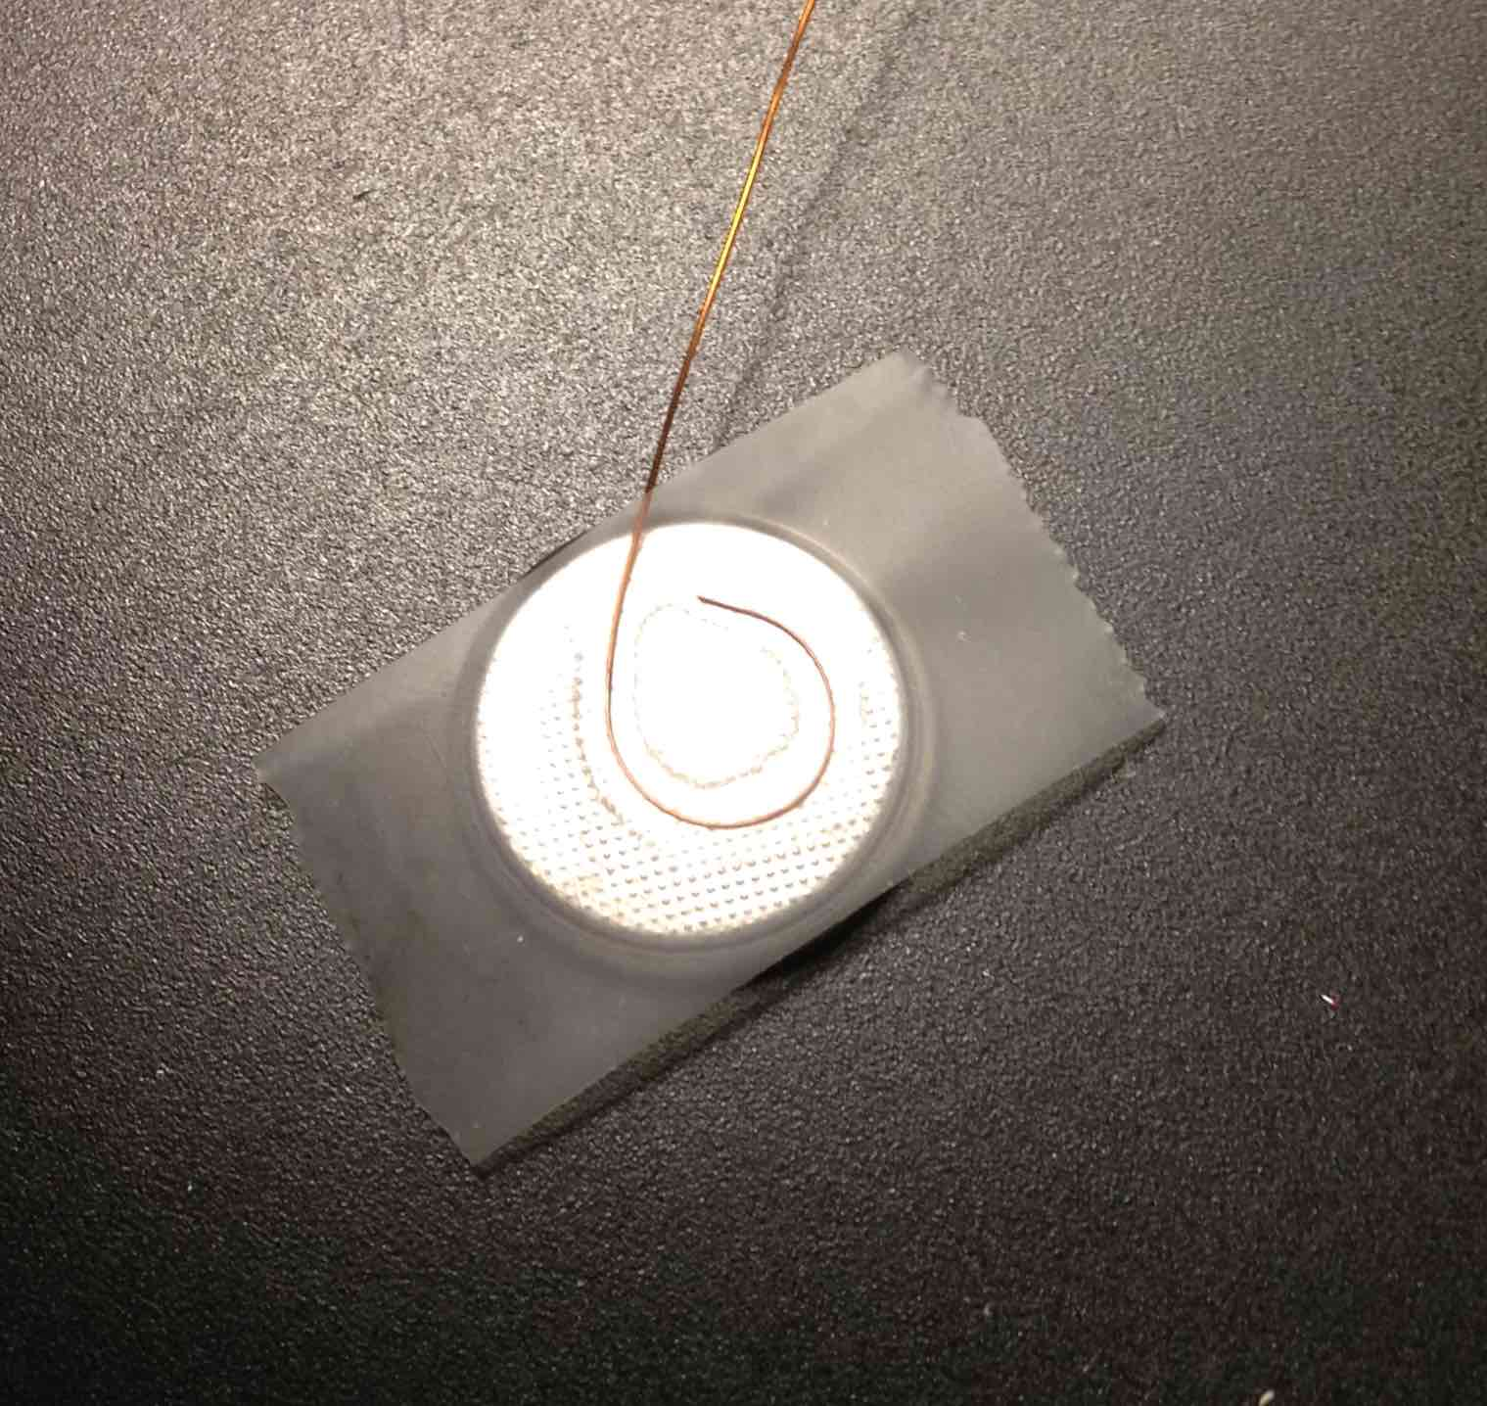
Tape loop to bottom (-) side of battery

Slide 24
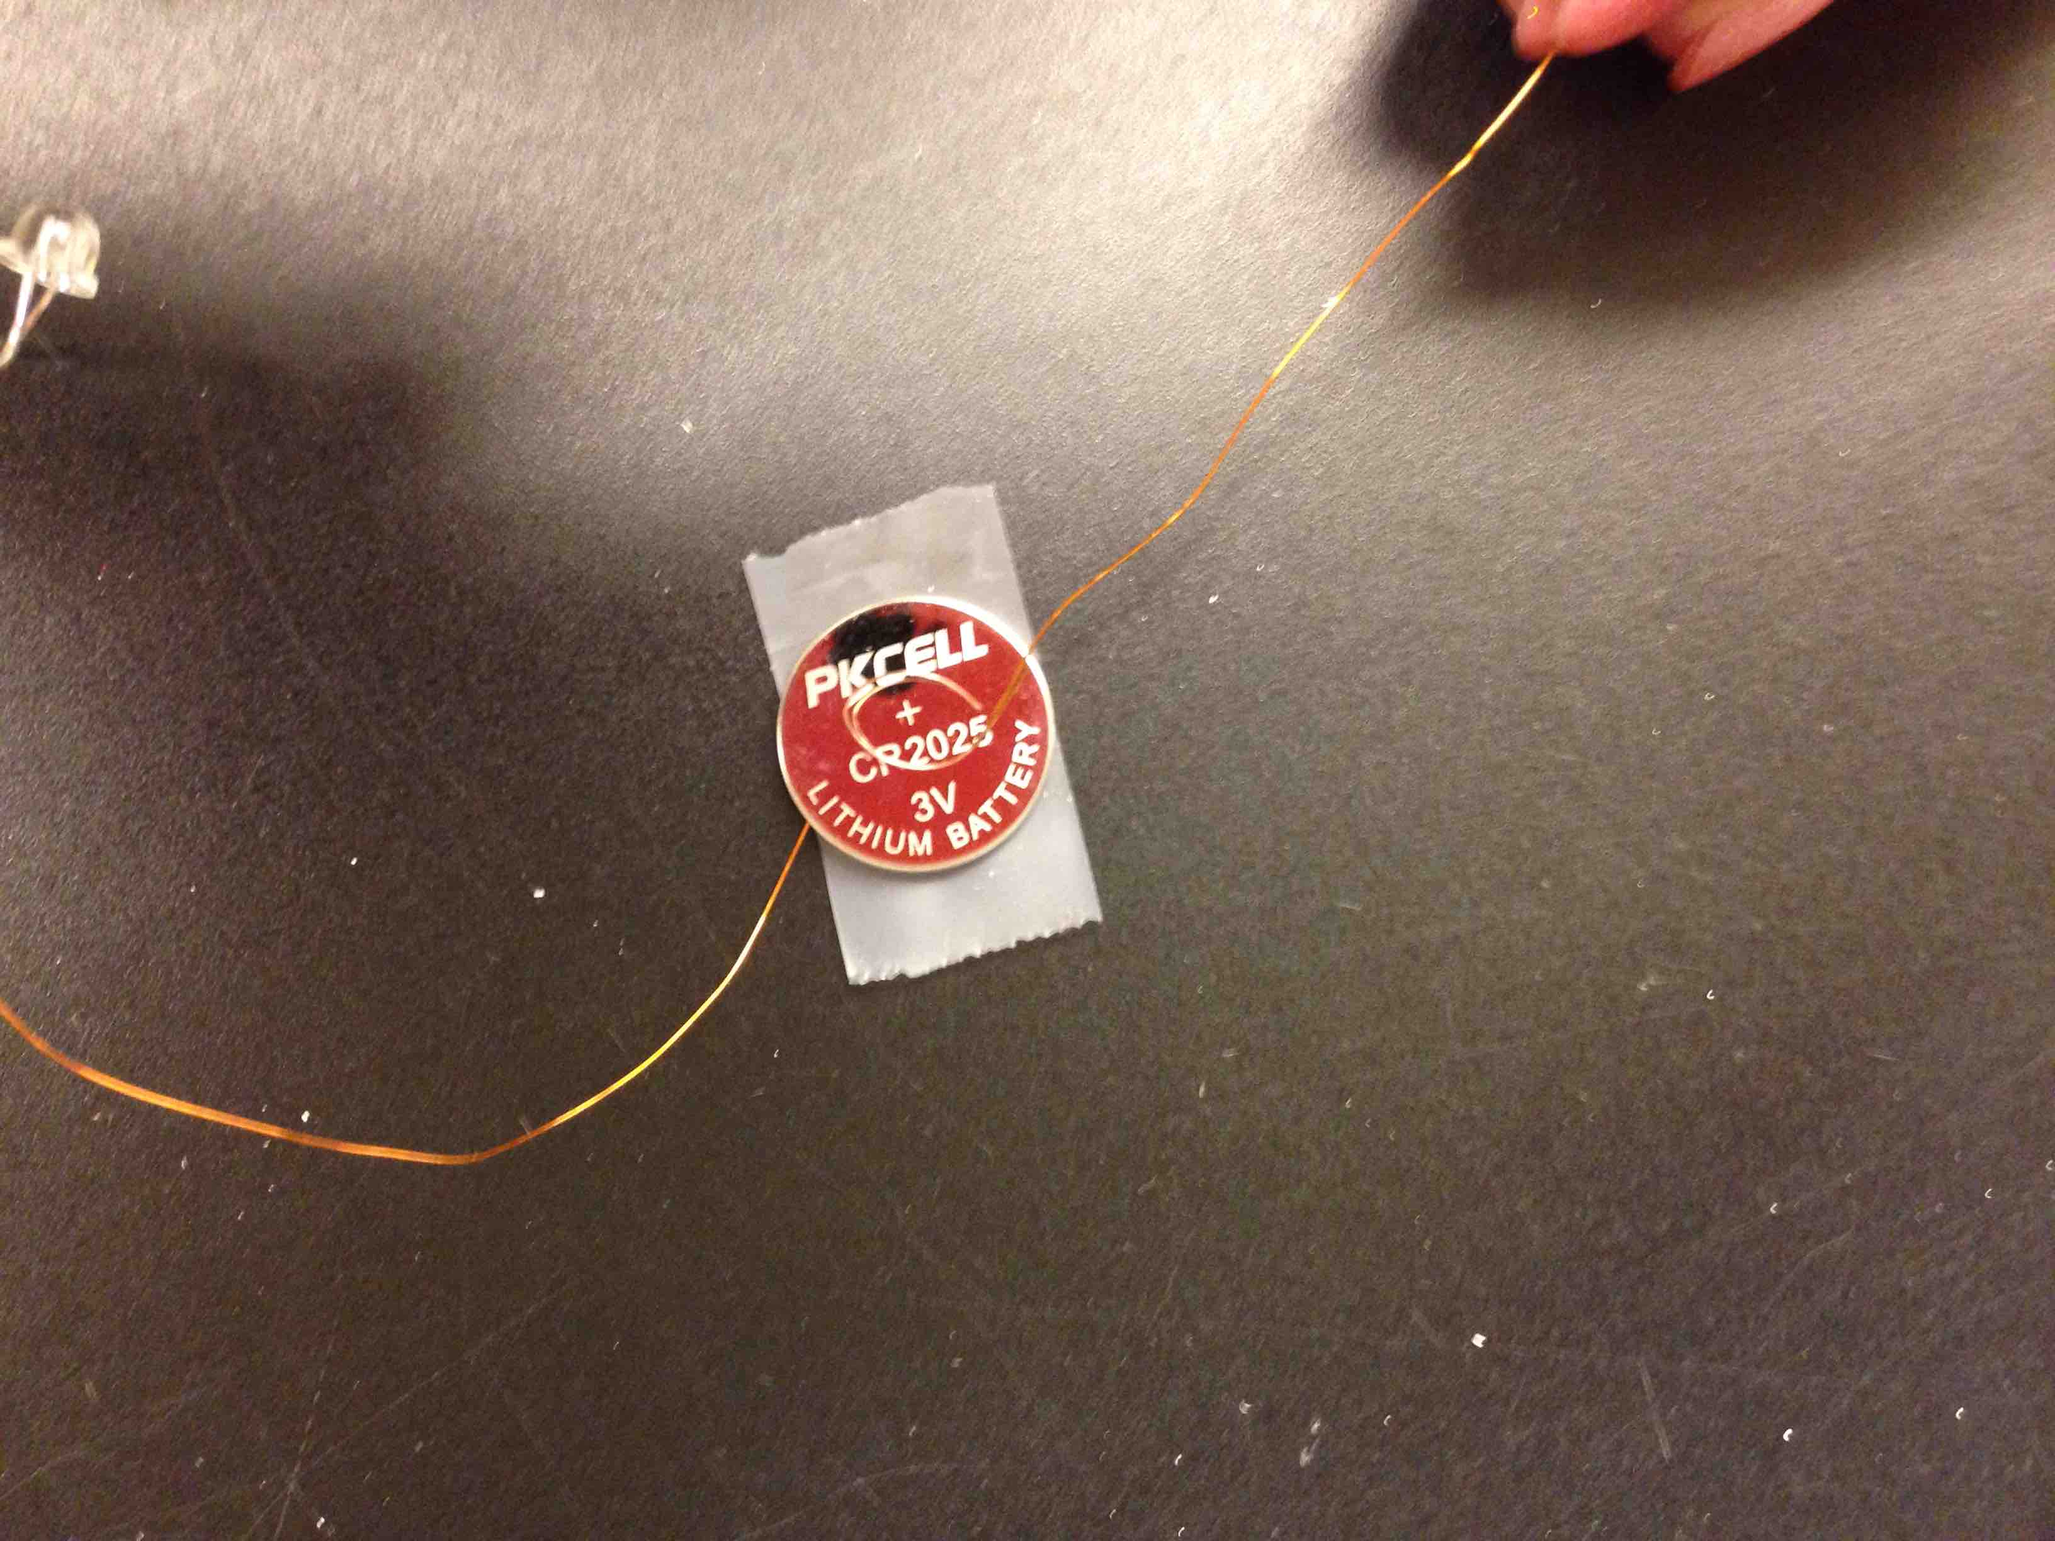
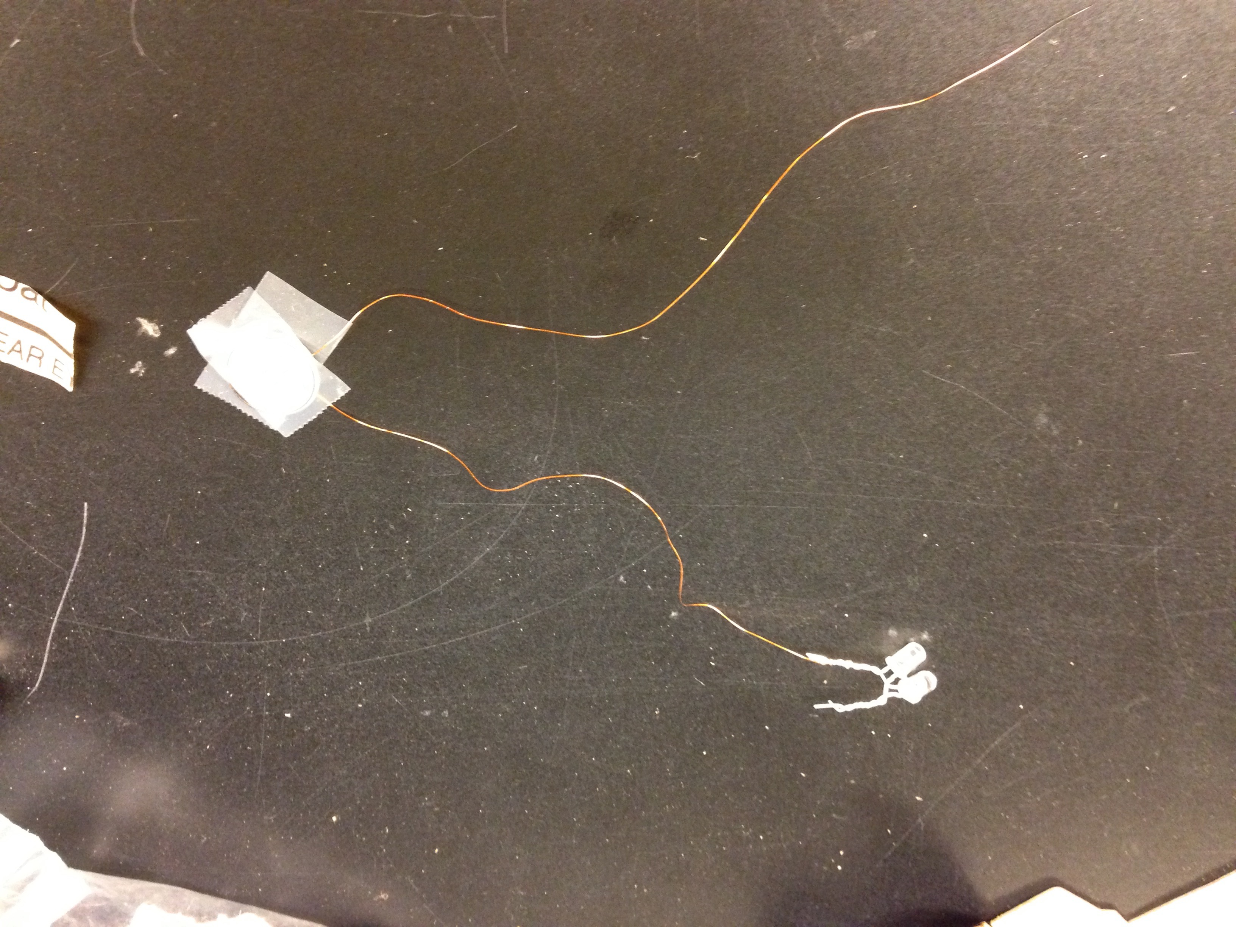
Make a loop in another wire and tape it to the top (+) side of battery

Slide 25
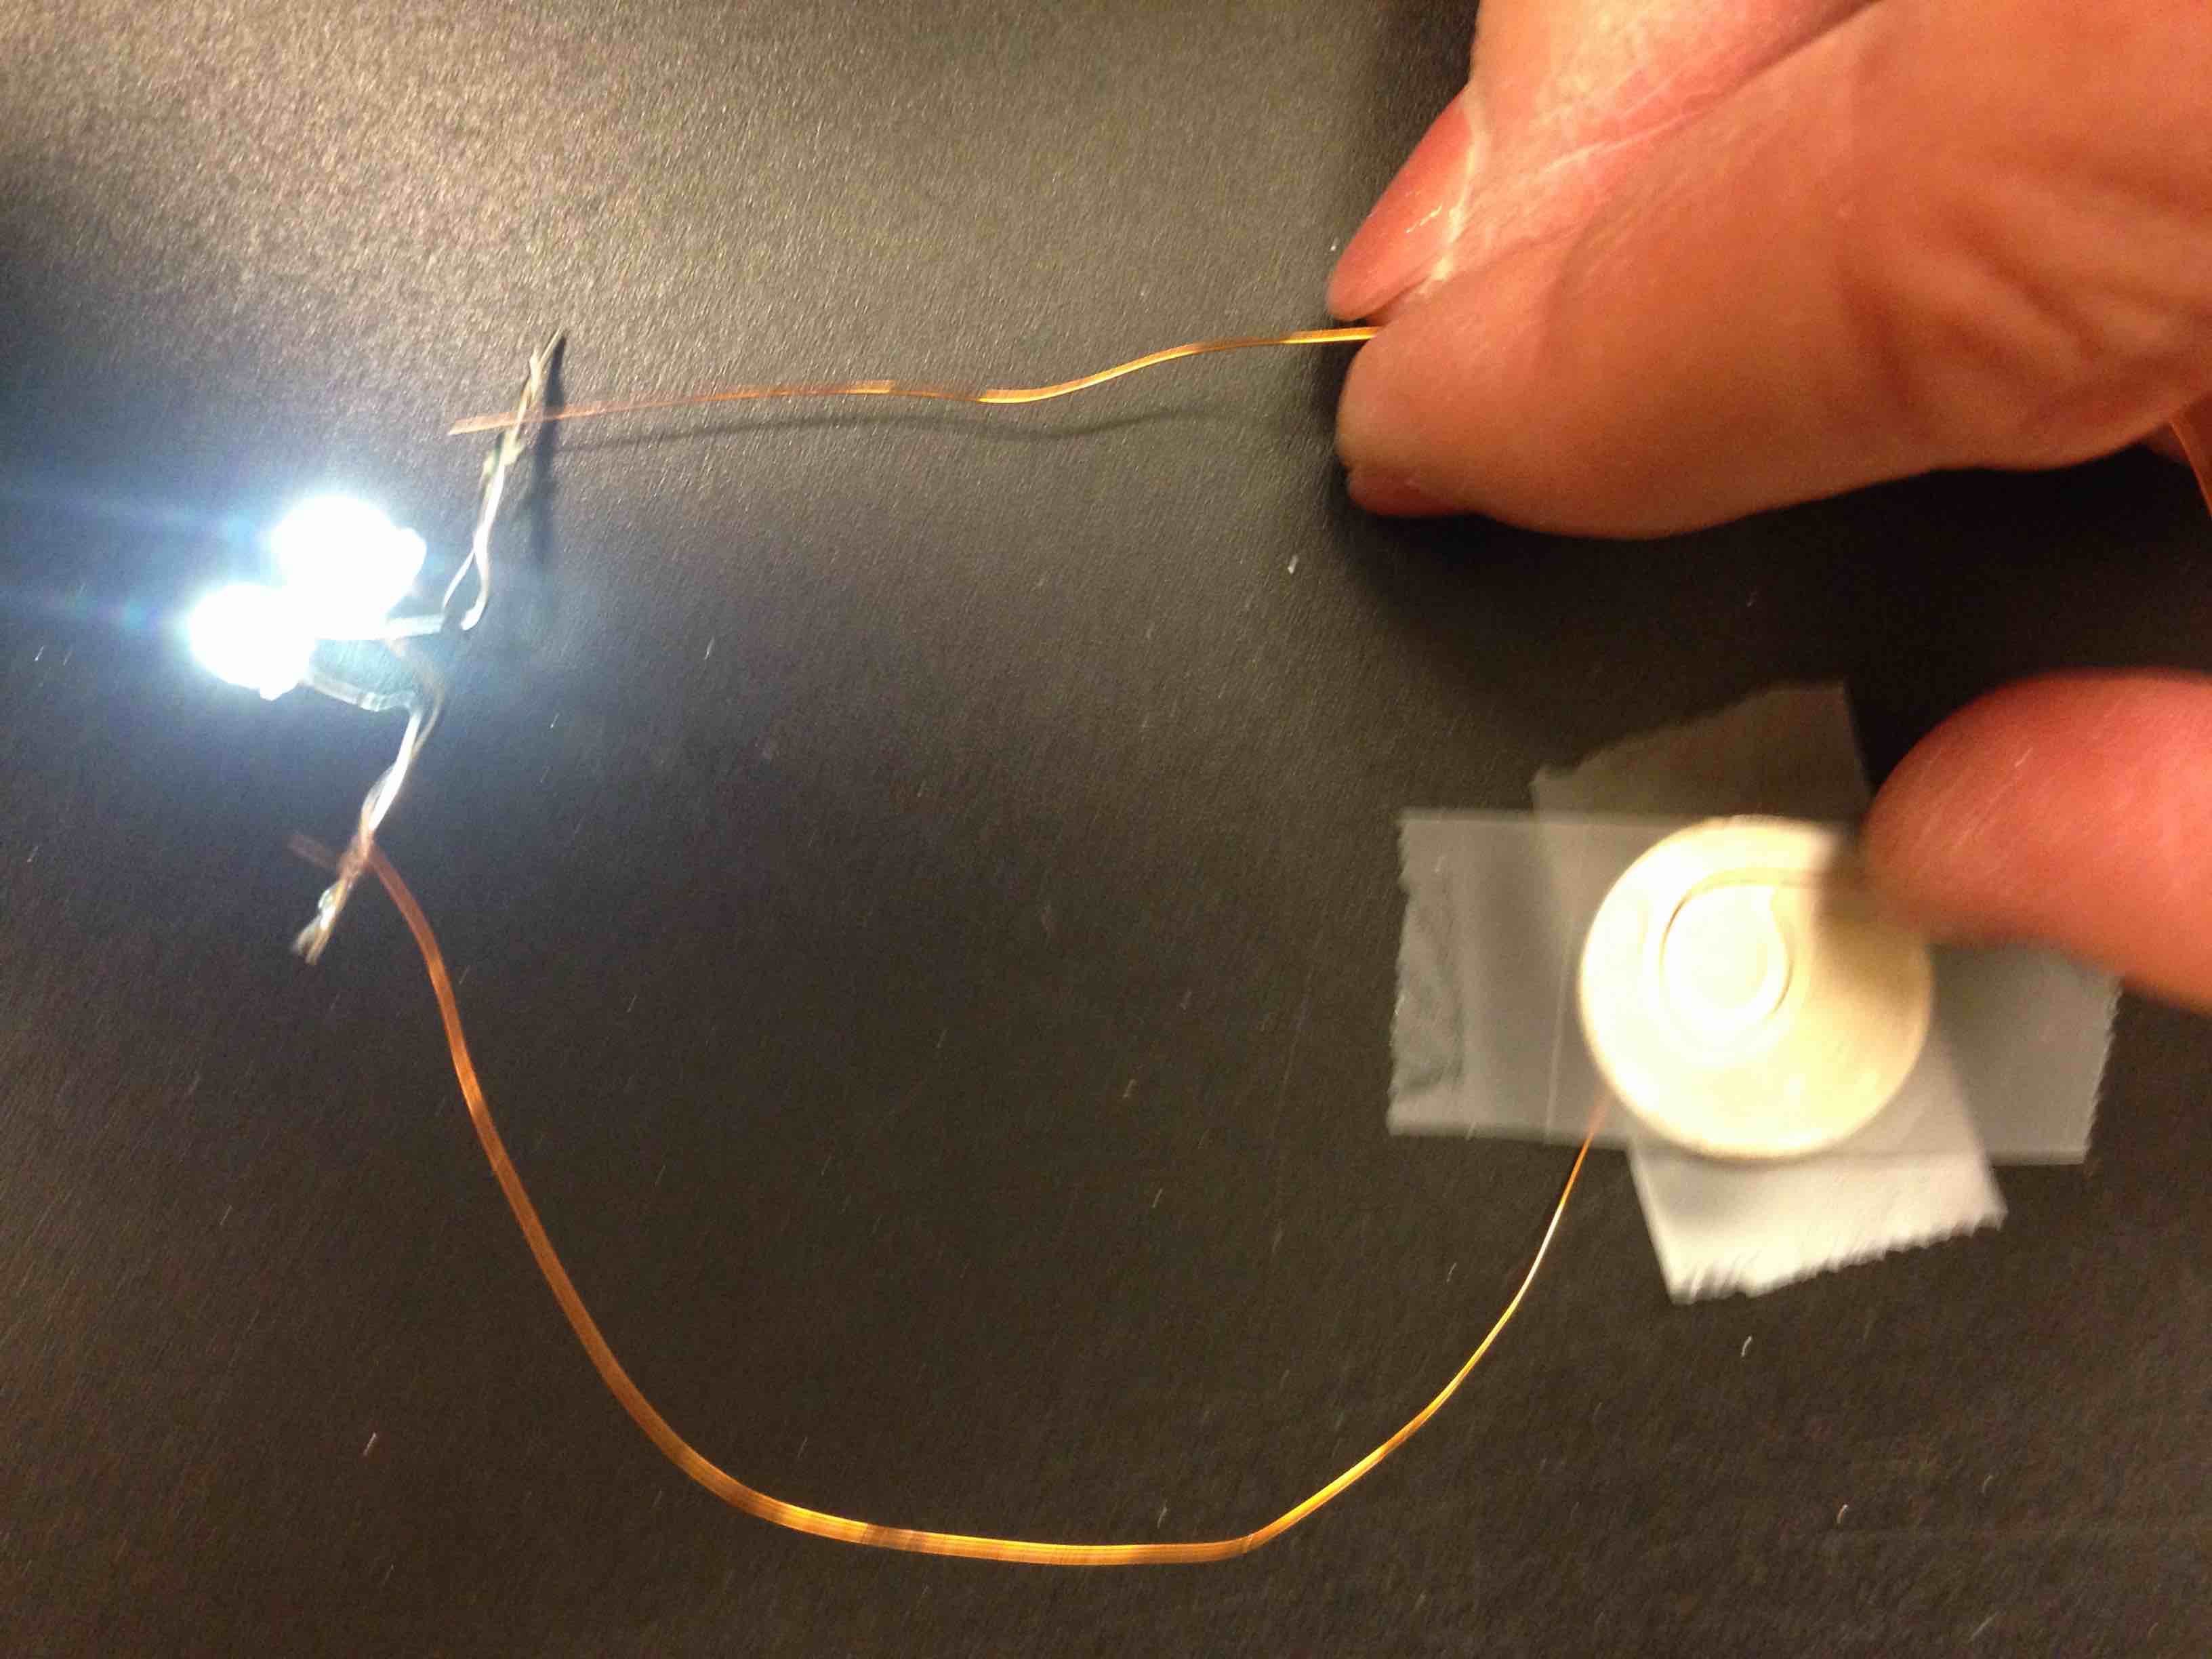
Here’s a chance to test it!
Touch, don’t twist!
Touch the other end of the second wire to the other LED leads.
It should light up.

Slide 26
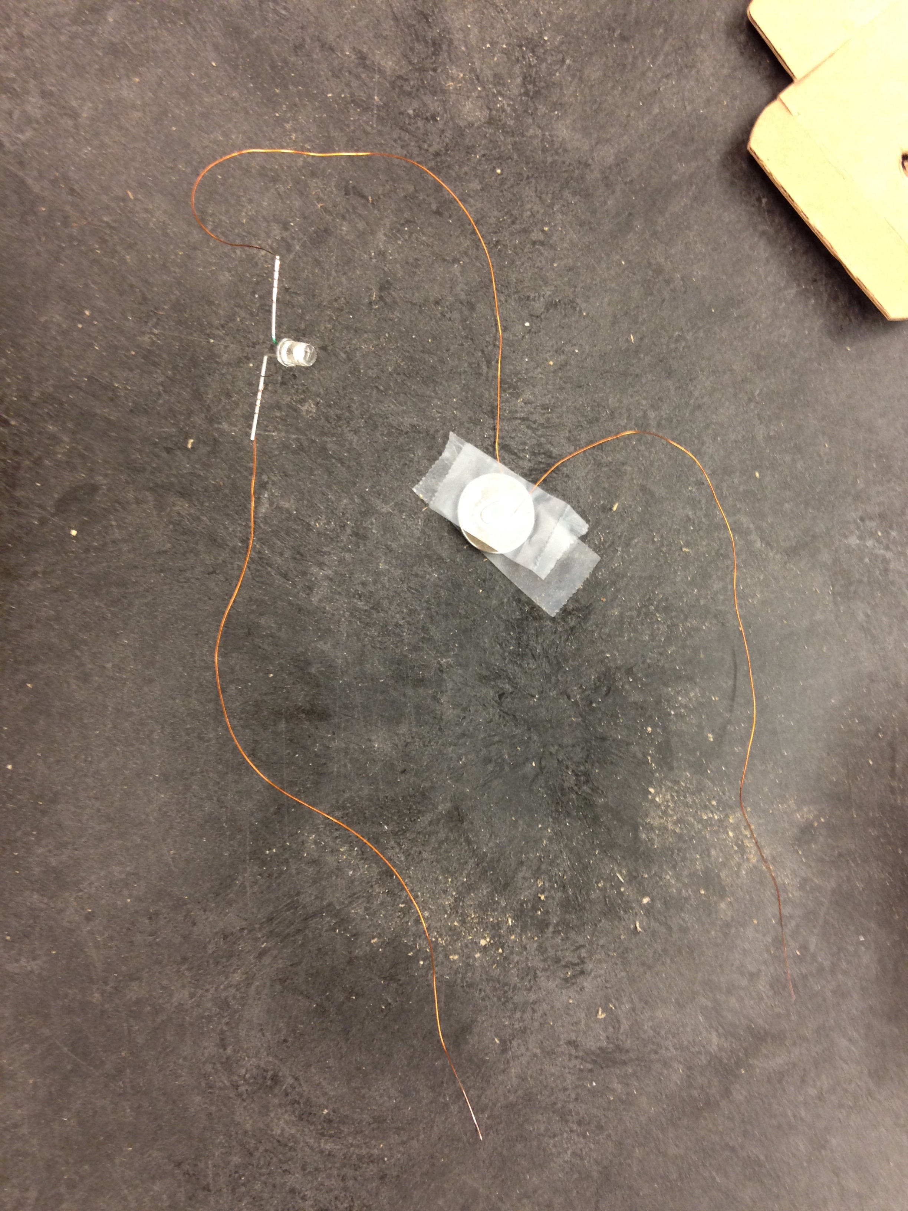
Find the THIRD wire
Twist one end to the unused LED leads
Wire ONE goes LED to battery
Wire TWO goes battery to nowhere right now
Wire THREE goes from LED to nowhere
Tape battery inside box

Slide 27
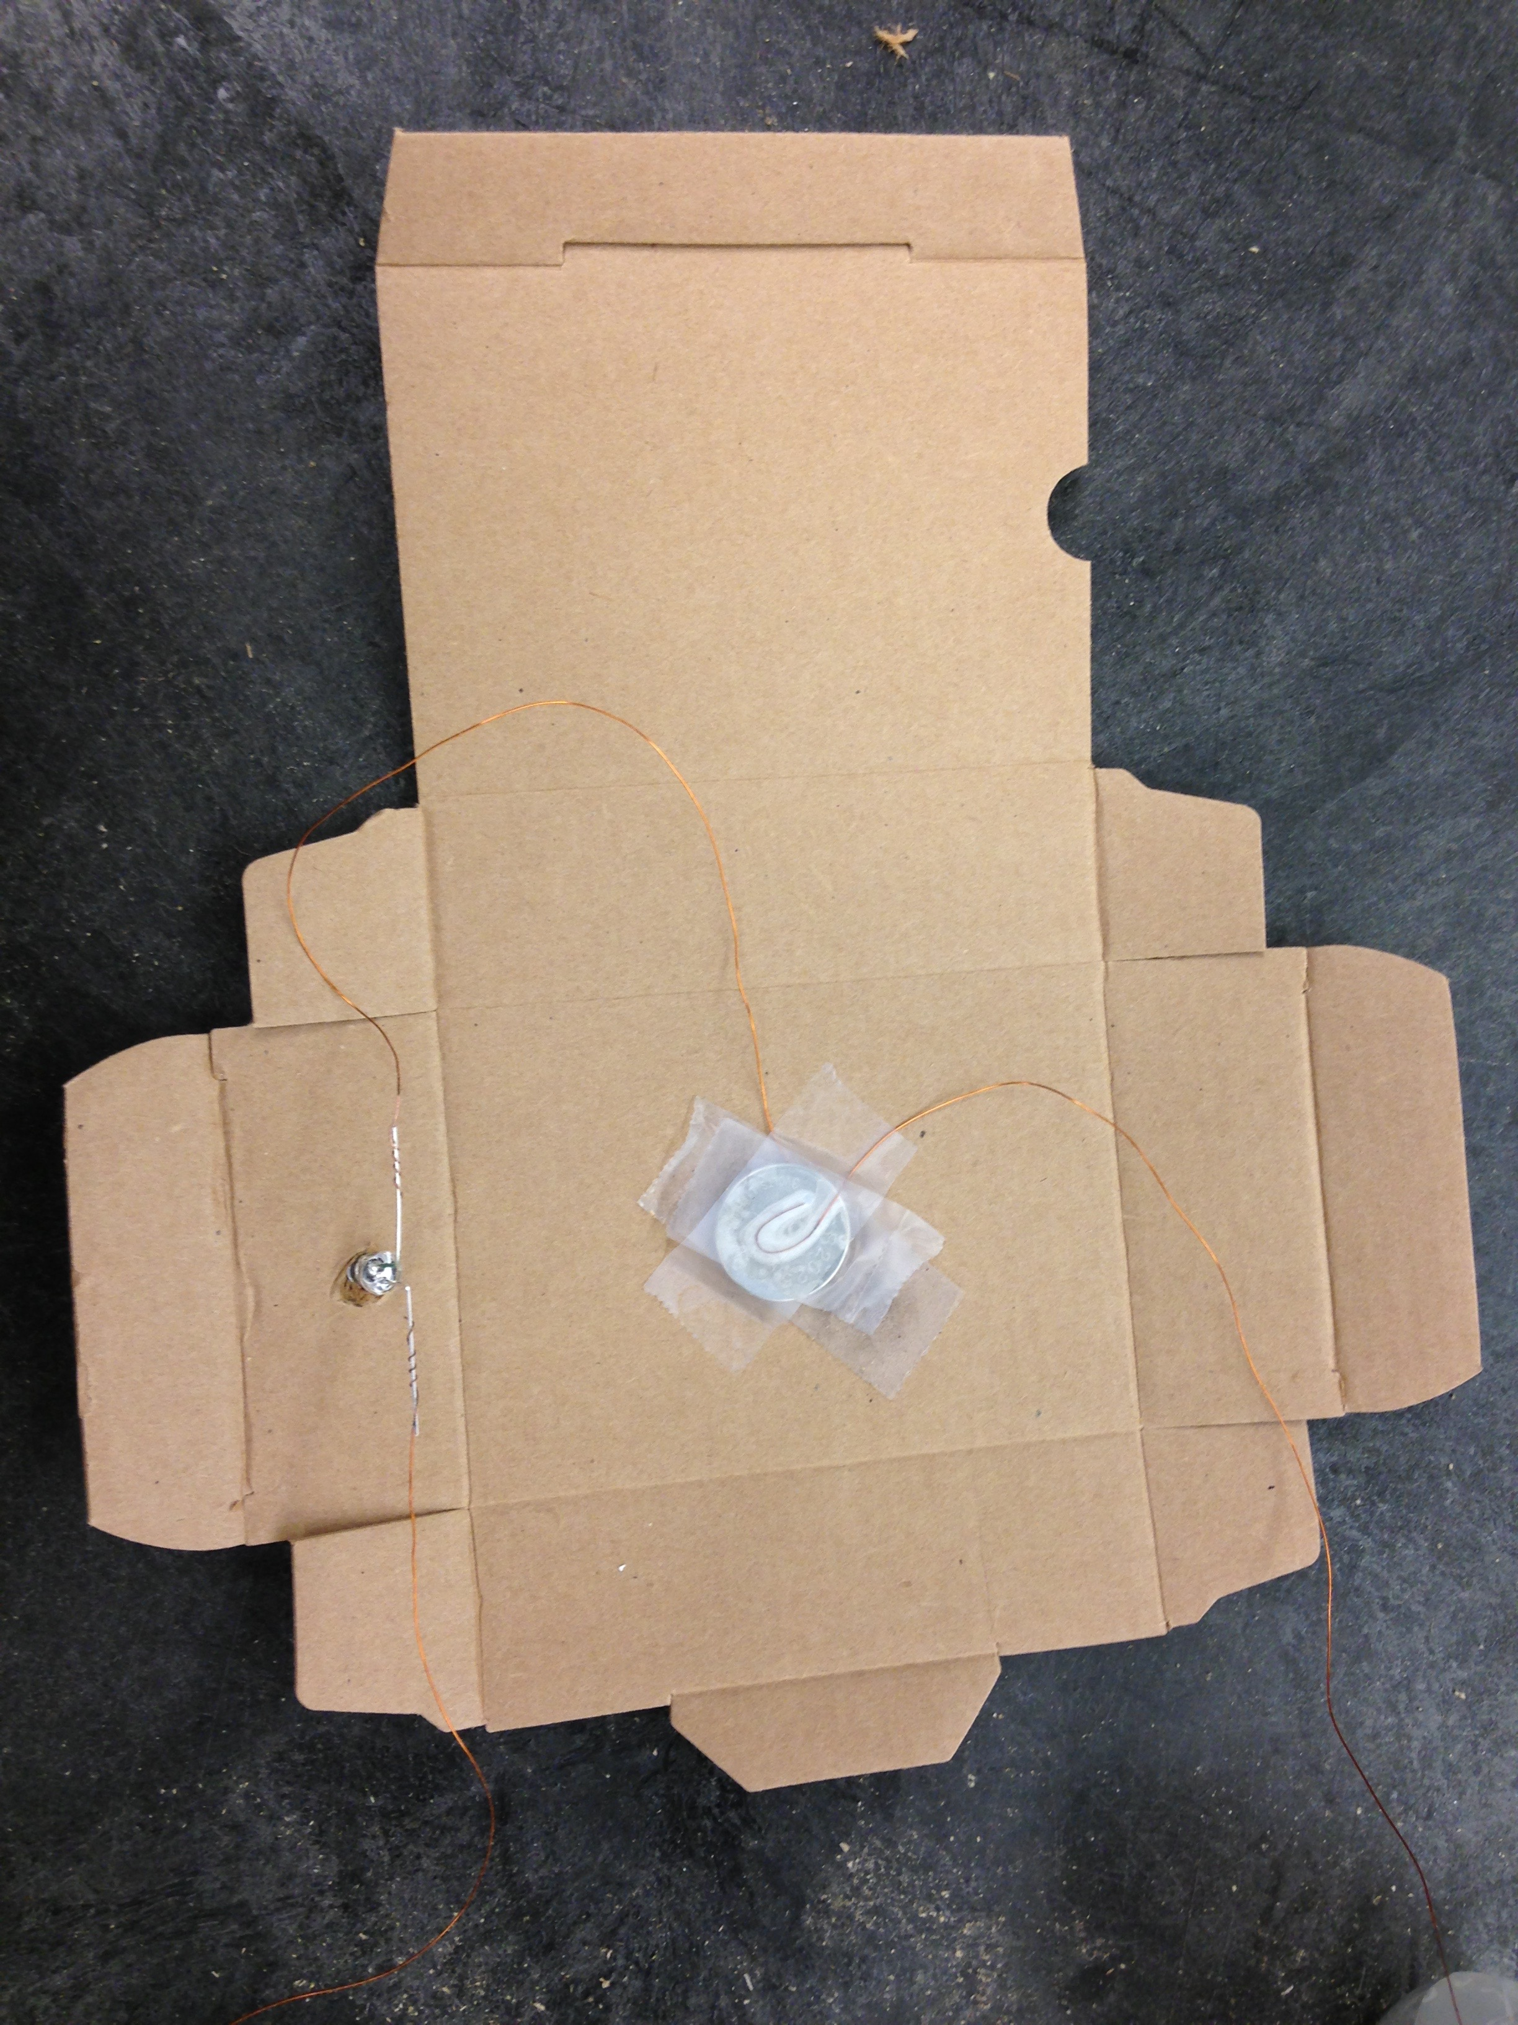
Tape battery inside box
Poke LED out through the hole

Slide 28
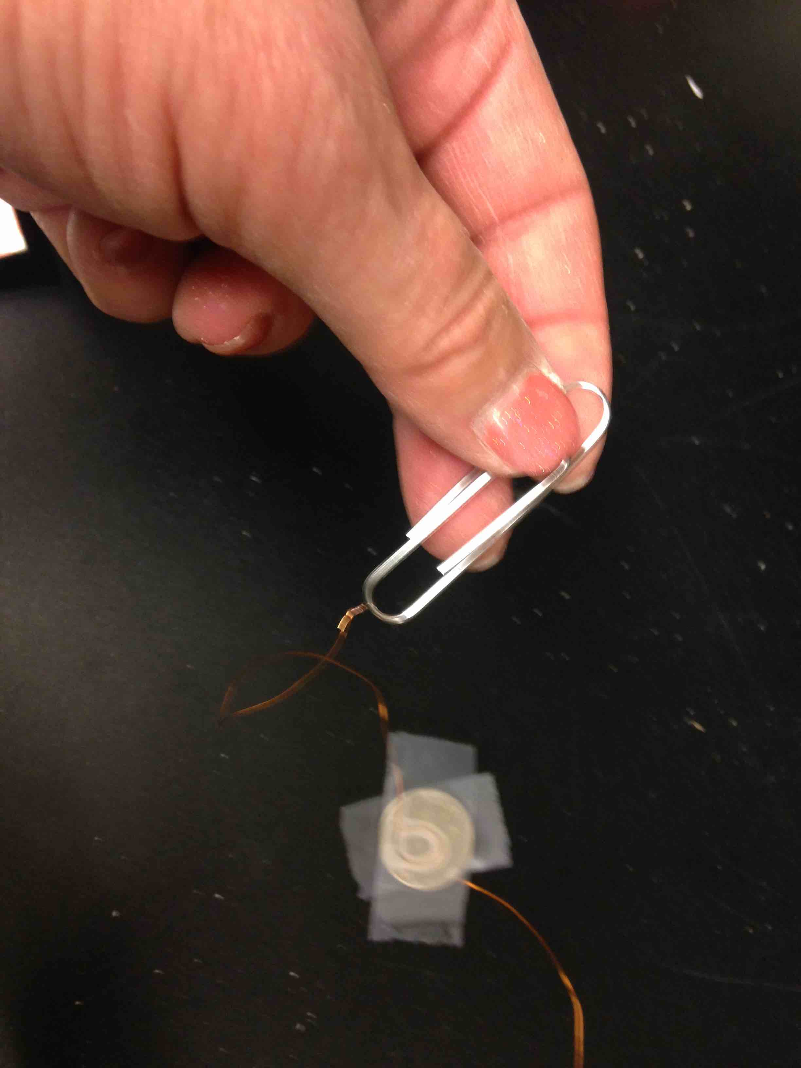
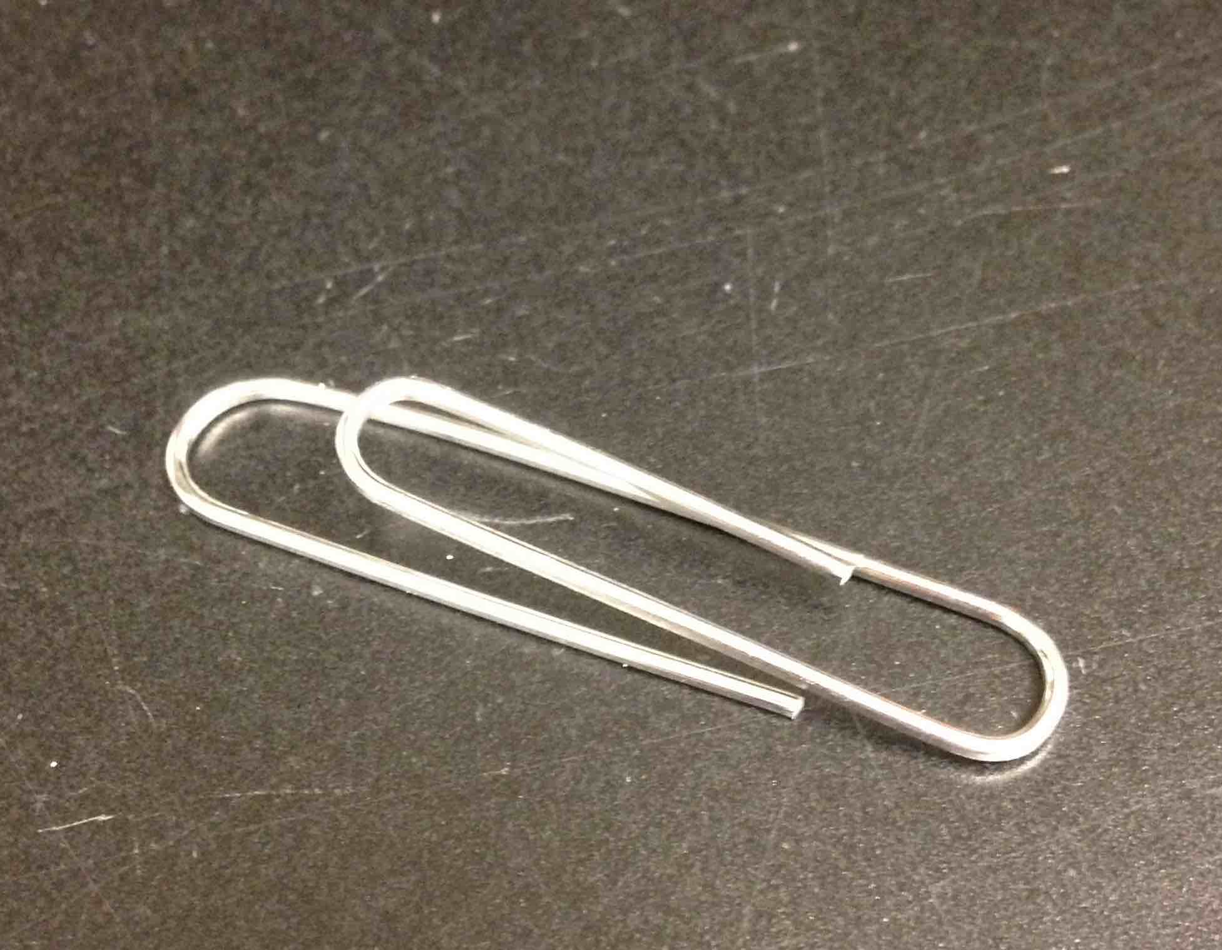
Bend the paper clip a little
Twist the end of the second wire to the paper clip

Slide 29
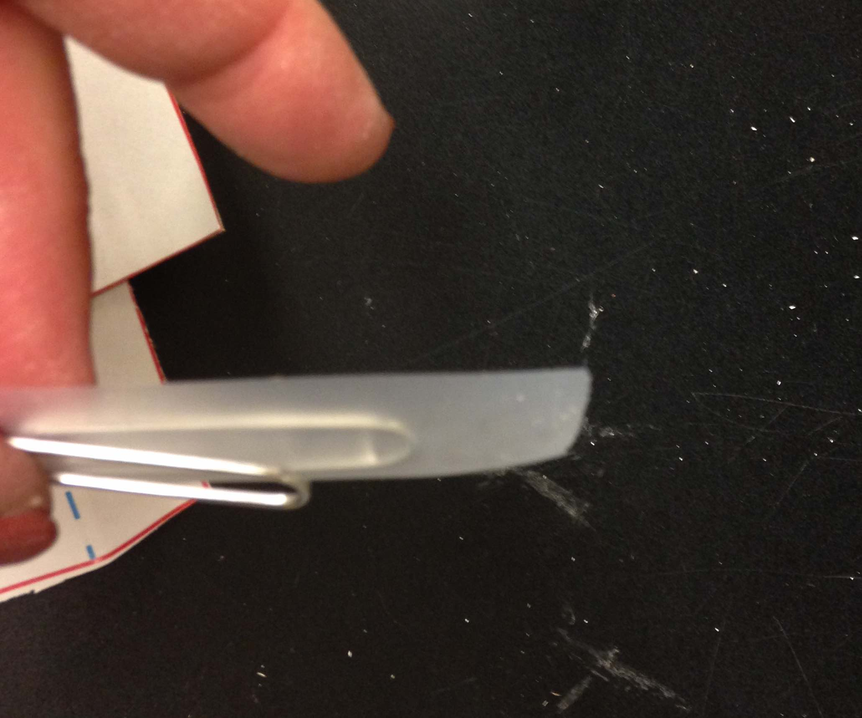
Cover big loop of paper clip with tape
Tape to outside of box
Don’t cross fold in flap here

Slide 30
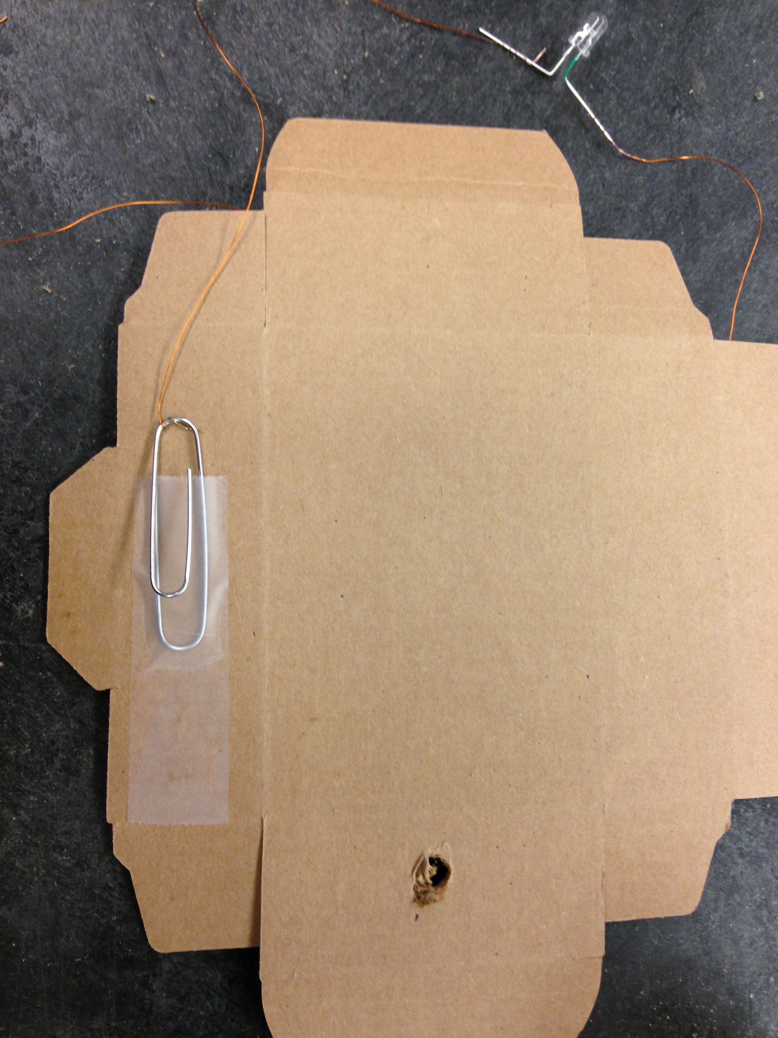
Tape the big loop of the paper clip to the outside of the box
Cover the big loop with tape

Slide 31
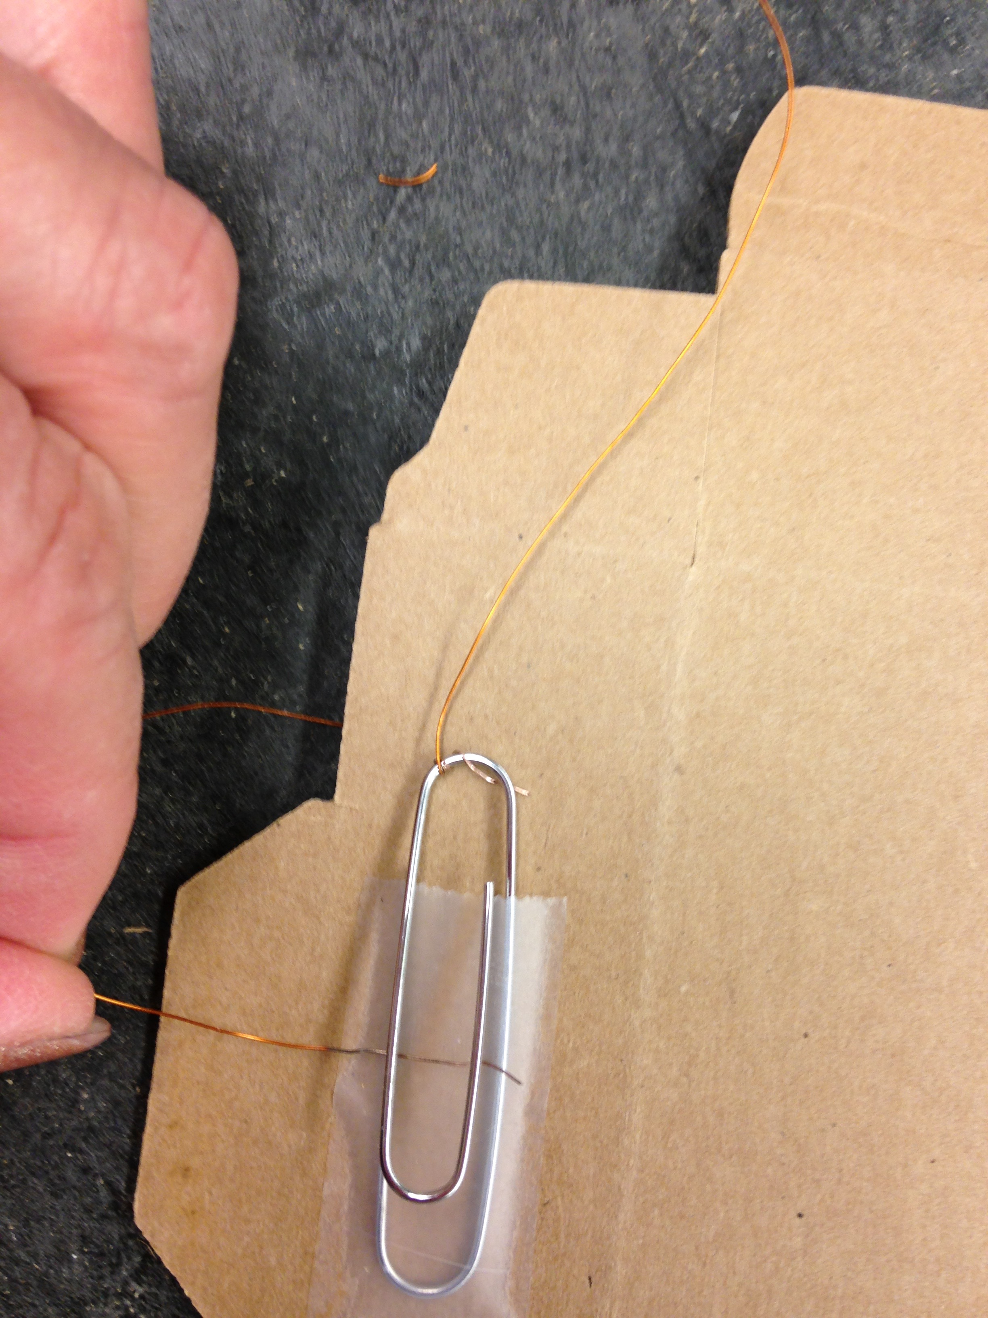
Get the last piece of wire
Slide one sanded end under the top part of the clip
This is going to be your switch!
Must be sanded part!!!

Slide 32
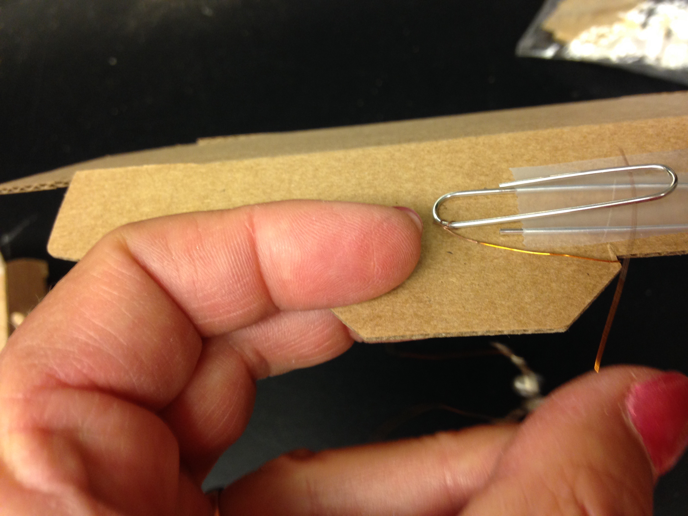
Tape it down ONY THE END

Slide 33
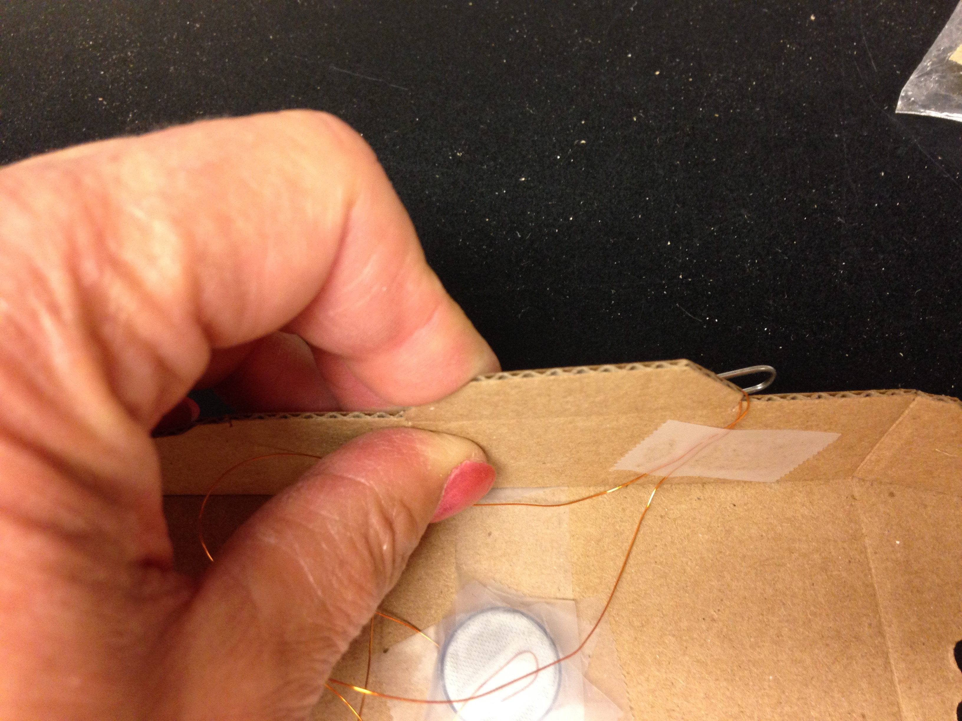
Thread the two wires from the switch to the inside
Tape it!
Test it! Close the switch! Does it light up?

Slide 34
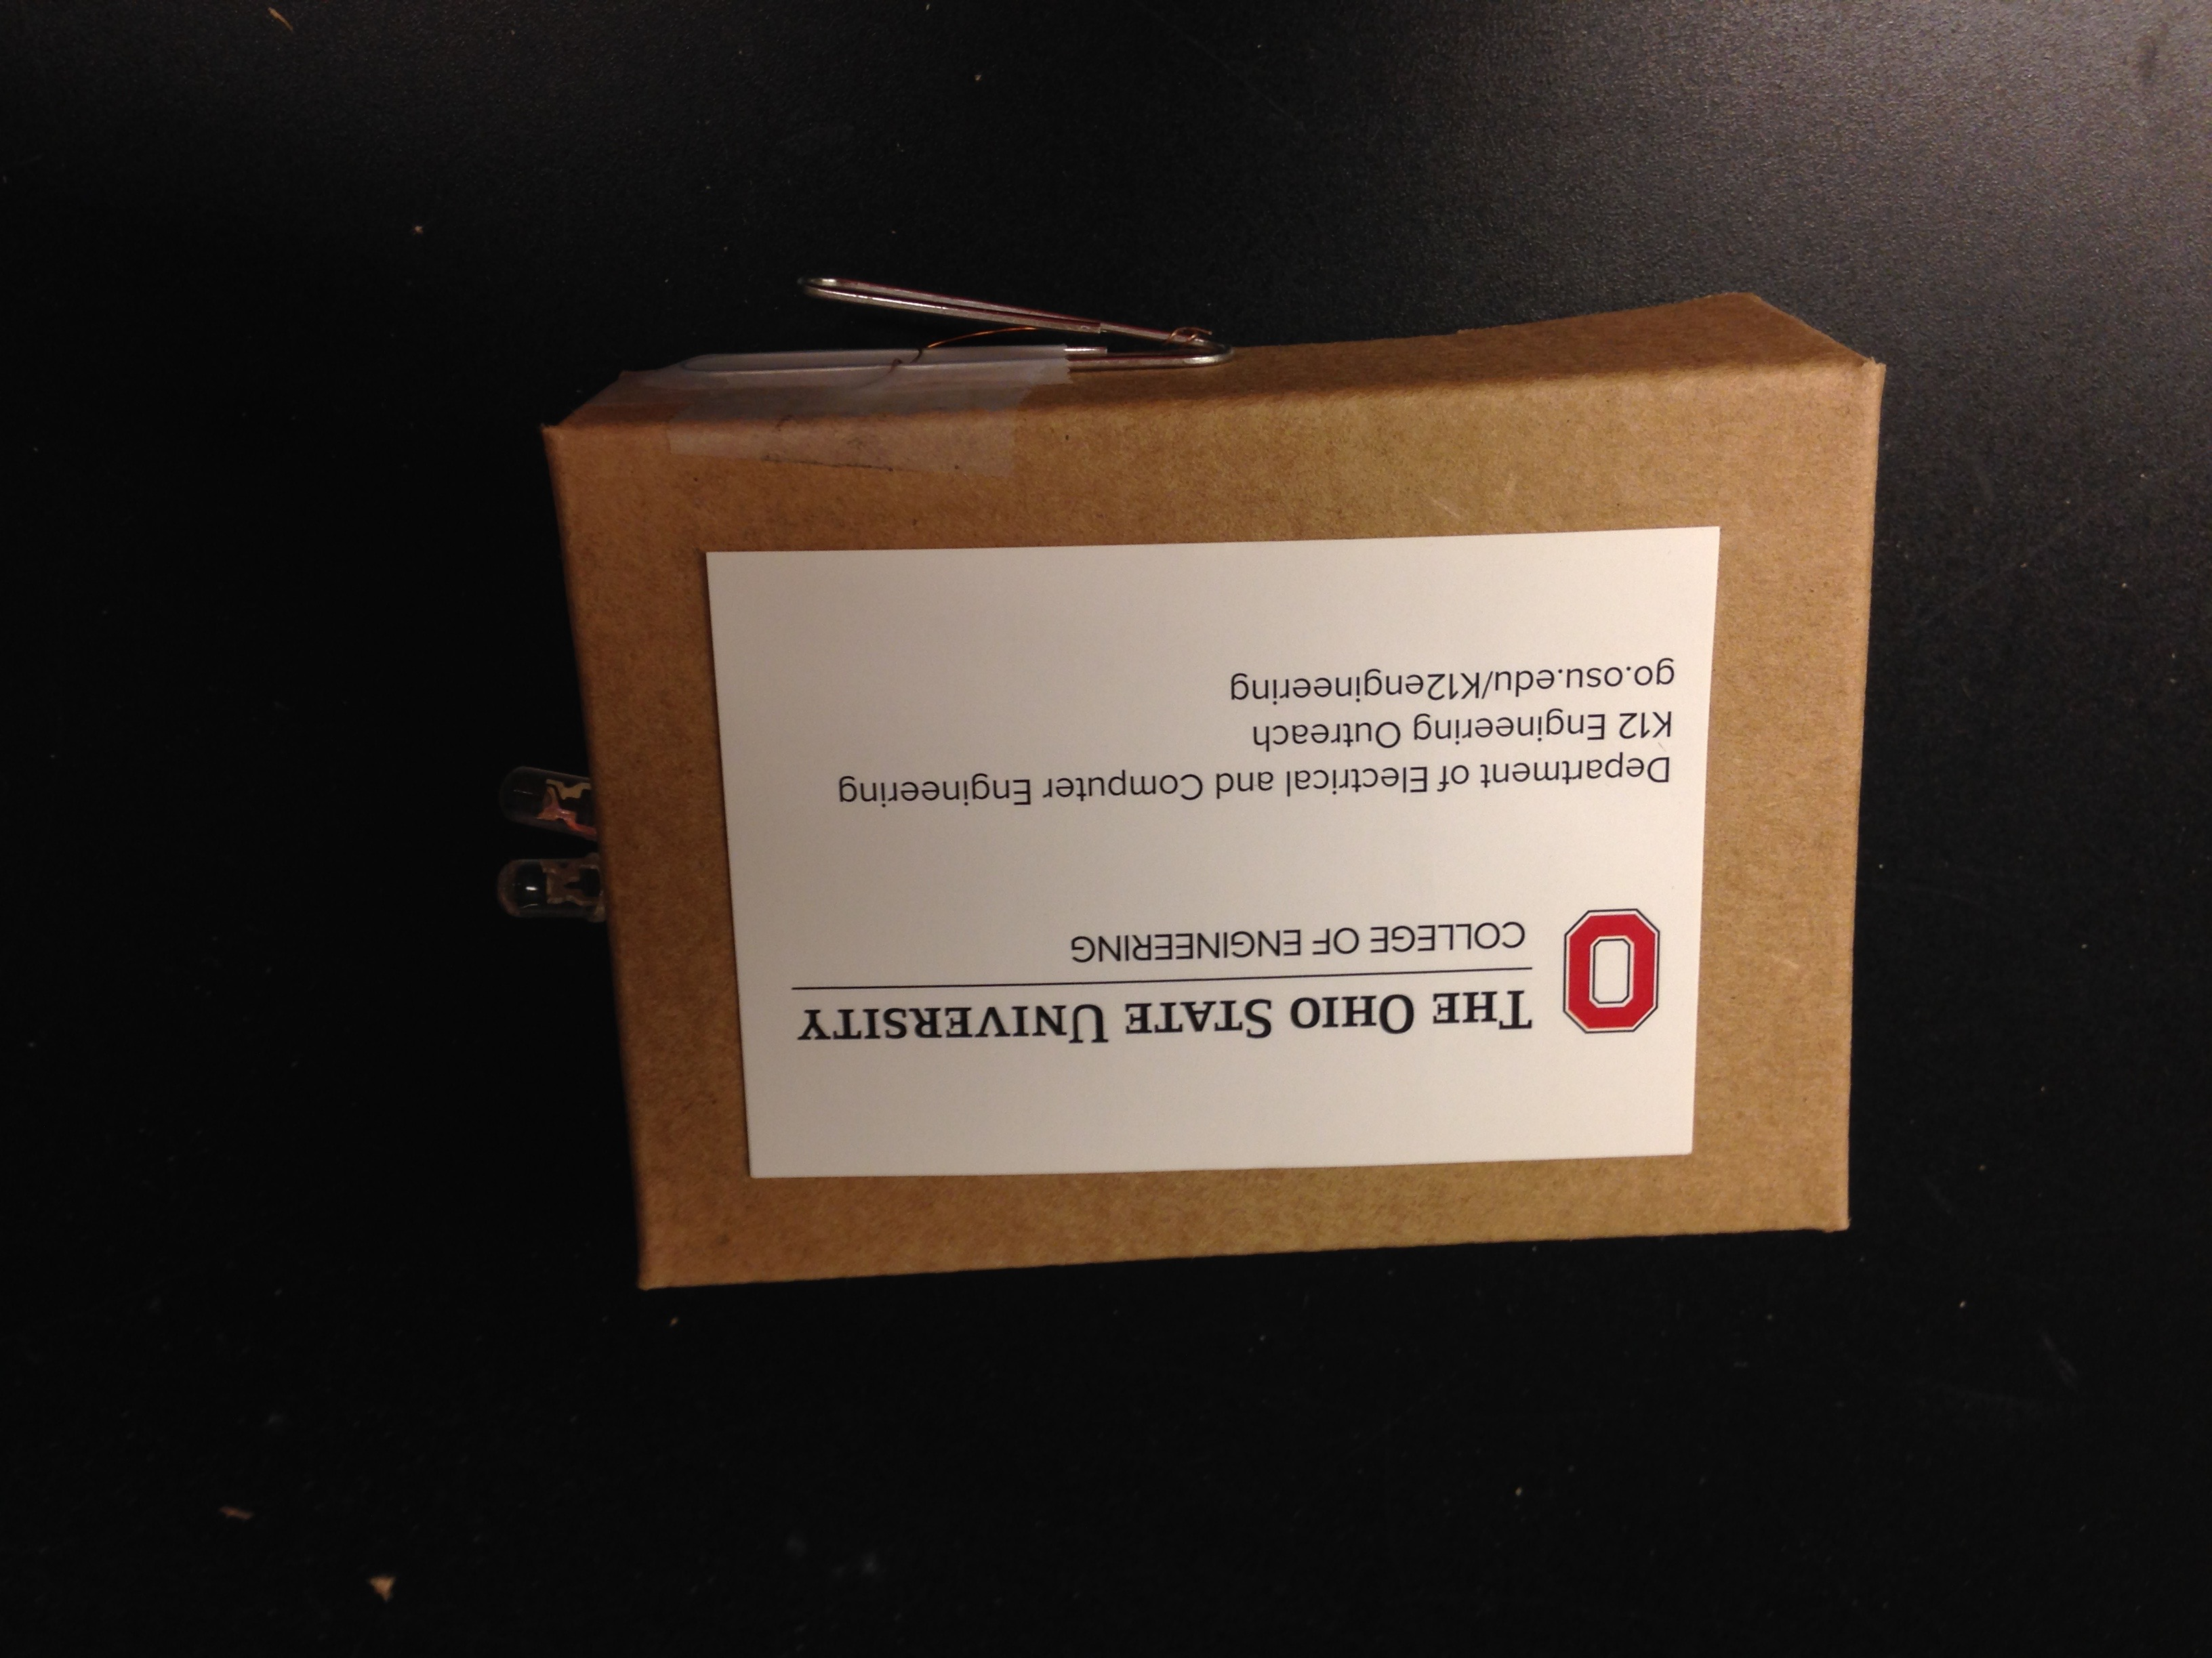
Fold up the box and put on the sticker!

Slide 35
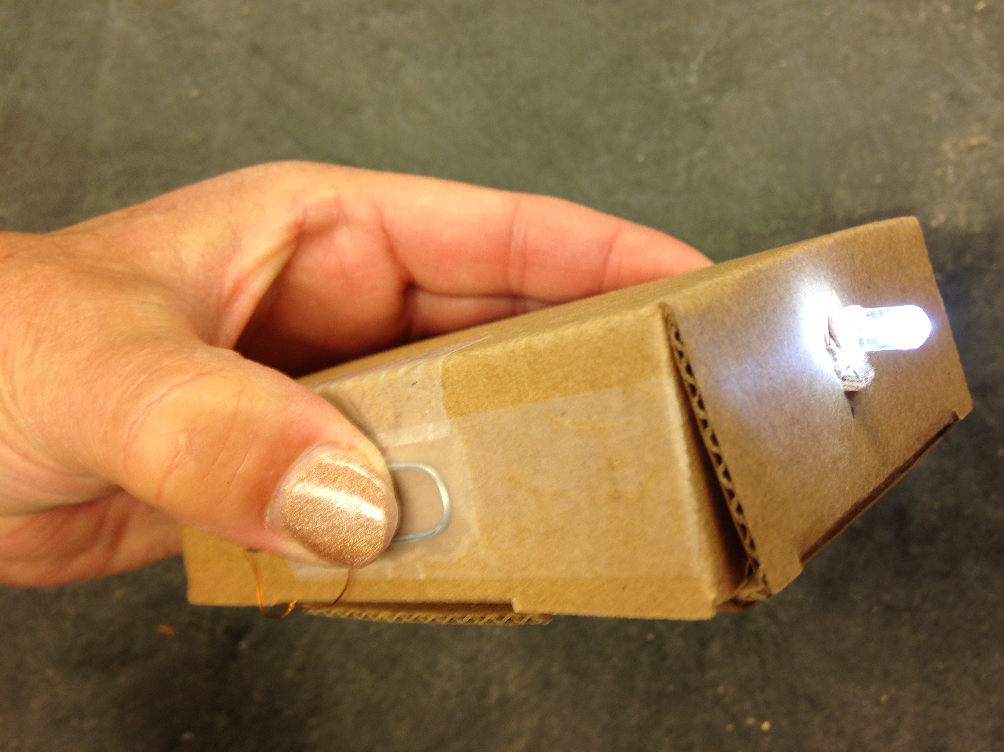
You are all done!

