Slide 1
BINARY BEADS

Slide 2
How do computers talk to each other?
They don’t have mouths or ears
They send electrical signals back and forth
https://www.illustrationsource.com/stock/image/113954/two-computers-communicating/

Slide 3
Since they talk via electricity, they use voltages.
But they need some kind of code because you can’t speak English with voltages
There are three parts to the code.

Slide 4
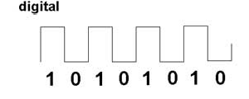
The voltage being sent can be “high” (say, 5 Volts) or “low” (say 0 Volts)
When the voltage is “high” we call it a “one”, and when it’s low we call it a “zero”
https://study.com/academy/lesson/what-are-digital-and-analog-signals-definition-lesson-quiz.html

Slide 5
You could do this yourself with a battery and a light
When you close the switch, the voltage (high) can get to the light and turn it on
When you open the switch, the voltage can’t get to the light, so it turns off
When the light is “on” we call it a “one”
When the light is “off” we call it a zero
http://www.technologystudent.com/elec_flsh/button1.html

Slide 6
3) What about the third part of the code?
That’s called “ASCII” (American Standard Code for Information Interchange)
Each letter in the alphabet is represented by a series of ones and zeros
Example: A=01000001

Slide 7
Each “code” is 8 symbols long
We’ll put a space in our pictures to make it easier to read:
A: 0100 0001
Or, if you were using a light:

Slide 8
Suppose I wanted to send a “B” to a computer?
B=0100 0010

Slide 9
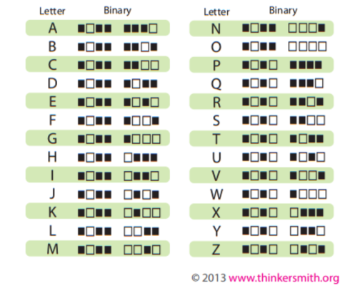
Here is the entire alphabet
There are additional codes for periods, commas, numbers, etc.

Slide 10
Suppose I wanted to send “OSU” to a computer
O
S
U

Slide 11
By the way, this is a “binary” code
“Bi” means “two”- there are two possible values for each digit
A binary digit is called a “BIT”
So each of our letters is 8 bits long

Slide 12
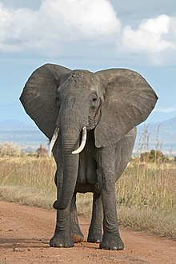
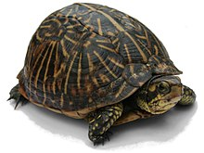
You can use any two different things as symbols for ones and zeros

Slide 13
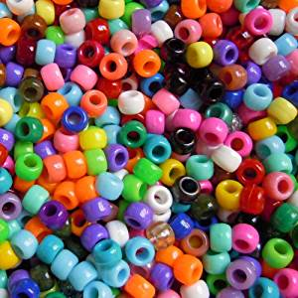
We’re going to use beads!
Pick two colors
Decide which one is “one” and which one is “zero”
Put the beads in the right order to spell your name
OK to use a third color between letters

Slide 14
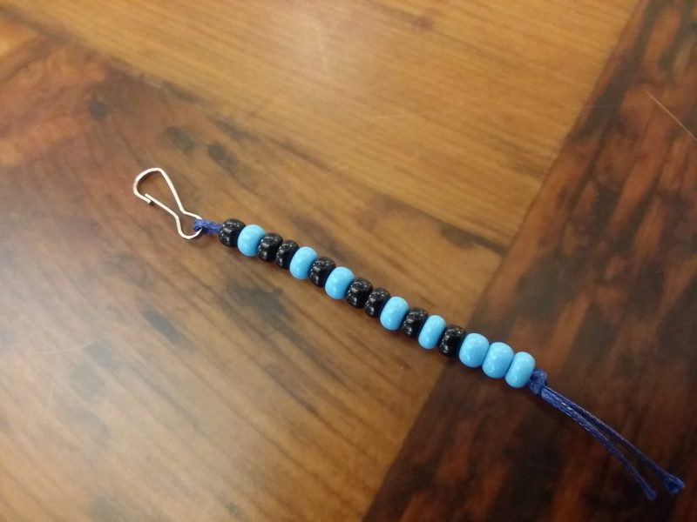
What did this person spell?
First letter is :
0100 1010
Second letter is
0101 0111
J
W
http://www.makerexpo.ca/exhibitor/binary-beads/

Slide 15
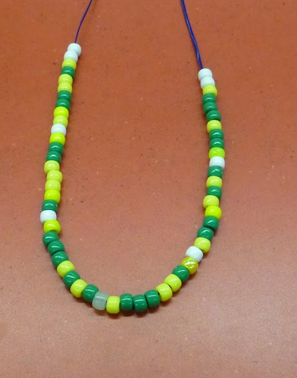
OK, Now it’s your turn!
http://librarybugb8te.blogspot.com/2014/11/bead-binary-bracelet.html

