Slide 1
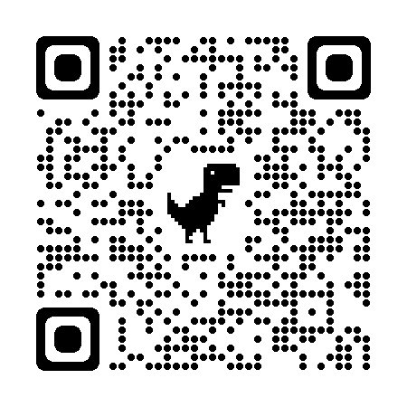
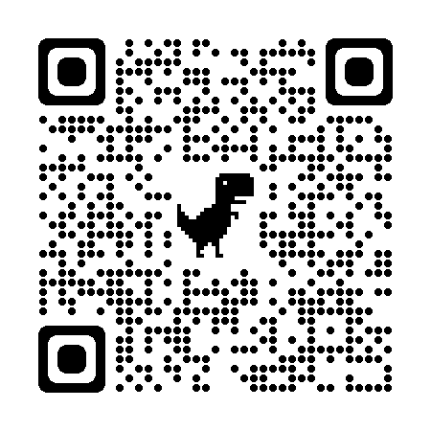
Welcome To Buckeyes For Accessibility
Discord
linktr.ee/b4a
These slides can be found at:
org.osu.edu/b4a/home/archives/presentation-slides/

Slide 2
Member intros!
Name & Pronouns
Community Connection (100% Optional)
Quick visual description
(100% Optional)
How's your week been?

Slide 3
Announcement:
This presentation will be recorded! The recording will stop at the last slide.​

Slide 4
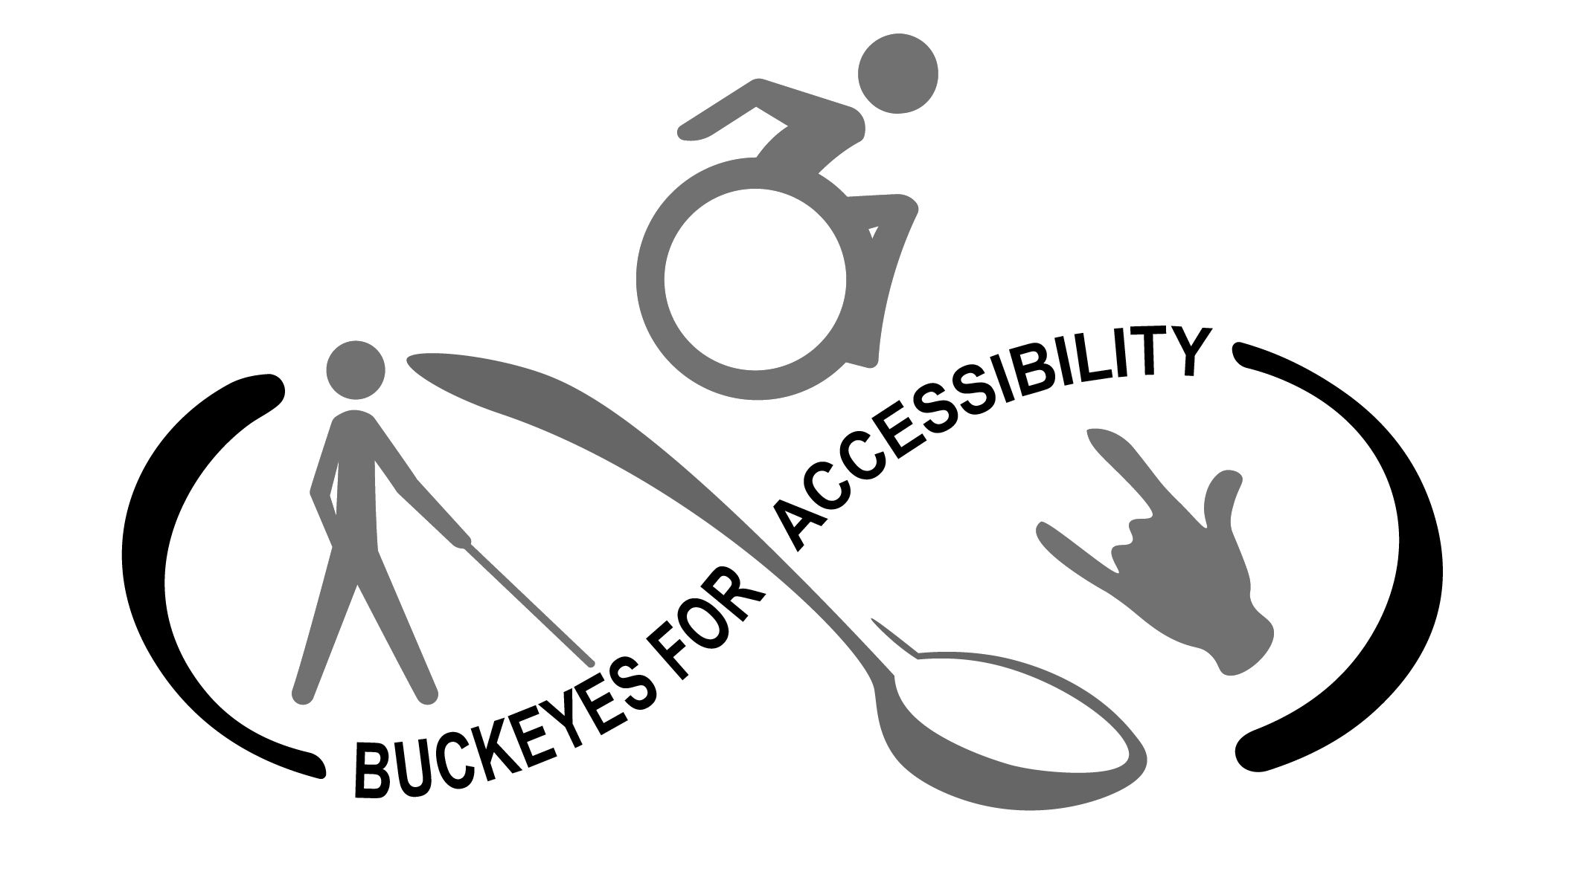
About B4A

Slide 5
What’s it mean to have a Disability?
Medically/Legally
Socially
Culturally
Medical Jargon: having a condition that impacts how you perform your ADLs and IADL
Legalese: having a condition that limits one or more major life activity or bodily function or being regarded as having one
Being seen as existing outside of global and cultural norms.
Being treated differently or not being able to access your environment equally.
Being told or socialized to believe part of you isn’t “normal” or needs to be fixed.
Human variation.
Experiencing, approaching, or navigating life in a way that falls on a diverse spectrum outside of the cultural default.

Slide 6
Language is Constantly Evolving
Not all members of the Disability Community agree on the same language.
It’s always a good idea to ask someone’s preferred language
Person First: People with Disabilities (PWD)
Puts the human being above before anything else. Safe choice.
Identity First: Disabled Person
Puts pride in the identity and reinforces that Disabilities are nothing to be ashamed of.
Movements such as the Crip Culture Movement are reclaiming the words like Crip in a similar fashion to the LGBTQ+ Community with the word Queer.

Slide 7
Who’s in the Disability Community?
Mental Health
Chronic Health/Spoonie
Neurodiversity
Learning Disabilities
Physical/Mobility
People still figuring it out
ADHD/ADD
ASD/Aspie
Blind, Low Vision, & Visually Impaired
Deaf & Hard of Hearing
Mental Health
Chronic Health/Spoonie
Neurodiversity
Physical/Mobility
Blind, Low Vision, & Visually Impaired
Deaf & Hard of Hearing
People still figuring it out.

Slide 8
Language – Hint: Just Ask
Disabled/Disability
Disabled Person or Person with a Disability
NOT:
Handicapped (purge this word from your vocabulary)
Impaired
Handicapable
Special/special needs
Differently abled
Invalid

Slide 9
Guided Discussion and Vibes
Recording Ends!

Slide 10
Interested in Joining B4A?
Discord
linktr.ee/b4a

