Slide 1
Self-Diagnosis!!
10/9/2023

Slide 2
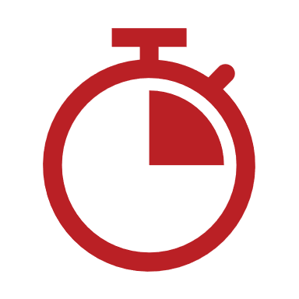
Introductions!!!
Name and Pronouns
Disability Connection
Quick Visual Description
How’s your week going?

Slide 3
This presentation will be recorded. The recording will stop on the last slide.

Slide 5
What is a diagnosis?
A "diagnosis" is the process of explaining abnormal experiences and behaviors by medically categorizing them.

Slide 6
What is a diagnosis?
Implicitly, diagnoses are meant to represent the "true nature" or "true cause" of the symptoms they describe.

Slide 7
What is a diagnosis?
(this paradigm has given doctors and psychologists power over how their culture interprets their bodies and their social environment)

Slide 8
Why would you get diagnosed?
Many workplaces, schools and government programs gatekeep accommodations behind the institutional approval of an official diagnosis.

Slide 9
Why would you get diagnosed?
Health insurance companies also require diagnoses to cover certain kinds of healthcare.

Slide 10
Why would you get diagnosed?
Putting a standardized label on an experience can help people with similar experiences find and learn from each other.

Slide 11
Why would you get diagnosed?
It can feel good!
(personally, knowing I'm not alone in my experiences can me feel less "broken" or "out of place")

Slide 12
Why avoid an official diagnosis?
It's bloody expensive!

Slide 13
Why avoid an official diagnosis?
Doctors are often only familiar with a specific set of standard symptoms that may be outdated, unhelpful, or discriminatory.

Slide 14
Why do people self-diagnose?
Understanding your own experiences more deeply can help you find treatments and deal with impairments more easily.

Slide 15
Why do people self-diagnose?
Diagnostic labels are often used to signify in-group belonging to a community.

Slide 16
The internet is changing culture
The internet has created new ecosystems that make money off explaining medicine and psychology to non-professionals.

Slide 17
The internet is changing culture
Social media algorithms prioritize broad appeal and virality, encouraging content about niche experiences to be accessible to a mainstream audience.

Slide 18
The internet is changing culture
Disabled and Neurodivergent people can share their voice through content in ways it would be difficult to in real life.

Slide 19
The internet is changing culture
In virtual spaces, non-local communities can form much more easily, enabling people to categorize their own experiences without medical expertise.

Slide 20
The internet is changing culture
Note to self: talk about metamodernism!

Slide 21
Reactionary opposition
Many people oppose these cultural shifts in how diagnosis (and Disability in general) are socially understood.

Slide 22
Reactionary opposition
Many reactionaries are deeply invested in the security of their sense of reality, and become defensive when their frameworks are challenged.

Slide 23
Reactionary opposition
Opposition to self-diagnosis often carries an implication that people are "denying reality" by bypassing medical institutions
(i.e. "you're just faking it because of tiktok")

Slide 24
Reactionary opposition
In-community opposition to self-diagnosis often carries and undercurrent of gatekeeping the community from outsiders.

Slide 25
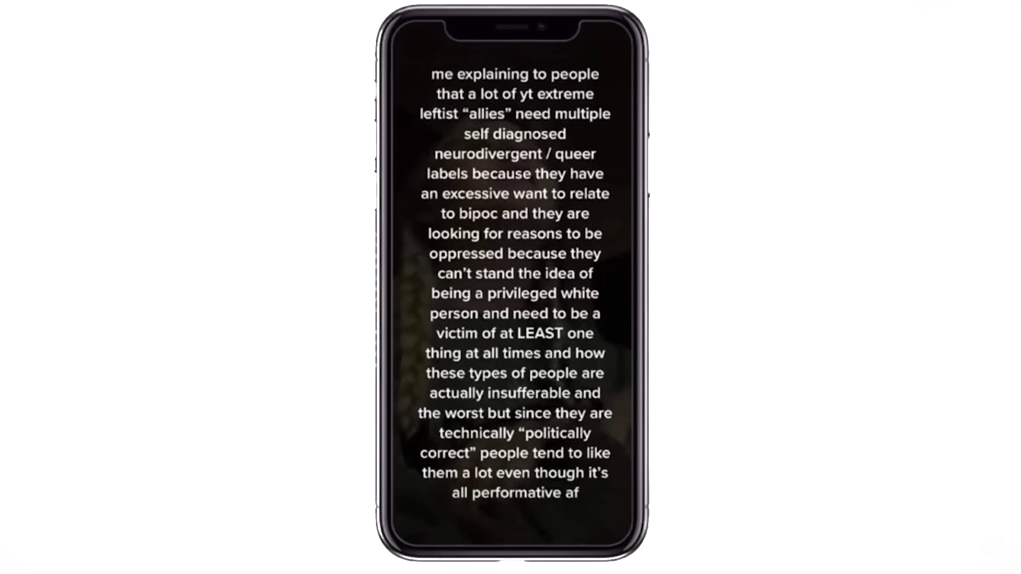
@MadisynBrown on YouTube

Slide 26
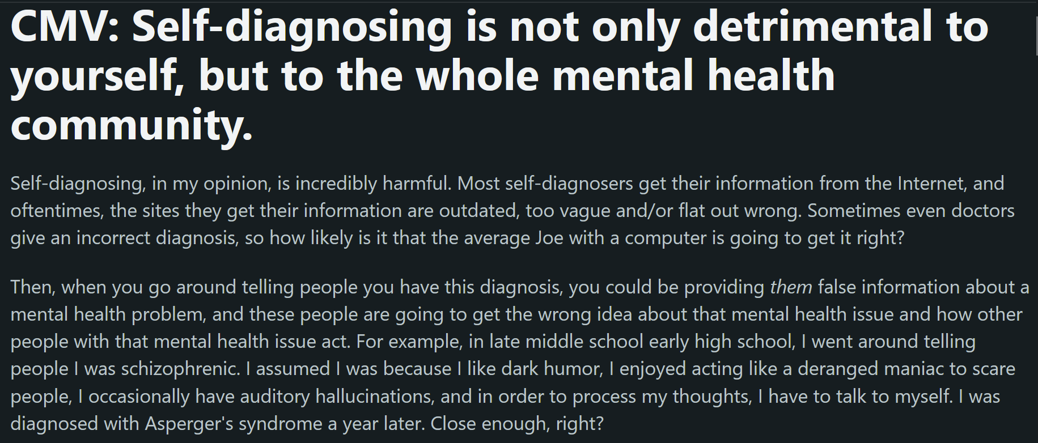
u/Ainrana on Reddit

Slide 27
The dangers of self-diagnosis
Medical information found online can often be outdated, biased, or untrue.

Slide 28
The dangers of self-diagnosis
We are approaching this as college-educated people... but not everyone has the education to do medical research productively

Slide 29
The dangers of self-diagnosis
This can cause people to be exploited to seek actively ineffective, unsafe and unregulated treatments

Slide 30
The dangers of self-diagnosis
Seeking medical care based on a false understanding of a condition can eat up time and money of both hospitals and patients

Slide 31
The dangers of self-diagnosis
… (I know there's more but nothing else seemed at all compelling to me, if people disagree with that, I'd love to talk about it after the presentation :)

Slide 32
Discussion Questions
Have you ever self-diagnosed yourself?
Do you think there are valid criticisms of self-diagnosis?
What's the best way to spread awareness of our experiences?
What role should medical institutions play?

