Slide 1
Accessibility in the Arts / Museum Spaces
Code Beschler
Buckeyes for Accessibility
November 20, 2023

Slide 2
Member Intros!
Name & Pronouns
Community Connection (100% Optional)
Quick Visual Description
(100% Optional)
How's your week been?

Slide 3
Announcement:
This presentation will be recorded! The recording will stop at the last slide.​

Slide 4
Table of Contents
Inaccessibility in the Arts and Museums
Accessibility Programming in Museums
Recent Works About Disability
Organizations in Ohio and the US
Opportunities for Disabled Artists
*Recording Ends*
Guided Questions
Signage Developed by Helyn Marshall for the Wexner Center for the Arts

Slide 5
Inaccessibility in the Arts and Museums
According to the National Endowment for the Arts, about 23.3% of adults with disabilities attended an arts event in 2012, 14% below the national average.
Inaccessibility can be found in many forms, including physical, visual, auditory, sensory, and informational.
Elitism has been very present in art and museum spaces, with many groups feeling purposely excluded from these environments.
The arts are often inaccessible from a financial perspective as well; they are difficult to engage with when worrying about other ventures, like work, school, and general survival.
Notes:
New NEA Research on Arts Participation among People with Disabilities | National Endowment for the Arts

Slide 6
Accessible Museum Programming
If you’re looking for accessible museum programming, be sure to check the website! Many museums have accessibility pages with a list of their offerings.
Some things to look for:
Sensory maps, communication cards, and sensory kits
Magnifiers, color-correcting glasses, audio guides, and large-print or braille materials
Recorded ASL guides and captioned materials
Programming that may be available:
Guided Touch Tours and ASL Tours
Sensory Friendly Events

Slide 7
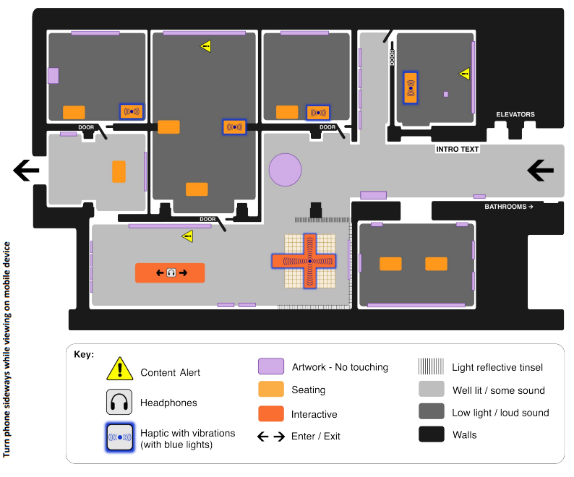
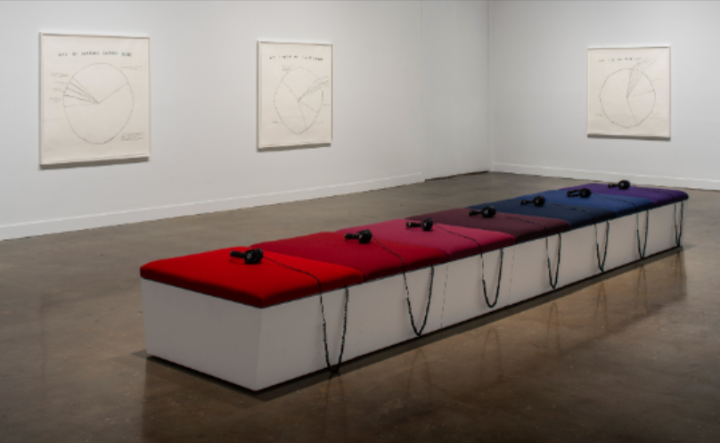
Musical Thinking - SAAM

Slide 8
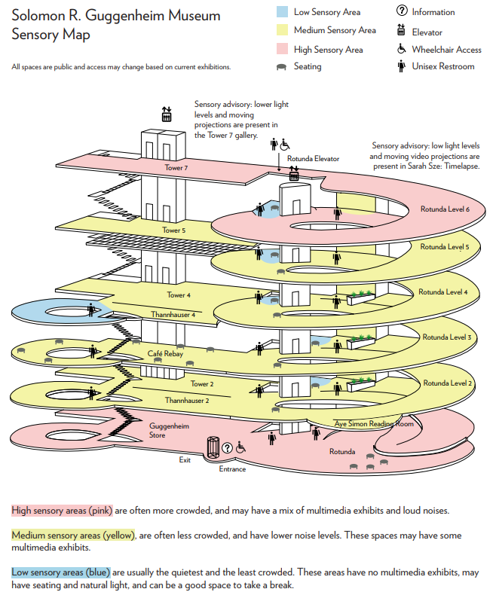
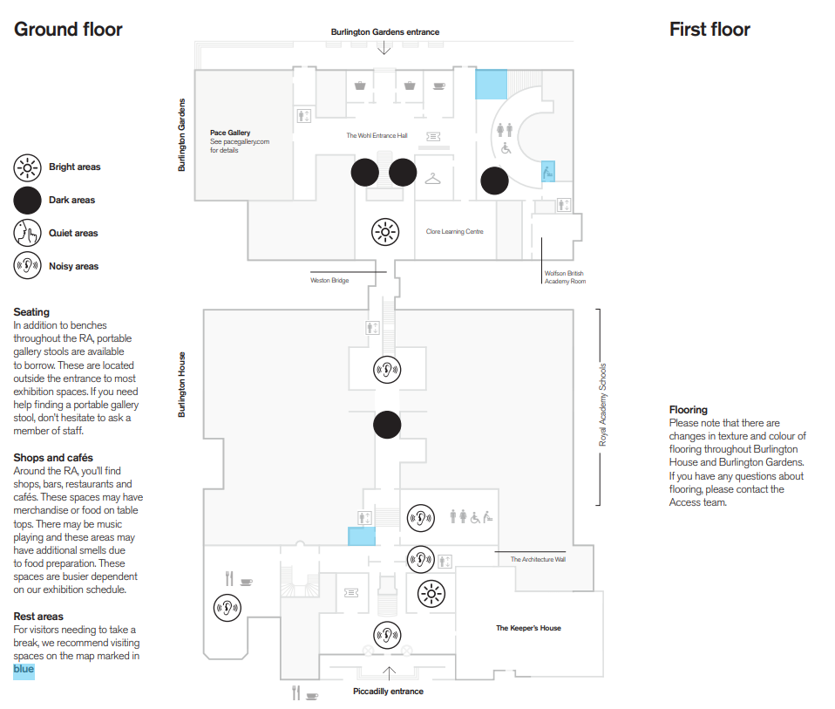
Sensory Maps

Slide 9
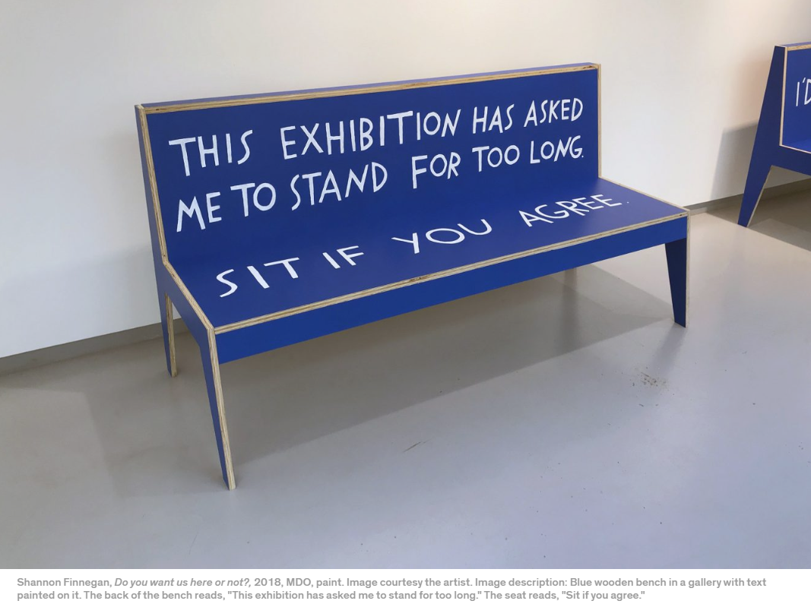
Seating

Slide 10
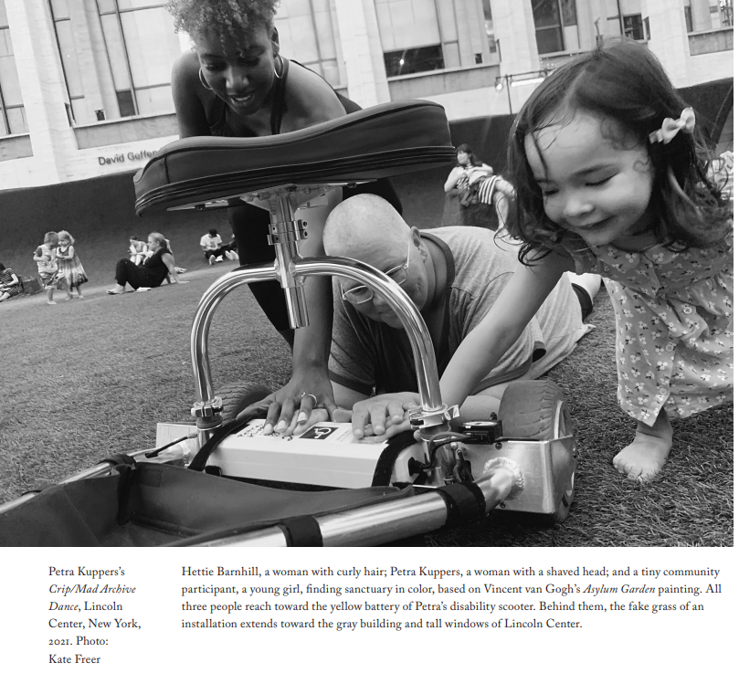
Recent Works About Disability
“W/O Limits: Art, Chronic Illness, and Disability” Presented at the Artists Archive in Cleveland
Petra Kuppers – Wheelchair dancer and disability activist on Guggenheim Residency “Crip/Mad Archive Dances”
“Being Human” at the Wellcome Museum in London. Designed with accessibility as a priority. It reflects on what it means to be human in the 21st century.

Slide 11
Organizations in Ohio and the US
Art Possible Ohio – Ohio based non-profit working with disabled artists and professionals.
VSA / LEAD Conference from the Kennedy Center – Conference to increase accessibility at art and cultural institutions throughout the US.
Disabled Dismantlers – A group of disabled artists and cultural institution professionals. Bi-monthly virtual meetings focusing on disabled joy.
Office of Accessibility, National Endowment for the Arts – National organization focused on increasing accessibility in artistic institutions.

Slide 12
Opportunities for Disabled Artists
Artists with Disabilities Access Program through the Ohio Arts Council provides funding to disabled artists in Ohio.
Accessible Expressions Ohio is a yearly exhibition created by Art Possible Ohio. Disabled artists can submit and present work each fall.
Sick and Disabled Zine and Craft Fair (SAD Fair) is a yearly virtual event organized by disabled artists for disabled artists.
MoMA hosts virtual Crip Art Chats to discuss art in their collection through disabled perspectives and dialogues.

Slide 13
Guided Discussion and Vibes
Recording Ends!

Slide 14
Guided Questions
Have you experienced inaccessibility in museum and art spaces?
What accessibility options or programs would you like to see in the arts?
Do you think museums have a responsibility to create accessible spaces?
Is this responsibility greater than in other public spaces?
Do you have any favorite disabled artists?
Is there anything you’d like to know more about this topic?

Slide 15
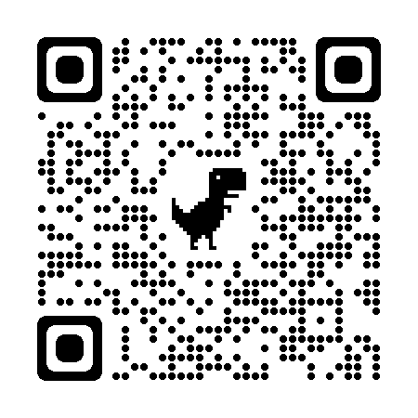
Interested in Joining B4A?
Discord
linktr.ee/b4a

