Slide 1
Welcome Back Engineers – Meeting 1

Slide 2
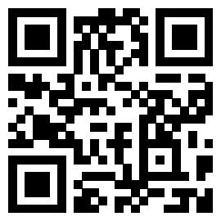
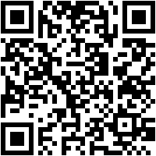
Join the GroupMe!
Attendance

Slide 3
Introductions
2023-2024 E-council Exec Team

Slide 4
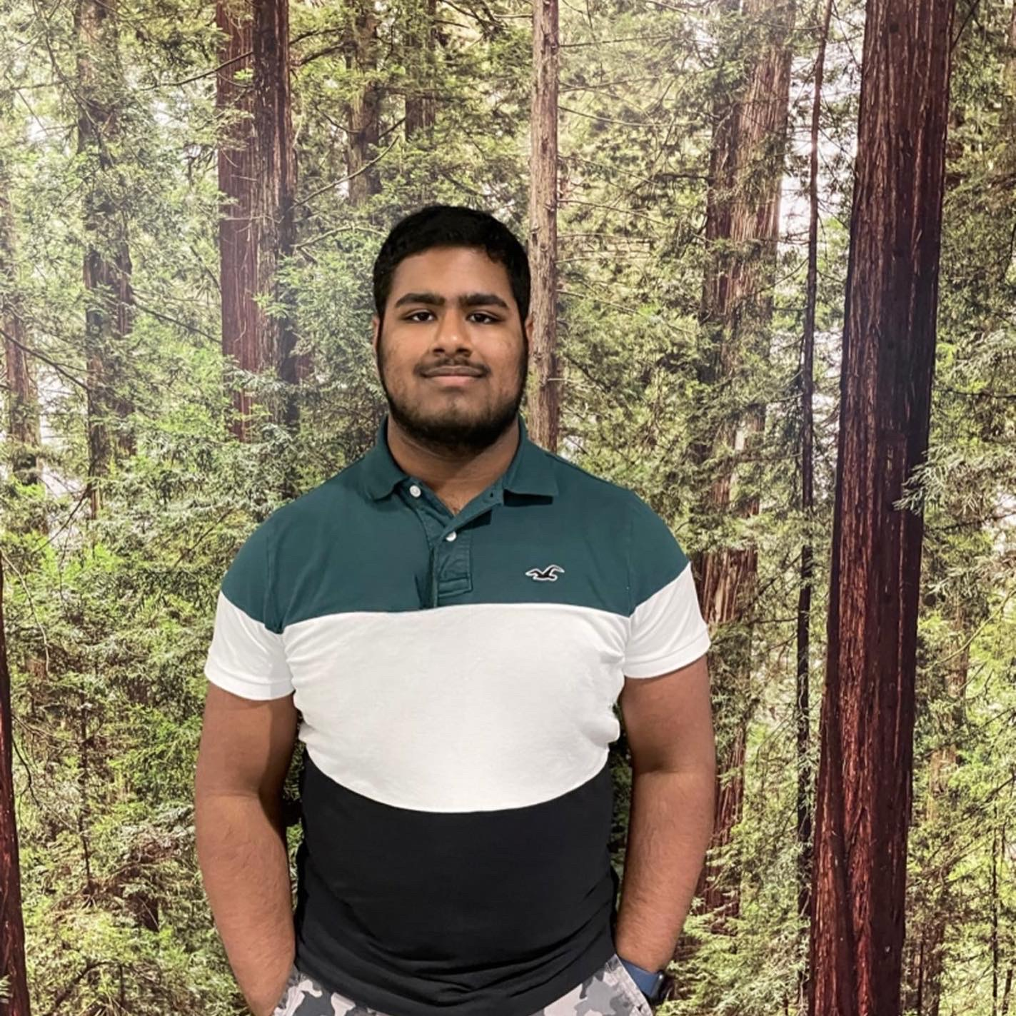
President
Prapul Arumilli
Computer Science and Engineering
Executive Board Member of OHI/O

Slide 5
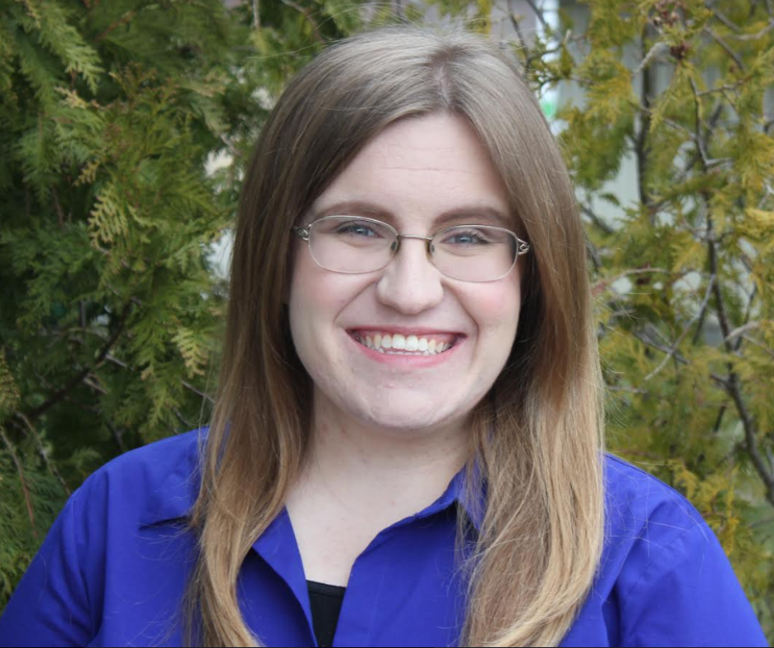
Vice President
Liz Lekarczyk
Welding Engineering (online distance)
Founder and President of the Welding Engineering Distance Student Network Collaboration

Slide 6
Treasurer
Erik Nilsson
Computer Science Engineering
Member of Triangle Fraternity

Slide 7
Secretary
Weston Ruffer
Food, Agricultural and Biological Engineering
Chapter Officer of American Society of Agricultural Engineering

Slide 8
ECouncil Rep Training

Slide 9
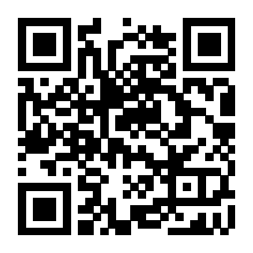
Register to be Recognized by ECouncil
At the beginning of each year, students orgs must register to be recognized by E-Council to receive funding
An active member roster must be uploaded in the registration form with the specified format
The form can also be found on the website homepage under “registered orgs”
Early registration reward: Earn $$$ if you register by Oct. 1st
Attendance link

Slide 10
Attendance
Attendance is required! Your org can have one unexcused absence per semester
There is a spread sheet with the attendance log for the semester on the website
You can use this form to check if your attendance was logged for a certain meeting, and see if you have already missed a meeting
If you ever see a mistake with this form, reach out to Weston (ruffer.9@osu.edu)

Slide 11
Website

Slide 12
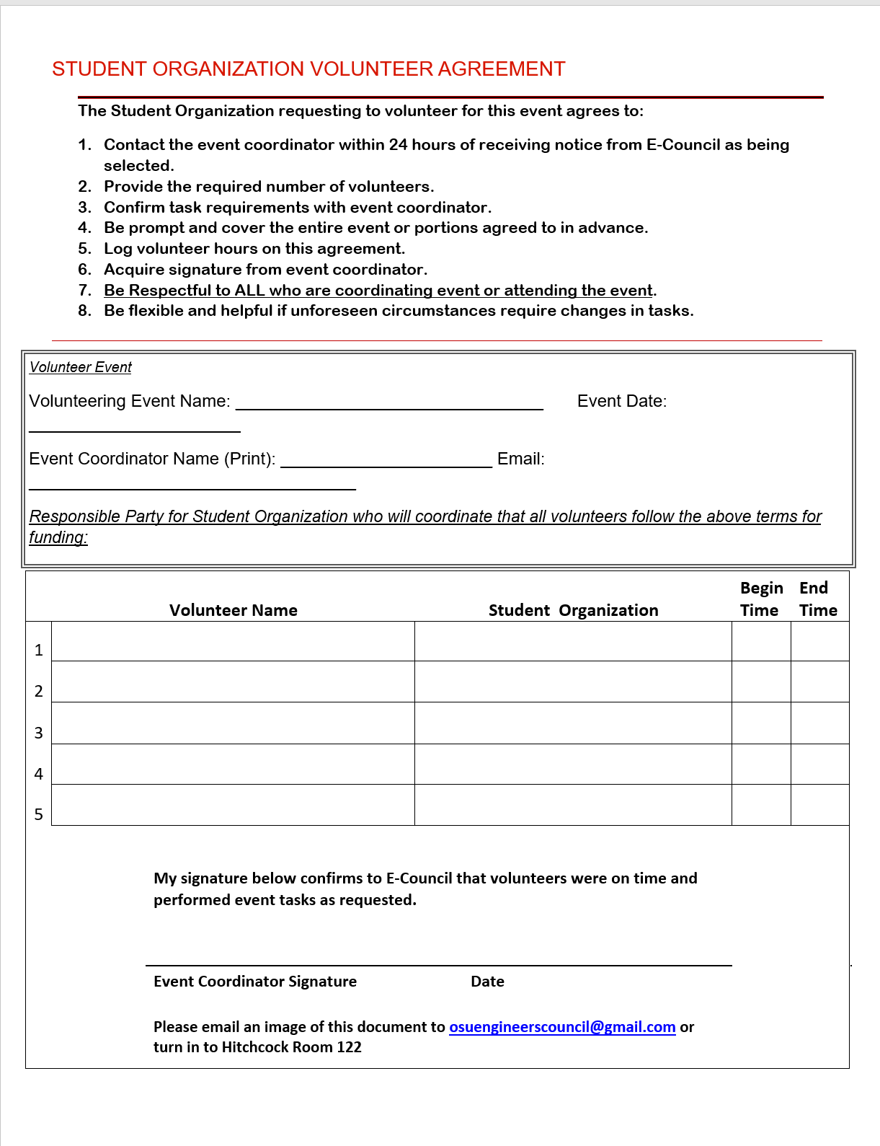
Paper SOV

Slide 13
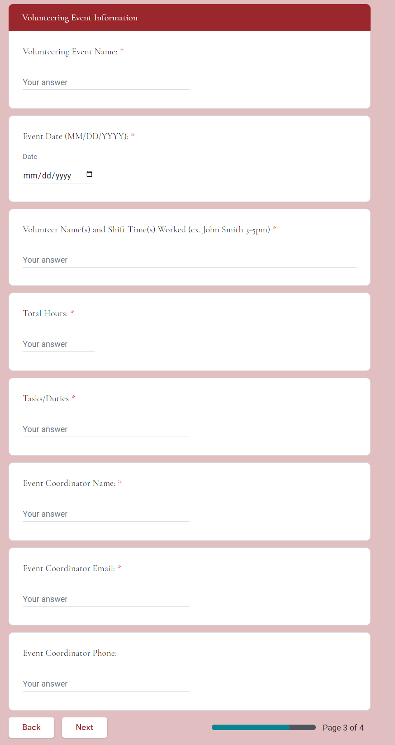
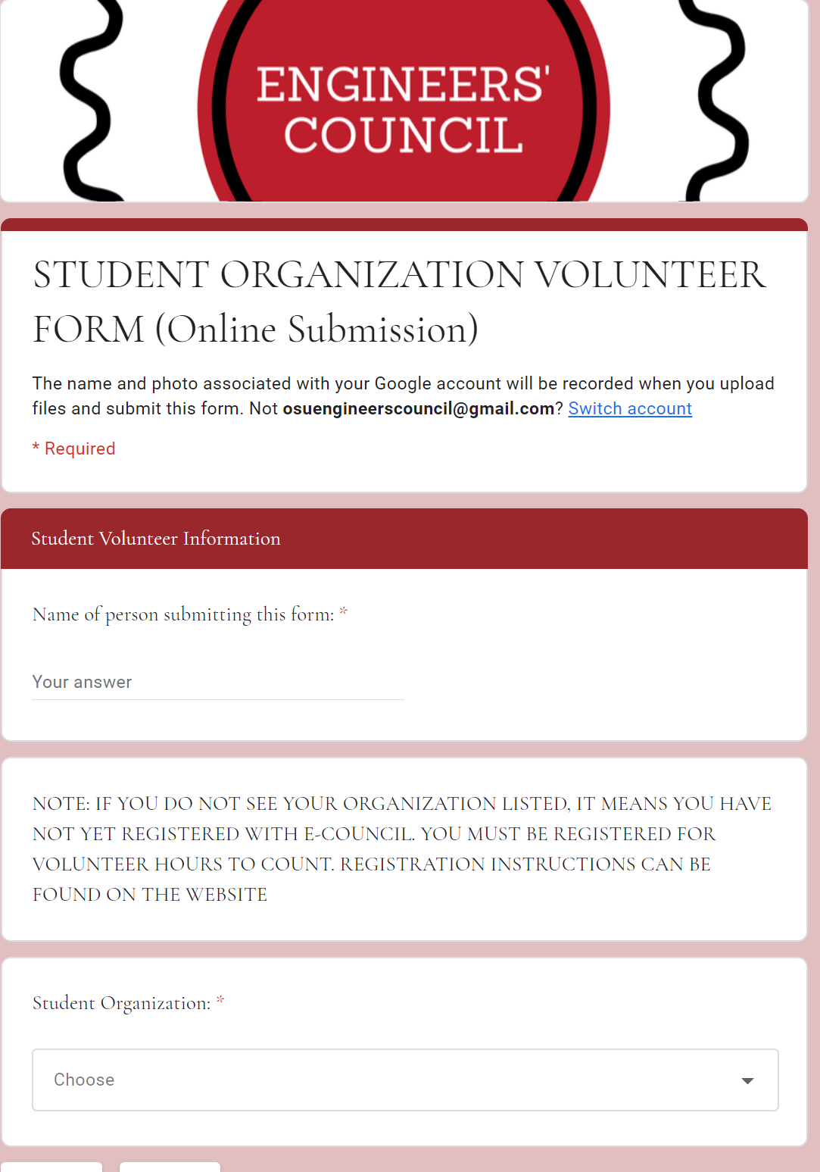
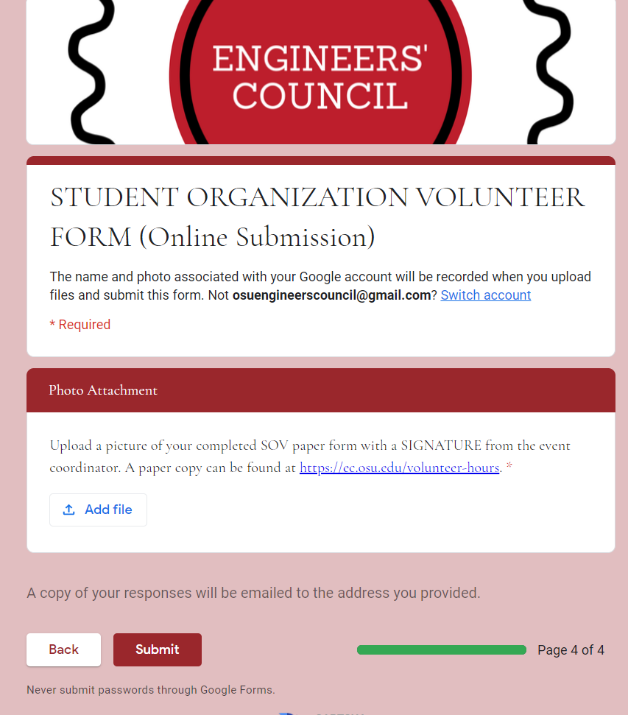
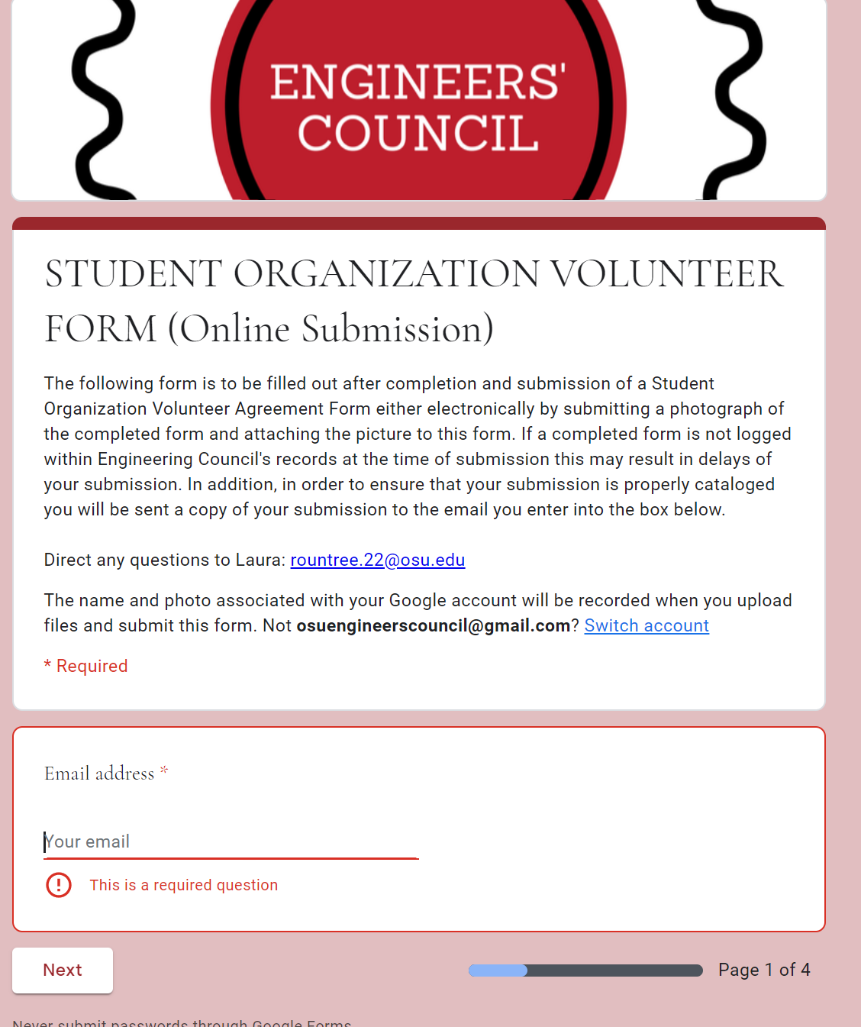
Online SOV

Slide 14
Get ECouncil Volunteers for Your Event
To have your event recognized by ECouncil for volunteer hours, there is a form you have to fill out
If your event is approved, it will be posted to the website and advertised in meetings
This form can be found under the “volunteer opportunities” tab and then “Request Volunteers”

Slide 15
How can your org get money?
Early Registration – If your org registers promptly and gets all their forms in before Oct 1st, your org gets a bonus (Amount still being budgeted)
Volunteering at Registered Events – This gives your org involvement points which can be redeemed for $50 per hour worked at each event by each volunteer. These are the points you can use to make a fund request with at the end of each semester (a maximum amount is being budgeted).
Working the Career Fair! – 6 Committee chairs are given $100/hr (max of 10hrs) and volunteers are given $50/hr during the event. These funds are directly paid to their orgs.
ArchE Week – Hold an event during ArchE Week and get reimburse up to (maximun amount to be budgeted) for your event.
SOA ECouncil Awards – Create a presentation on why your org deserves a number of awards we give out at the end of each year. These awards run up to $1000+ for your org.

Slide 16
Volunteer Hours
Volunteer hours submitted must be from ECouncil sponsored events, which can be found on the “Volunteer Opportunities” tab on the site and the meeting slides
To submit volunteer hours, both an online and a paper form must be completed. The paper copy must have the event coordinator signature and a picture of it must be uploaded with the form
The SOV form can be found on the website under “Documents” and then “Volunteer Hours”

Slide 17
Involvement Points
Your org can also earn points to be fund requested on by attending ECouncil committee events!
One point per person who attends from your org, up to 5 points
Each person who attends (unless more than 5) needs to fill out the involvement points form, located on the site.

Slide 18
Checking Volunteer Hours
There is a summary sheet of all recorded volunteer hours/involvement points that orgs are eligible to make a fund request for on the site
This form shows the number of hours you can request in addition to request elegibility for the semester.

Slide 19
Fund Request Requirements
In order to be eligible to fund request, there are a few requirements that must be met:
FUND REQUEST MEETING IS
Your student org must be registered for this semester and should have been registered last semester
You can only fund request every other semester, so if you fund request in the spring you cannot fund request in the fall
Your org is allowed to miss one meeting a semester, other than that you must have perfect meeting attendance in order to fund request
During the fund request meeting, you will present a powerpoint and the majority of the general body must approve your request
You can only request for the volunteer hours you have

Slide 20
Fund Request Procedure
Things to check before fund requesting:
If your student org is registered
When you student org last fund requested
What your attendance was last semester
How many volunteer hours you have
Fund Request forms can be found under the “Pertinent Document” tab and then “Fund Requests”
A template for fund requesting presentations can be found on the website
Under “Pertinent Documents”, then “Fund Requesting”
1 volunteer hour = $50

Slide 21
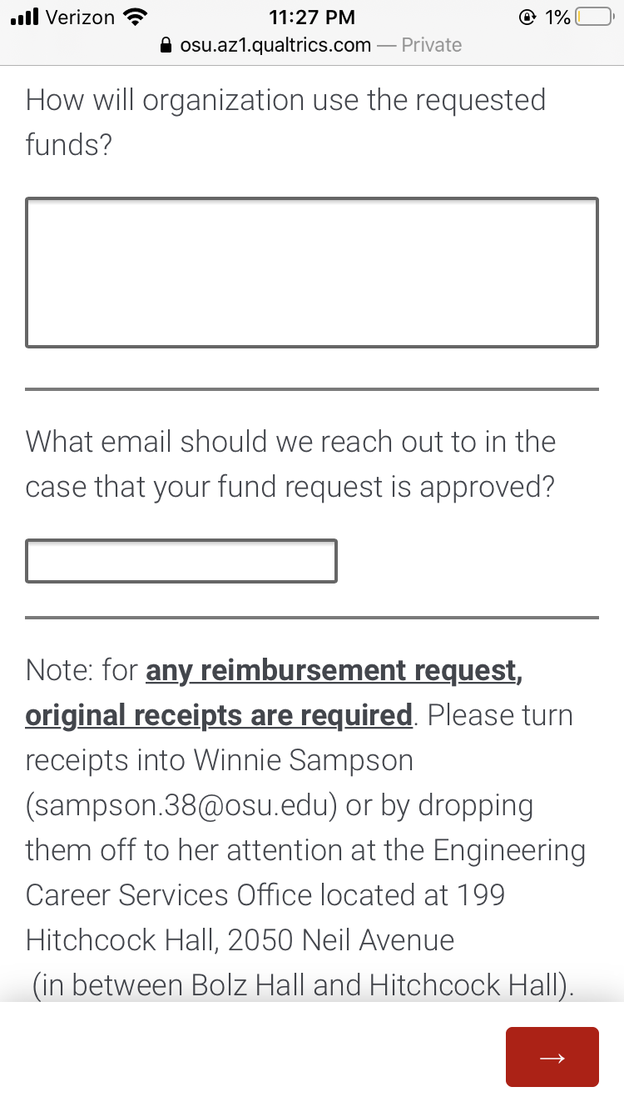
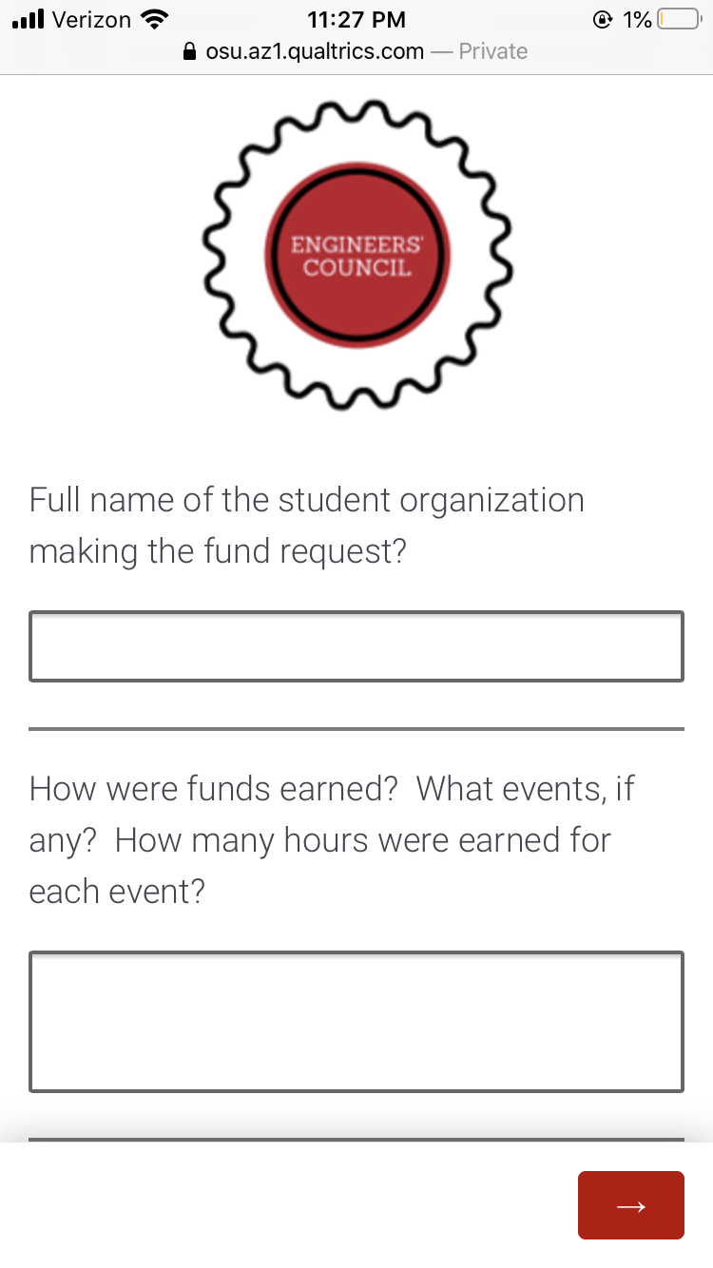
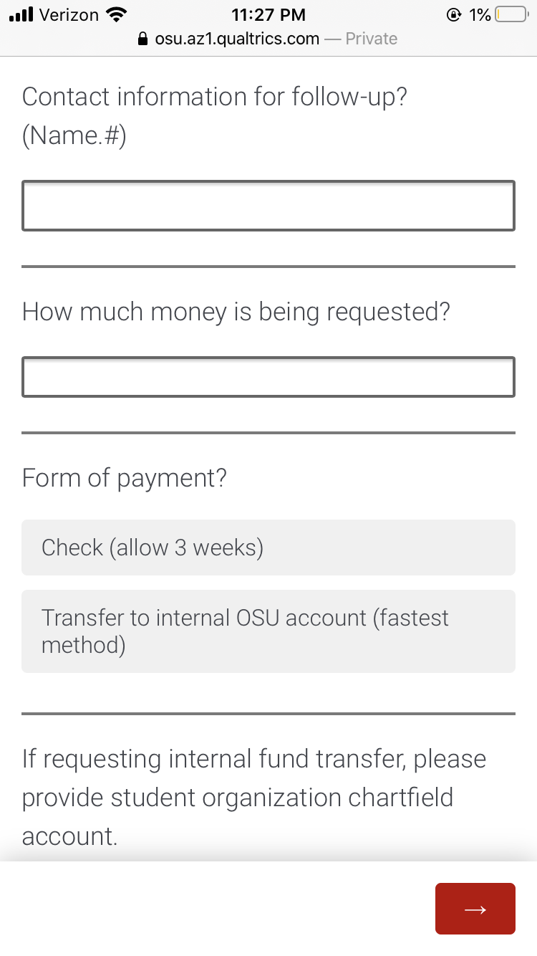
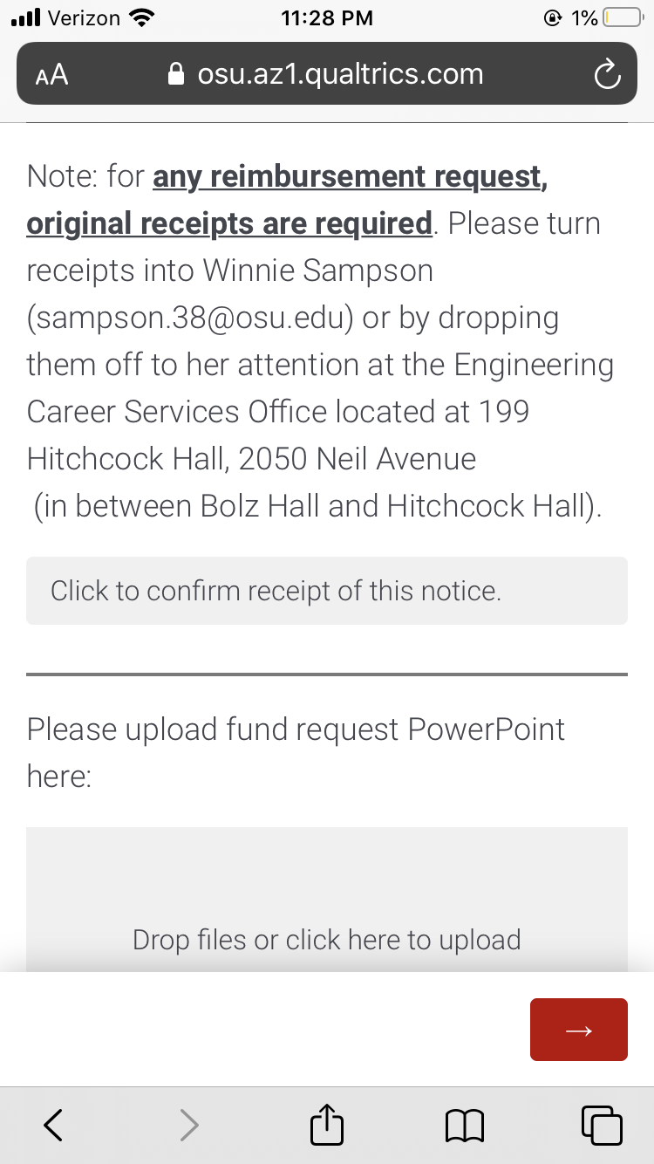

Slide 22
Expectations
Pay attention to updates in the GroupMe
Sign up for our newsletter
Communicate any problems ASAP
Each org is required to have a representative at every meeting
One absence allowed per semester

Slide 23
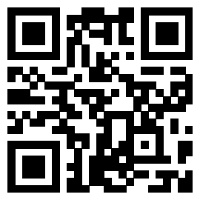
Communication
Main communication will be sent through bi-weekly newsletters
Last minute communication will be sent through groupme.
Its important to be on both platforms

Slide 24
Committee Chair Positions Need!

Slide 25
Positions needed:
Events
Wellness
Social Media and Outreach
Equality and Inclusion Chair
Former chairs will be given priority

Slide 26
Special Announcements

Slide 27
New Maker Space
Stayed tuned! Coming soon!
Opening in January
Looking to hire students

Slide 28
The LeaderShape Institute
Fall break (Oct 12th-15th)
designed for students seeking to develop their leadership capabilities and make an impact on campus.
go.osu.edu/LeaderShapeOSU

Slide 29
Next Meeting: Monday, Sept 11th, 2023 @ 6 p.m. in Scott Labs E1025

Slide 30
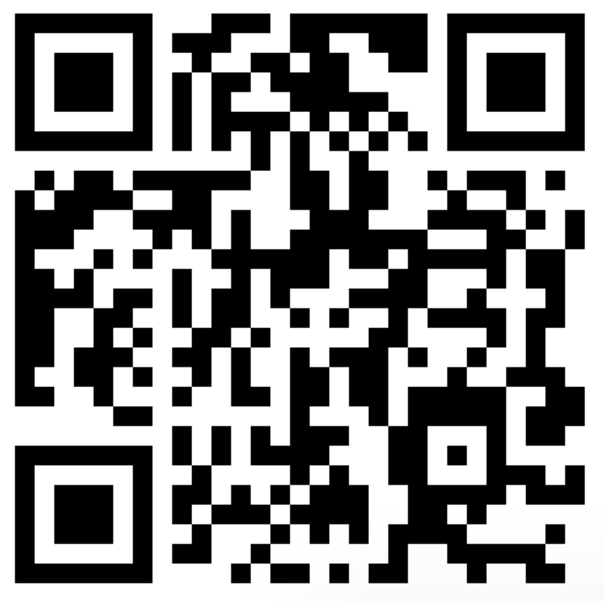
Apply for a committee
Join the GroupMe!

